Slide 1
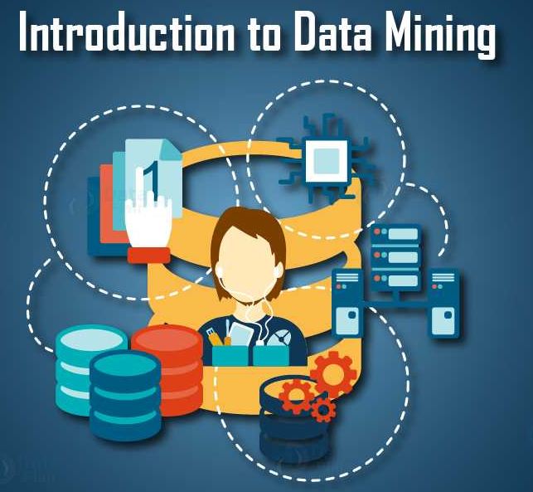
Lecture 6a – Association Pattern Mining
CS 495/595
Introduction to Data Mining
Dr. Sampath Jayarathna
Old Dominion University
Credit for some of the slides in this lecture goes to http://hanj.cs.illinois.edu/book & www.users.cs.umn.edu/~kumar001/dmbook/

Slide 2
What Is Pattern Discovery?
What are patterns?
  Patterns: A set of items, subsequences, or substructures that occur frequently together (or strongly correlated) in a data set
  Patterns represent intrinsic and important properties of datasets
Pattern discovery: Uncovering patterns from massive data sets
Motivation examples:
  What products were often purchased together?
  What are the subsequent purchases after buying an iPad?
  What code segments likely contain copy-and-paste bugs?
  What word sequences likely form phrases in this corpus?

Slide 3
Pattern Discovery: Why Is It Important?
Finding inherent regularities in a data set
Foundation for many essential data mining tasks
  Association, correlation, and causality analysis
  Mining sequential, structural (e.g., sub-graph) patterns
  Pattern analysis in spatiotemporal, multimedia, time-series, and stream data
  Classification: Discriminative pattern-based analysis
  Cluster analysis: Pattern-based subspace clustering
Broad applications
  Market basket analysis, sale campaign analysis, Web log analysis, biological sequence analysis

Slide 4
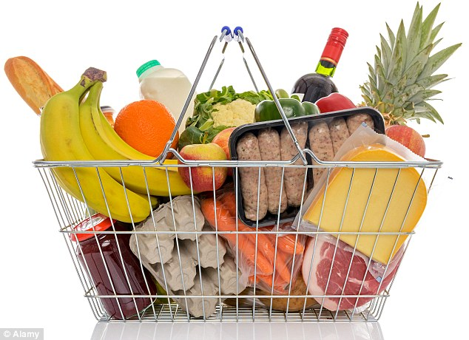
`Basket data’
A very common type of data; often also called transaction data.
Next slide shows example transaction database, where each record represents a transaction between (usually) a customer and a shop. Each record in a supermarket’s transaction DB, for example, corresponds to a basket of specific items.

Slide 5
ID apples, beer, cheese, dates, eggs, fish, glue, honey, ice-cream
1 | 1 | 1 |  | 1 |  |  | 1 | 1
2 |  |  | 1 | 1 | 1
3 |  | 1 | 1 |  |  | 1
4 |  | 1 |  |  |  | 1 |  |  | 1
5 |  |  |  |  | 1 |  | 1
6 |  |  |  |  |  | 1 |  |  | 1
7 | 1 |  |  | 1 |  |  |  | 1
8 |  |  |  |  |  | 1 |  |  | 1
9 |  |  | 1 |  | 1
10 |  | 1 |  |  |  |  | 1
11 |  |  |  |  | 1 |  | 1
12 | 1
13 |  |  | 1 |  |  | 1
14 |  |  | 1 |  |  | 1
15 |  |  |  |  |  |  |  | 1 | 1
16 |  |  |  | 1
17 | 1 |  |  |  |  | 1
18 | 1 | 1 | 1 | 1 |  |  |  | 1
19 | 1 | 1 |  | 1 |  |  | 1 | 1
20 |  |  |  |  | 1

Slide 6
Numbers
Our example transaction DB has 20 records of supermarket transactions, from a supermarket that only sells 9 things
One month in a large supermarket with five stores spread around a reasonably sized city might easily yield a DB of 20,000,000 baskets, each containing a set of products from a pool of around 1,000

Slide 7
Interesting/Useful rules
Statistically, anything that is interesting is something that happens significantly more than you would expect by chance.
E.g. basic statistical analysis of basket data may show that 10% of baskets contain bread, and 4% of baskets contain washing-up powder.
i.e: if you choose a basket at random:
  There is a probability 0.1 that it contains bread.
  There is a probability 0.04 that it contains washing-up powder.

Slide 8
Bread and washing up powder
What is the probability of a basket containing both bread and washing-up powder? The laws of probability say:
If these two things are independent, chance is 0.1 * 0.04 = 0.004
That is, we would expect 0.4% of baskets to contain both bread and washing up powder

Slide 9
Interesting means surprising
We therefore have a prior expectation that just 4 in 1,000 baskets should contain both bread and washing up powder.
If we investigate, and discover that really it is 20 in 1,000 baskets, then we will be very surprised. It tells us that:
  Something is going on in shoppers’ minds: bread and washing-up powder are connected in some way.
  There may be ways to exploit this discovery … put the powder and bread at opposite ends of the supermarket?

Slide 10
Association Rule Mining
Given a set of transactions, find rules that will predict the occurrence of an item based on the occurrences of other items in the transaction
Market-Basket transactions
Example of Association Rules
{Diaper} → {Beer},
{Milk, Bread} → {Eggs,Coke},
{Beer, Bread} → {Milk},

Slide 11
Definition: Frequent Itemset
Itemset
  A collection of one or more items
    Example: {Milk, Bread, Diaper}
  k-itemset
    An itemset that contains k items
Support count (σ)
  Frequency of occurrence of an itemset
  E.g. σ({Milk, Bread,Diaper}) = 2
Support
  Fraction of transactions that contain an itemset
  E.g. s({Milk, Bread, Diaper}) = 2/5
Frequent Itemset
  An itemset whose support is greater than or equal to a minsup threshold

Slide 12
Definition: Association Rule
Association Rule
  An implication expression of the form X → Y, where X and Y are itemsets
  Example:
  {Milk, Diaper} → {Beer}
Rule Evaluation Metrics
  Support (s)
    Fraction of transactions that contain both X and Y
  Confidence (c)
    Measures how often items in Y
    appear in transactions that
    contain X
Example:

Slide 13
Activity 9
Calculate the support (s) and confidence (c) for following Itemsets and report similar to below example
{Milk,Diaper} → {Beer} (s=0.4, c=0.67)
{Milk} → {Diaper,Beer} (s=?, c=0?)
{Milk,Beer} → {Diaper} (s=?, c=0?)
{Diaper,Beer} → {Milk} (s=?, c=0?)
{Diaper} → {Milk,Beer} (s=?, c=0?)

Slide 14
Association Rule Mining Task
Given a set of transactions T, the goal of association rule mining is to find all rules having
  support ≥ minsup threshold
  confidence ≥ minconf threshold
Brute-force approach:
  List all possible association rules
  Compute the support and confidence for each rule
  Prune rules that fail the minsup and minconf thresholds
  ⇒ Computationally prohibitive!

Slide 15
Mining Association Rules
Example of Rules:
{Milk,Diaper} → {Beer} (s=0.4, c=0.67)
{Milk,Beer} → {Diaper} (s=0.4, c=1.0)
{Diaper,Beer} → {Milk} (s=0.4, c=0.67)
{Beer} → {Milk,Diaper} (s=0.4, c=0.67)
{Diaper} → {Milk,Beer} (s=0.4, c=0.5)
{Milk} → {Diaper,Beer} (s=0.4, c=0.5)
Observations:
All the above rules are binary partitions of the same itemset:
{Milk, Diaper, Beer}
Rules originating from the same itemset have identical support but
can have different confidence
Thus, we may decouple the support and confidence requirements

Slide 16
Mining Association Rules
Two-step approach:
  Frequent Itemset Generation
    Generate all itemsets whose support ≥ minsup
  Rule Generation
    Generate high confidence rules from each frequent itemset, where each rule is a binary partitioning of a frequent itemset
Frequent itemset generation is still computationally expensive

Slide 17
Frequent Itemset Generation
Given d items, there are 2^{d} possible candidate itemsets

Slide 18
Frequent Itemset Generation
Brute-force approach:
  Each itemset in the lattice is a candidate frequent itemset
  Count the support of each candidate by scanning the database
  Match each transaction against every candidate
  Expensive since M = 2^{d} !!!

Slide 19
Algorithms to find frequent pattern
Apriori: uses a generate-and-test approach – generates candidate itemsets and tests if they are frequent
  Generation of candidate itemsets is expensive (in both space and time)
  Support counting is expensive
    Subset checking (computationally expensive)
    Multiple Database scans (I/O)
FP-Growth: allows frequent itemset discovery without candidate generation. Two step:
  1.Build a compact data structure called the FP-tree
    2 passes over the database
  2.extracts frequent itemsets directly from the FP-tree
    Traverse through FP-tree
Notes:
FP: Frequent Pattern

Slide 20
The Apriori Algorithm
There is nothing very special or clever about Apriori; but it is simple, fast, and very good at finding interesting rules of a specific kind in baskets or other transaction data, using operations that are efficient in standard database systems.
It is used a lot in the R&D Depts of retailers in industry (or by consultancies who do work for them).
But note that we will now talk about itemsets instead of rules.
Don’t get confused!

Slide 21
Apriori Principle
If an itemset is frequent, then all of its subsets must also be frequent
If an itemset is infrequent, then all of its supersets must be infrequent too
frequent
frequent
infrequent
infrequent

Slide 22
Illustrating Apriori Principle
Found to be Infrequent
Pruned supersets

Slide 23
Apriori Algorithm
Method:
  Let k=1
  Generate frequent itemsets of length 1
  Repeat until no new frequent itemsets are identified
    Generate length (k+1) candidate itemsets from length k frequent itemsets
    Prune candidate itemsets containing subsets of length k that are infrequent
    Count the support of each candidate by scanning the Database
    Eliminate candidates that are infrequent, leaving only those that are frequent

Slide 24
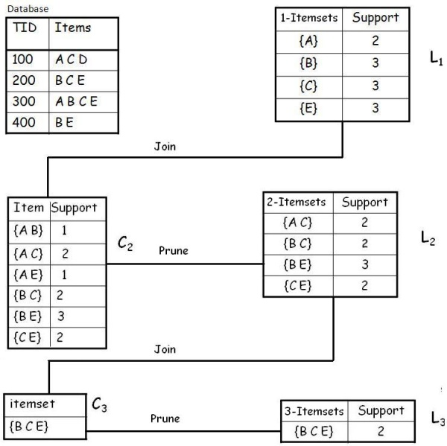
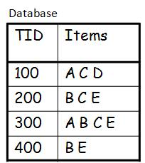
Step 1
Example
A database has five transactions. Let the min sup freq = 2 and min conf = 80%.
Solution
Step 1: Find all Frequent Itemsets
Frequent Itemset:
{A} {B} {C} {E} {A C} {B C} {B E} {C E} {B C E}
Notes:
C1 – 1 frequent itemset
C2 – 2 frequent itemset (ignore 3 itemsets when creating candidates)
C3 – 3 frequent itemset (ignore 4 itemset when creating candidates)
L represents the candidates with minimum support count satisfied from database

Slide 25
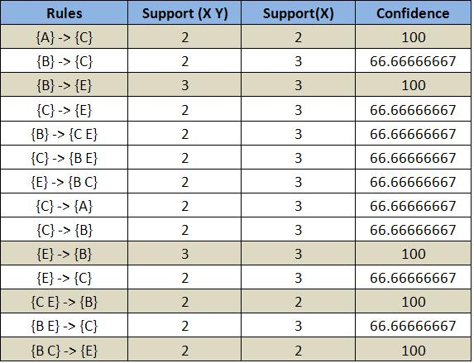
Step 2
Step 2: Generate strong association rules from the frequent itemsets
Frequent Itemset:
{A} {B} {C} {E} {A C} {B C} {B E} {C E} {B C E}
Example
A database has five transactions. Let the min sup = 2 and min conf = 80%.

Slide 26
Apriori : Python implementation
dataset = [['Milk', 'Onion', 'Nutmeg', 'Kidney Beans', 'Eggs', 'Yogurt'],
['Dill', 'Onion', 'Nutmeg', 'Kidney Beans', 'Eggs', 'Yogurt'],
['Milk', 'Apple', 'Kidney Beans', 'Eggs'],
['Milk', 'Unicorn', 'Corn', 'Kidney Beans', 'Yogurt'],
['Corn', 'Onion', 'Onion', 'Kidney Beans', 'Ice cream', 'Eggs']]
import pandas as pd
from mlxtend.preprocessing import TransactionEncoder
te = TransactionEncoder()
te_ary = te.fit(dataset).transform(dataset)
df = pd.DataFrame(te_ary, columns=te.columns_)
print(df)
from mlxtend.frequent_patterns import apriori
frequent_itemsets = apriori(df, min_support=0.6, use_colnames=True)
from mlxtend.frequent_patterns import association_rules
association_rules(frequent_itemsets, metric="confidence", min_threshold=0.5)

Slide 27
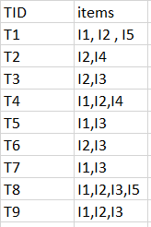
Activity 10
For the following market basket, generate frequent itemset for min sup count =2

