Slide 1
Midterm I
CS 495/595
Introduction to Data Mining
Dr. Sampath Jayarathna
Old Dominion University

Slide 2
Study guide
Associate Rule Mining
Aprori algorithm. Should be able to solve and find frequent itemsets given a support count. You need to be able to show the intermediate results before and after pruning.
Classification
KNN with different K values given a distance with classes
How to find an optimum K value for KNN
Clustering
Purity and Rand Index
Correlation vs Regression
Rocchio vs KNN
Type of data attributes
Nominal, ordinal, binary, continues, desecrate.
Should be able to find which data attribute given an example, e.g., "height"
Sampling Techniques
Random, cluster, stratified, convenience

Slide 3
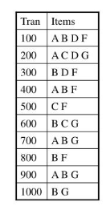
Apriori
Consider the following database of transactions
If the item count threshold is 2, calculate all the frequent itemsets

Slide 4
Classification
Following is a set of instances in a 2D space.
How is the star (*) classified by (O or X):
Roccio with Euclidean distance
3-NN
9-NN

Slide 5
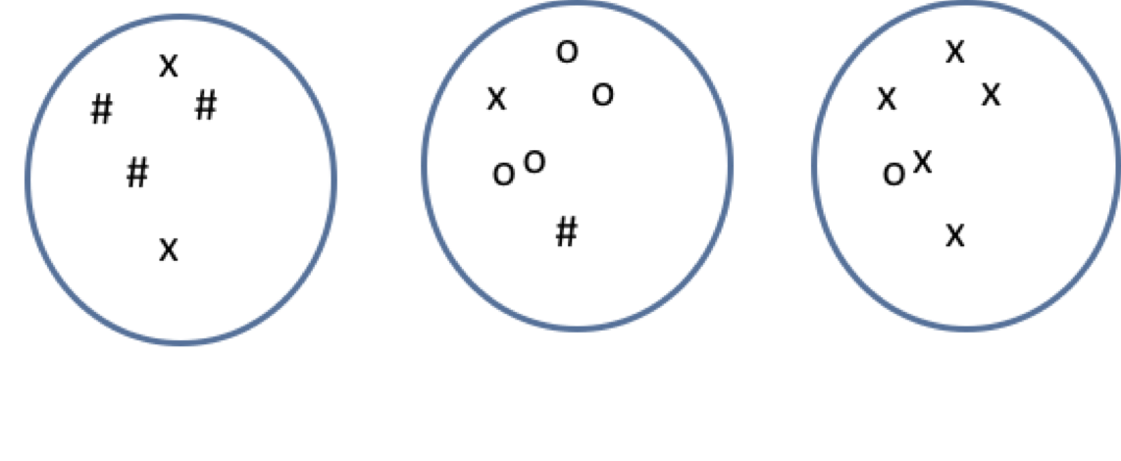
Clustering
Calculate the purity and Rand index of the following cluster assignments

