Slide 1
Lecture 4 Conditions and Selections
CS 128
Introduction to C++
Sampath Jayarathna
Cal Poly Pomona
Based on slides created by Bjarne Stroustrup & Tony Gaddis

Slide 2
Relational Operators
Used to compare numbers to determine relative order
Operators:
> | Greater than
< | Less than
>= | Greater than or equal to
<= | Less than or equal to
== | Equal to
!= | Not equal to

Slide 3
Relational Expressions
Boolean expressions – true or false
Examples:
12 > 5 is true
7 <= 5 is false
if x is 10, then
x == 10 is true,
x != 8 is true, and
x == 8 is false

Slide 4
Relational Expressions
Can be assigned to a variable:
result = x <= y;
Assigns 0 for false, 1 for true
Do not confuse = and ==

Slide 5
The if Statement
Allows statements to be conditionally executed or skipped over
Models the way we mentally evaluate situations:
"If it is raining, take an umbrella."
"If it is cold outside, wear a coat."

Slide 6
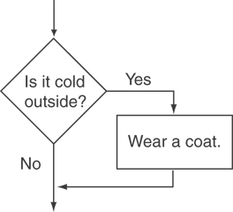
Flowchart for Evaluating a Decision

Slide 7
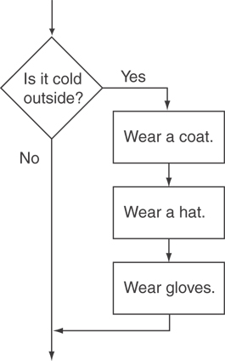
Flowchart for Evaluating a Decision

Slide 8
The if Statement
General Format:
if (expression)
statement;

Slide 9
The if Statement-What Happens
To evaluate:
if (expression)
statement;
If the expression is true, then statement is executed.
If the expression is false, then statement is skipped.

Slide 10
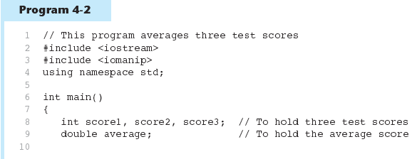
if Statement in Program 4-2
Continued…

Slide 11
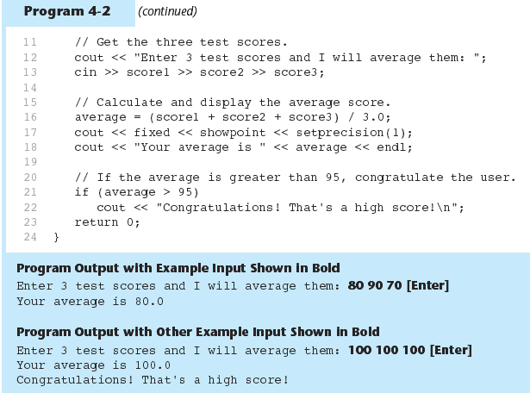
if Statement in Program 4-2

Slide 12
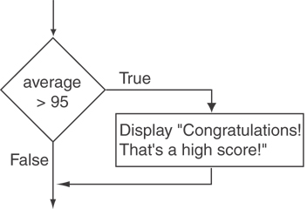
Flowchart for Program 4-2 Lines 21 and 22

Slide 13
if Statement Notes
Do not place ; after (expression)
Place statement; on a separate line after (expression), indented:
if (score > 90)
grade = 'A';
Be careful testing floats and doubles for equality
0 is false; any other value is true

Slide 14
Expanding the if Statement
To execute more than one statement as part of an if statement, enclose them in { }:
if (score > 90)
{
grade = 'A';
cout << "Good Job!\n";
}
{ } creates a block of code

Slide 15
The if/else statement
Provides two possible paths of execution
Performs one statement or block if the expression is true, otherwise performs another statement or block.

Slide 16
The if/else statement
General Format:
if (expression)
statement1; // or block
else
statement2; // or block

Slide 17
if/else-What Happens
To evaluate:
if (expression)
statement1;
else
statement2;
If the expression is true, then statement1 is executed and statement2 is skipped.
If the expression is false, then statement1 is skipped and statement2 is executed.

Slide 18
Activity 7
Create a program to enter an integer from user input and display whether the integer is odd or even.

Slide 19
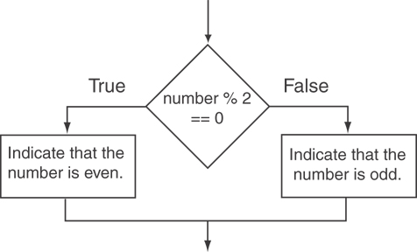
Flowchart for activity 7

Slide 20
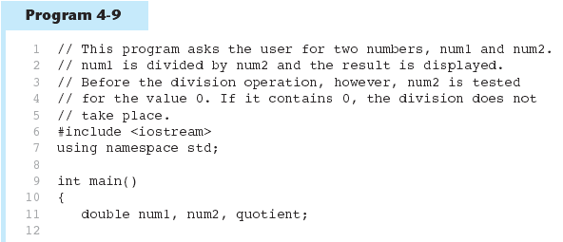
Testing the Divisor in Program 4-9
Continued…

Slide 21
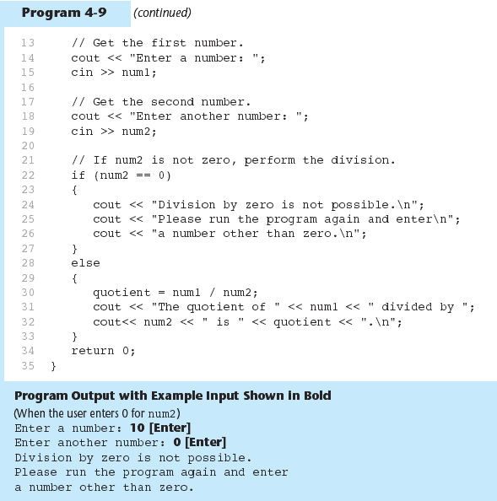
Testing the Divisor in Program 4-9

Slide 22
Nested if Statements
An if statement that is nested inside another if statement
Nested if statements can be used to test more than one condition

Slide 23
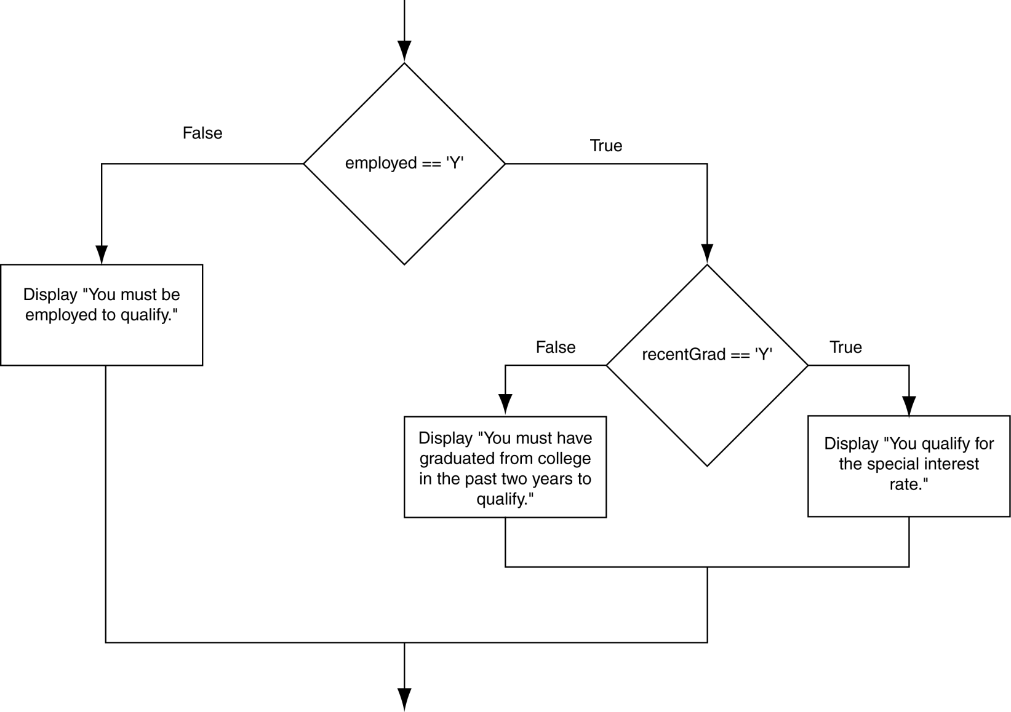
Flowchart for a Nested if Statement

Slide 24
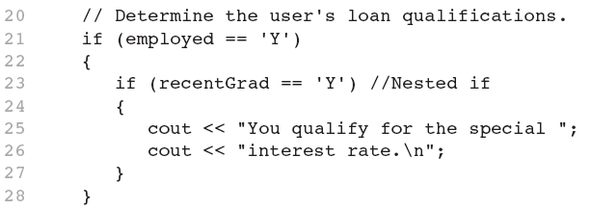
Nested if Statements
From Program 4-10

Slide 25
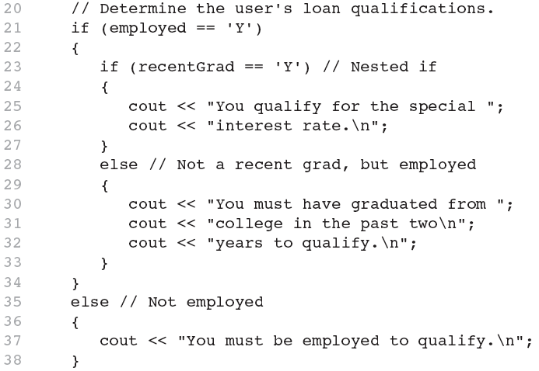
Nested if Statements
Another example, from Program 4-1

Slide 26
Use Proper Indentation!

Slide 27
The if/else if Statement
Tests a series of conditions until one is found to be true
Often simpler than using nested if/else statements
Can be used to model thought processes such as: "If it is raining, take an umbrella, else, if it is windy, take a hat, else, take sunglasses”

Slide 28
if/else if Format
if (expression)
statement1; // or block
else if (expression)
statement2; // or block
.
. // other else ifs .
else if (expression)
statementn; // or block

Slide 29
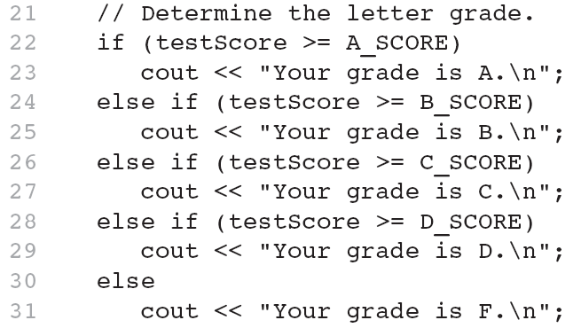
The if/else if Statement in Program 4-13

Slide 30
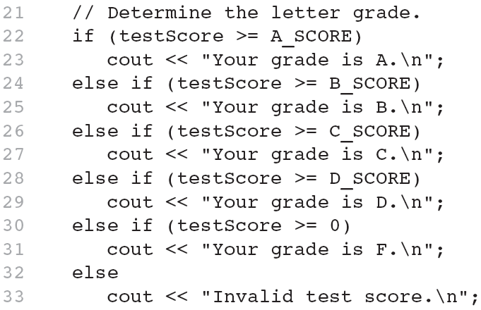
Using a Trailing else to Catch Errors in Program 4-14
The trailing else clause is optional, but it is best used to catch errors.
This trailing else catches invalid test scores

Slide 31
The Increment and Decrement Operators
++ is the increment operator. It adds one to a variable.
val++; is the same as val = val + 1;
++ can be used before (prefix) or after (postfix) a variable:
++val; val++;

Slide 32
The Increment and Decrement Operators
-- is the decrement operator. It subtracts one from a variable.
val--; is the same as val = val - 1;
-- can be also used before (prefix) or after (postfix) a variable:
--val; val--;

Slide 33
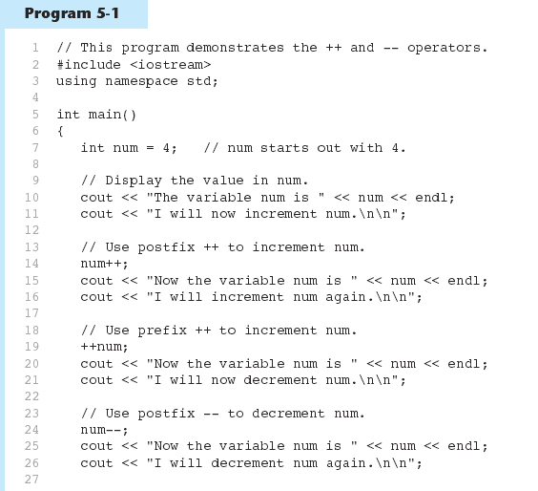
Increment and Decrement Operators in Program 5-1
Continued…

Slide 34
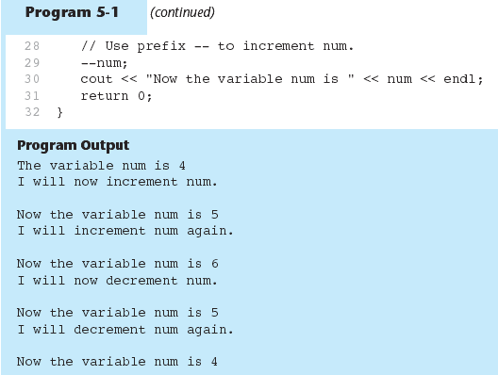
Increment and Decrement Operators in Program 5-1

Slide 35
Prefix vs. Postfix
++ and -- operators can be used in complex statements and expressions
In prefix mode (++val, --val) the operator increments or decrements, then returns the value of the variable
In postfix mode (val++, val--) the operator returns the value of the variable, then increments or decrements

Slide 36
Prefix vs. Postfix - Examples
int num, val = 12;
cout << val++; // displays 12,
// val is now 13;
cout << ++val; // sets val to 14,
// then displays it
num = --val; // sets val to 13,
// stores 13 in num
num = val--; // stores 13 in num,
// sets val to 12

Slide 37
Notes on Increment and Decrement
Can be used in expressions:
result = num1++ + --num2;
Must be applied to something that has a location in memory. Cannot have:
result = (num1 + num2)++;
Can be used in relational expressions:
if (++num > limit)
pre- and post-operations will cause different comparisons

Slide 38
Flags
Variable that signals a condition
Usually implemented as a bool variable
Can also be an integer
The value 0 is considered false
Any nonzero value is considered true
As with other variables in functions, must be assigned an initial value before it is used

Slide 39
Logical Operators
Used to create relational expressions from other relational expressions
Operators, meaning, and explanation:
&& | AND | New relational expression is true if both expressions are true
|| | OR | New relational expression is true if either expression is true
! | NOT | Reverses the value of an expression – true expression becomes false, and false becomes true

Slide 40
Logical Operators-Examples
int x = 12, y = 5, z = -4;
(x > y) && (y > z) | true
(x > y) && (z > y) | false
(x <= z) || (y == z) | false
(x <= z) || (y != z) | true
!(x >= z) | false

Slide 41
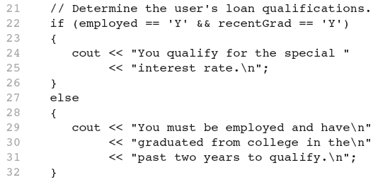
The logical && operator in Program 4-15

Slide 42
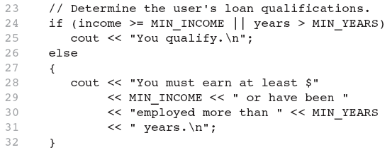
The logical || Operator in Program 4-16

Slide 43
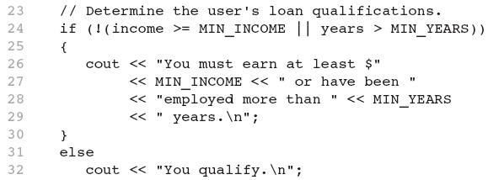
The logical ! Operator in Program 4-17

Slide 44
Logical Operator-Notes
! has highest precedence, followed by &&, then ||
If the value of an expression can be determined by evaluating just the sub-expression on left side of a logical operator, then the sub-expression on the right side will not be evaluated (short circuit evaluation)

Slide 45
Checking Numeric Ranges with Logical Operators
Used to test to see if a value falls inside a range:
if (grade >= 0 && grade <= 100)
cout << "Valid grade";
Can also test to see if value falls outside of range:
if (grade <= 0 || grade >= 100)
cout << "Invalid grade";
Cannot use mathematical notation:
if (0 <= grade <= 100) //doesn’t work!

Slide 46
Menus
Menu-driven program: program execution controlled by user selecting from a list of actions
Menu: list of choices on the screen
Menus can be implemented using if/else if statements

Slide 47
Menu-Driven Program Organization
Display list of numbered or lettered choices for actions
Prompt user to make selection
Test user selection in expression
if a match, then execute code for action
if not, then go on to next expression

Slide 48
Validating User Input
Input validation: inspecting input data to determine whether it is acceptable
Bad output will be produced from bad input
Can perform various tests:
Range
Reasonableness
Valid menu choice
Divide by zero

Slide 49
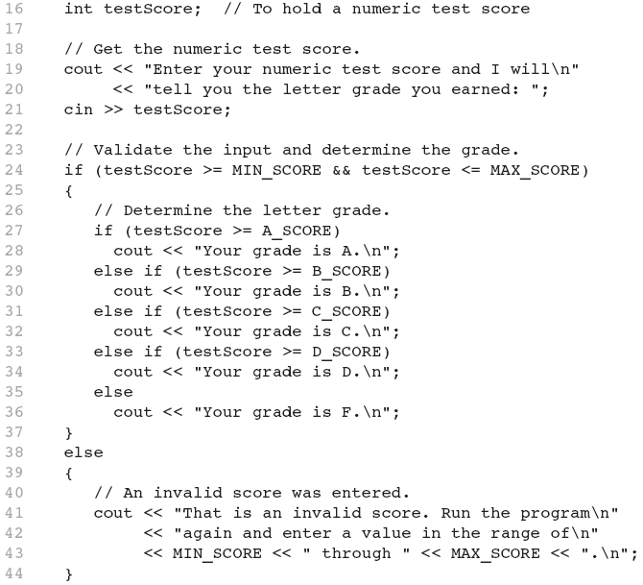
Input Validation in Program 4-19

Slide 50
Comparing string Objects
Like characters, strings are compared using their ASCII values
string name1 = "Mary";
string name2 = "Mark";
The characters in each string must match before they are equal
name1 > name2 // true
name1 <= name2 // false
name1 != name2 // true
name1 < "Mary Jane" // true

Slide 51
Relational Operators Compare Strings

Slide 52
The Conditional Operator
Can use to create short if/else statements
Format: expr ? expr : expr;
x<0 ? y=10 : z=20;
First Expression:
Expression to be
tested
2nd Expression:
Executes if first
expression is true
3rd Expression:
Executes if the first
expression is false

Slide 53
The Conditional Operator
The value of a conditional expression is
The value of the second expression if the first expression is true
The value of the third expression if the first expression is false
Parentheses () may be needed in an expression due to precedence of conditional operator

Slide 54
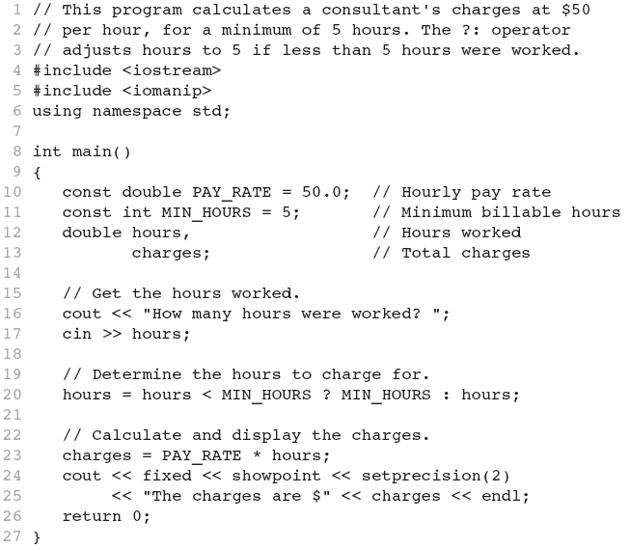
The Conditional Operator in Program 4-22

Slide 55
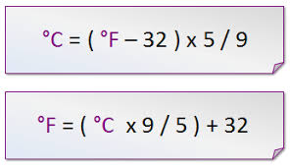
Activity 8
Use the ternary operator to create a program to convert temperature from Celsius to Fahrenheit or vice versa.
Ask from user a number 0 or 1 for each conversion
Enter 0 to convert from Celsius to Fahrenheit
Enter 1 to convert from Fahrenheit to Celsius
Ask from user the temperature to convert
Display the temperature in output message.

Slide 56
The switch Statement
Used to select among statements from several alternatives
In some cases, can be used instead of if/else if statements
switch (expression) //integer
{
case exp1: statement1;
case exp2: statement2;
...
case expn: statementn;
default: statementn+1;
}

Slide 57
switch Statement Requirements
1) expression must be an integer variable or char
exp1 through expn must be constant integer expressions or char, and must be unique in the switch statement
default is optional but recommended
Use break statement to stop flowing the case to next case statements.

Slide 58
break Statement
Used to exit a switch statement
If it is left out, the program "falls through" the remaining statements in the switch statement

Slide 59
switch Statement-How it Works
1) expression is evaluated
The value of expression is compared against exp1 through expn.
If expression matches value expi, the program branches to the statement following expi and continues to the end of the switch
If no matching value is found, the program branches to the statement after default:

Slide 60
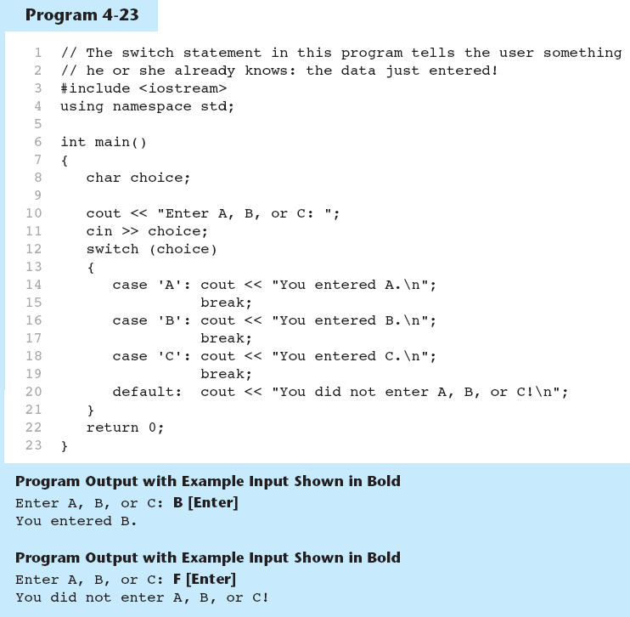
The switch Statement in Program 4-23

Slide 61
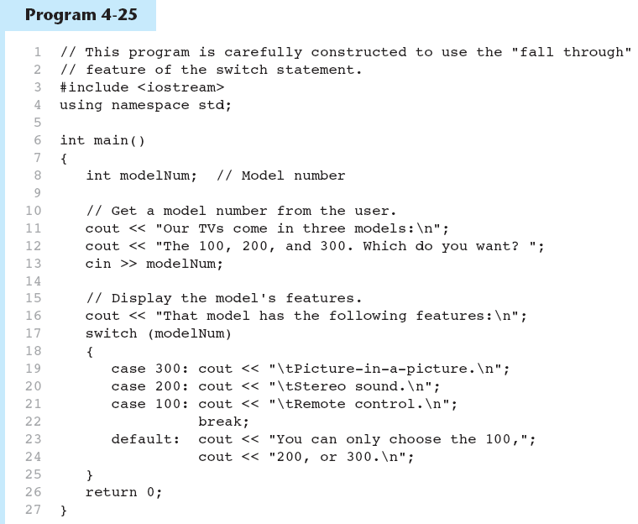
break and default statements
Continued…

Slide 62
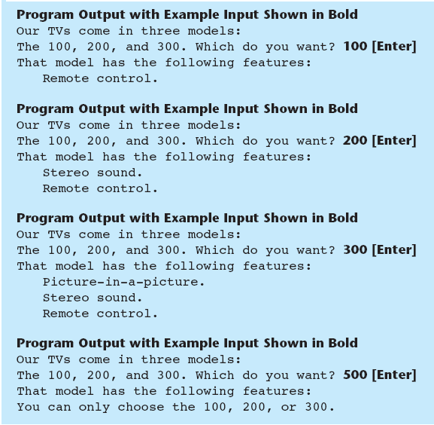
break and default statements in Program

Slide 63
More About Blocks and Scope
Scope of a variable is the block in which it is defined, from the point of definition to the end of the block
Usually defined at beginning of function
May be defined close to first use

Slide 64
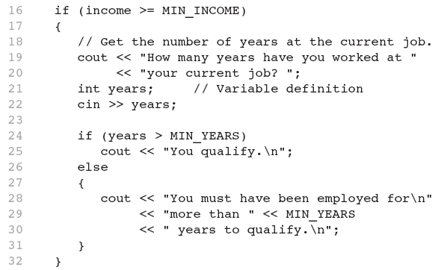
Inner Block Variable Definition

Slide 65
Variables with the Same Name
Variables defined inside { } have local or block scope
When inside a block within another block, can define variables with the same name as in the outer block.
When in inner block, outer definition is not available
Not a good idea

Slide 66
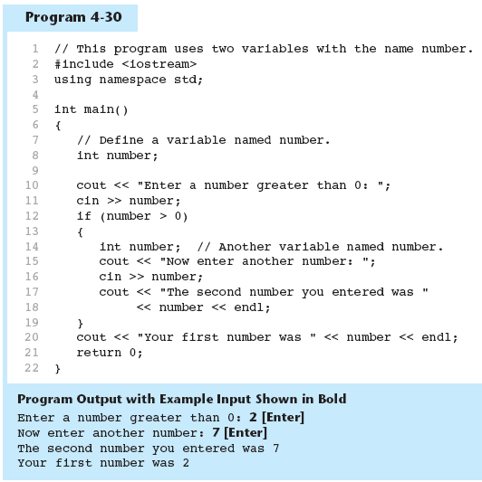
Two Variables with the Same Name in Program

Slide 67
Activity 9
Create a calculator program using a switch-case where each case behaves as a single operator. Ask 2 numbers from user and the operator in an expression and display the output.
Example:
Please enter mathematical expression: 4 * 5
Answer is 20

Slide 68
The next lecture
Will talk about Loops

