Slide 1
Normalization
Sampath Jayarathna
Cal Poly Pomona

Slide 2
Data normalization
Normalization is a formal process for deciding which attributes should be grouped together in a relation
Normalization is a process that “improves” a database design by generating relations that are of higher normal forms.
The objective of normalization: “to create relations where every dependency is on the key, the whole key, and nothing but the key”.

Slide 3
Semantics of the Relational Attributes must be clear
GUIDELINE 1: Informally, each tuple in a relation should represent one entity or relationship instance. (Applies to individual relations and their attributes).
Attributes of different entities (EMPLOYEEs, DEPARTMENTs, PROJECTs) should not be mixed in the same relation
Only foreign keys should be used to refer to other entities
Entity and relationship attributes should be kept apart as much as possible.
Bottom Line: Design a schema that can be explained easily relation by relation. The semantics of attributes should be easy to interpret.

Slide 4
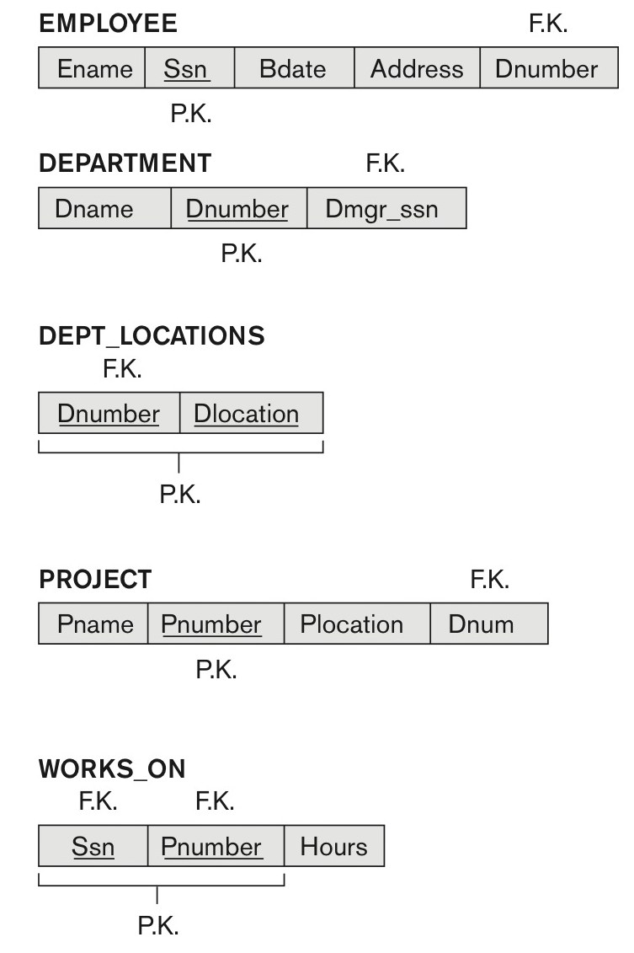
A simplified COMPANY relational database schema

Slide 5
Redundant Information in Tuples and Update Anomalies
Information is stored redundantly
Wastes storage
Causes problems with update anomalies
Insertion anomalies
Deletion anomalies
Modification anomalies
Consider the relation:
EMP_PROJ(Emp#, Proj#, Ename, Pname, No_hours)
Update Anomaly:
Changing the name of project number P1 from “Billing” to “Customer-Accounting” may cause this update to be made for all 100 employees working on project P1.

Slide 6
EXAMPLE OF AN INSERT ANOMALY
Consider the relation:
EMP_PROJ(Emp#, Proj#, Ename, Pname, No_hours)
Insert Anomaly:
Cannot insert a project unless an employee is assigned to it.
Conversely
Cannot insert an employee unless an he/she is assigned to a project.

Slide 7
EXAMPLE OF A DELETE ANOMALY
Consider the relation:
EMP_PROJ(Emp#, Proj#, Ename, Pname, No_hours)
Delete Anomaly:
When a project is deleted, it will result in deleting all the employees who work on that project.
Alternately, if an employee is the sole employee on a project, deleting that employee would result in deleting the corresponding project.

Slide 8
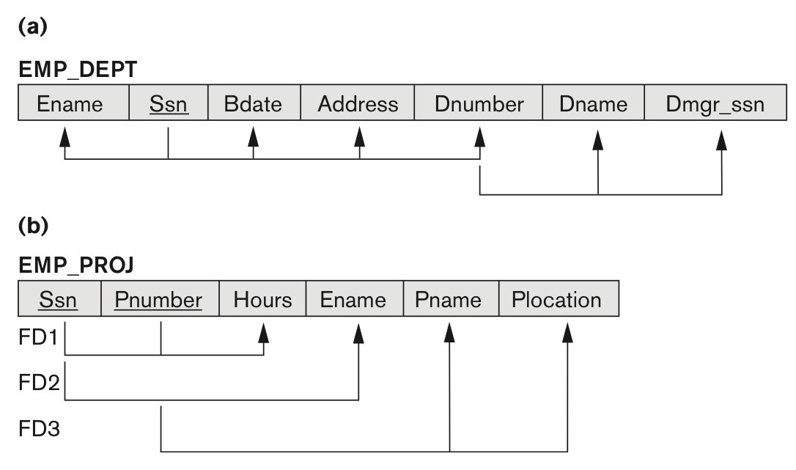
Two relation schemas suffering from update anomalies
Figure 14.3
Two relation schemas suffering from update anomalies. (a) EMP_DEPT and (b) EMP_PROJ.

Slide 9
Normalization of Relations
Normalization:
The process of decomposing unsatisfactory "bad" relations by breaking up their attributes into smaller relations
Normal form:
Condition using keys and FDs of a relation to certify whether a relation schema is in a particular normal form

Slide 10
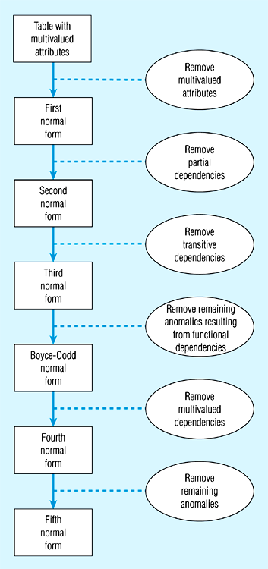
Data normalization
2NF is better than 1NF; 3NF is better than 2NF
For most business database design purposes, 3NF is as high as we need to go in normalization process
Highest level of normalization is not always most desirable

Slide 11
Functional dependencies and keys
Functional dependency: the value of one attribute (the determinant) determines the value of another attribute
A -> B, for every valid instance of A, that value of A uniquely determines the value of B
Candidate key: an attribute or combination of attributes that uniquely identifies an instance
Uniqueness: each non-key field is functionally dependent on every candidate key
Non-redundancy

Slide 12
Examples of FD constraints (1)
Social security number determines employee name
SSN  ENAME
Project number determines project name and location
PNUMBER  {PNAME, PLOCATION}
Employee ssn and project number determines the hours per week that the employee works on the project
{SSN, PNUMBER}  HOURS

Slide 13
Conversion to First Normal Form (continued)

Slide 14
First normal form
No multi-valued attributes.
Every attribute value is atomic.
The following in not in 1NF
EmpNum
EmpPhone
EmpDegrees
123
233-9876
333
233-1231
BA, BSc, PhD
679
233-1231
BSc, MSc

Slide 15
Second normal form
1NF and every non-key attribute is fully functionally dependent on the primary key.
Every non-key attribute must be defined by the entire key, not by only part of the key.
No partial functional dependencies.

Slide 16
Conversion to Second Normal Form

Slide 17
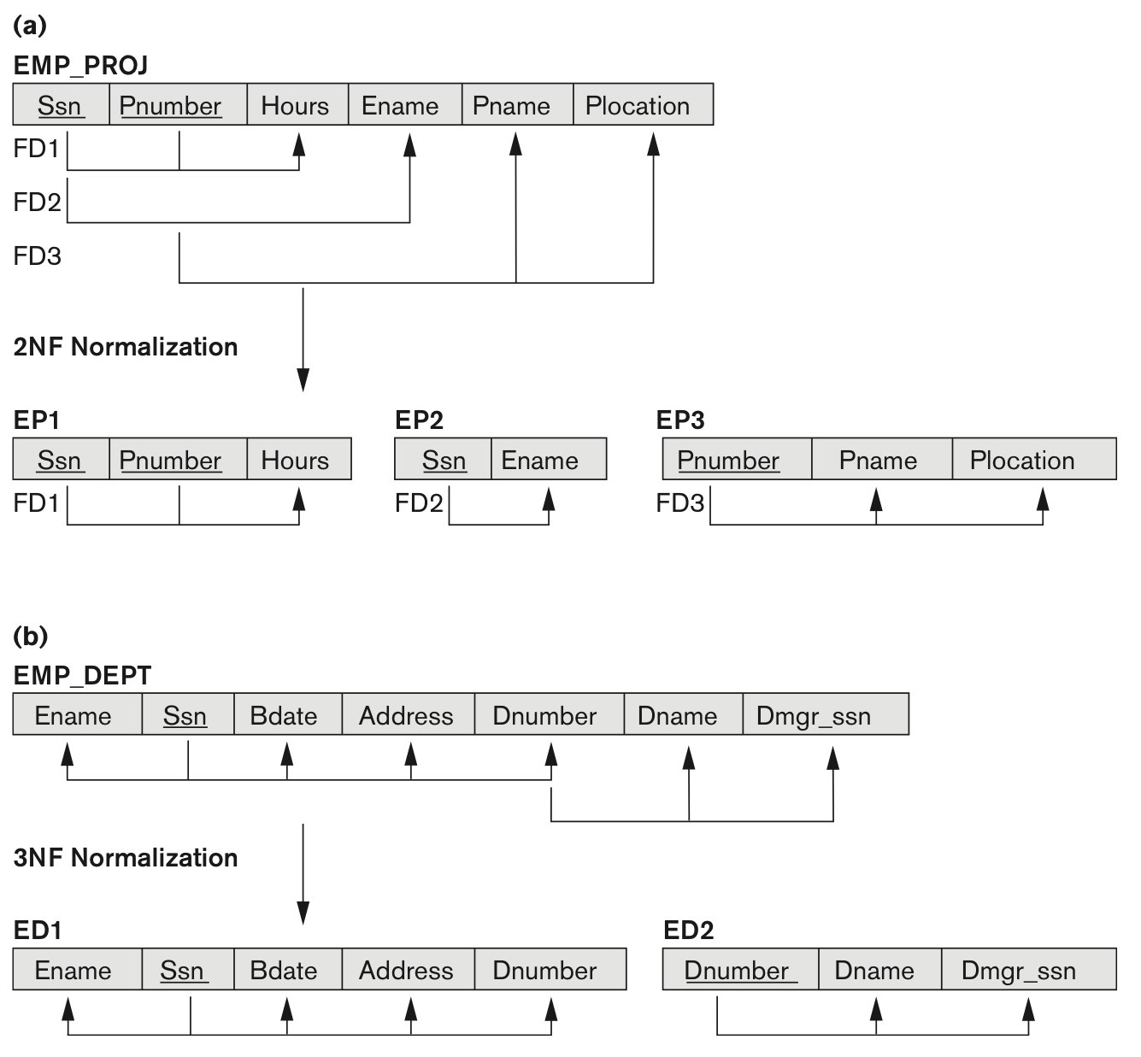
Normalizing into 2NF and 3NF
Figure 14.11
Normalizing into 2NF and 3NF. (a) Normalizing EMP_PROJ into 2NF relations. (b) Normalizing EMP_DEPT into 3NF relations.

Slide 18
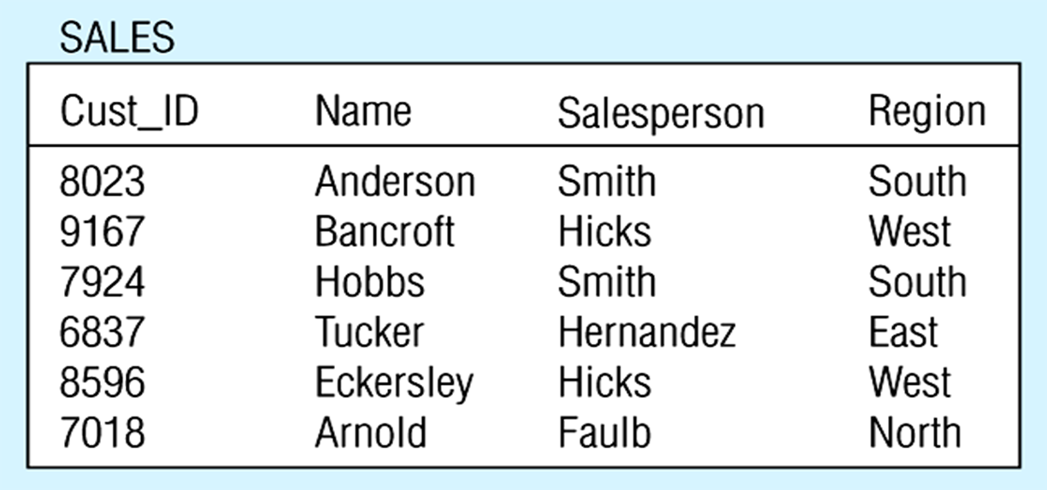
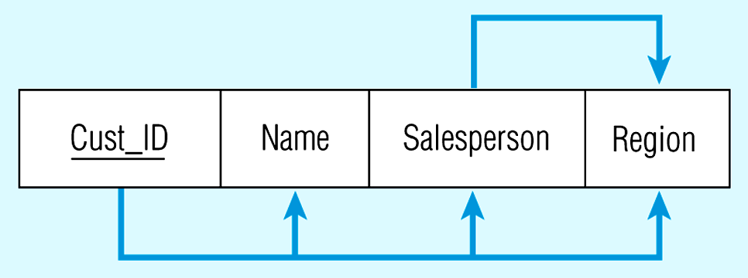
Third normal form
2NF and no transitive dependencies (functional dependency between non-key attributes.)

Slide 19
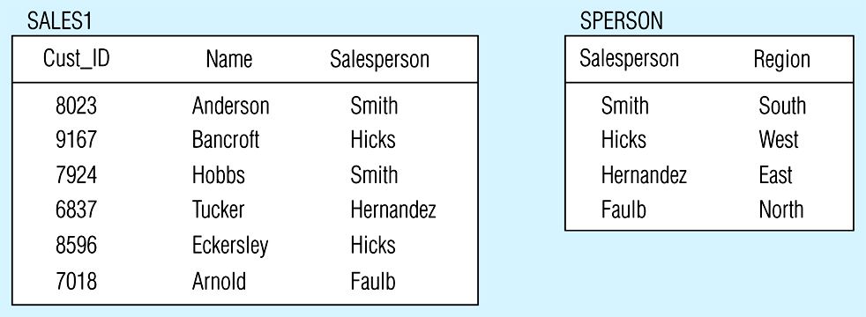
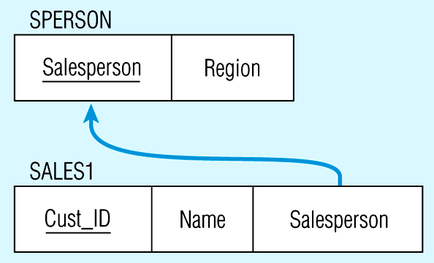
Removing a transitive dependency

Slide 20
Relations in 3NF

Slide 21
The Boyce-Codd Normal Form (BCNF)
Every determinant in table is a candidate key
Has same characteristics as primary key, but for some reason, not chosen to be primary key
When table contains only one candidate key, the 3NF and the BCNF are equivalent
BCNF can be violated only when table contains more than one candidate key

Slide 22
The Boyce-Codd Normal Form (BCNF) (continued)
Most designers consider the BCNF as special case of 3NF
Table is in 3NF when it is in 2NF and there are no transitive dependencies
Table can be in 3NF and fails to meet BCNF
No partial dependencies, nor does it contain transitive dependencies
A nonkey attribute is the determinant of a key attribute

Slide 23
The Boyce-Codd Normal Form (BCNF) (continued)

Slide 24
The Boyce-Codd Normal Form (BCNF) (continued)

Slide 25
Normal Forms Defined Informally
1st normal form
All attributes depend on the key
2nd normal form
All attributes depend on the whole key
3rd normal form
All attributes depend on nothing but the key

Slide 26
Class Activity 8
Given the schema R= (A,B,C,D,E) and the following dependencies:
A→B
A→C
D→E
Assuming only the above dependencies, find a key for R.
Decompose R into a schema in 3NF.

