Slide 1
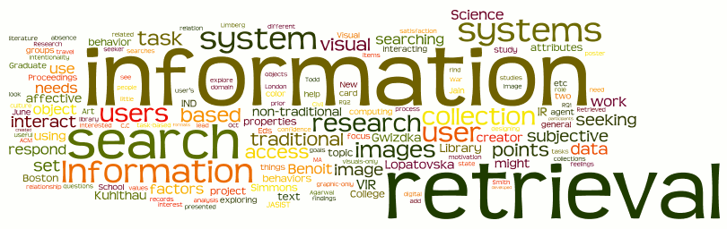
Introduction
Sampath Jayarathna
Cal Poly Pomona

Slide 2
Today
Who I am
CS 599 educational objectives (and why)
Overview of the course, and logistics
Quick overview of IR and why we study it

Slide 3

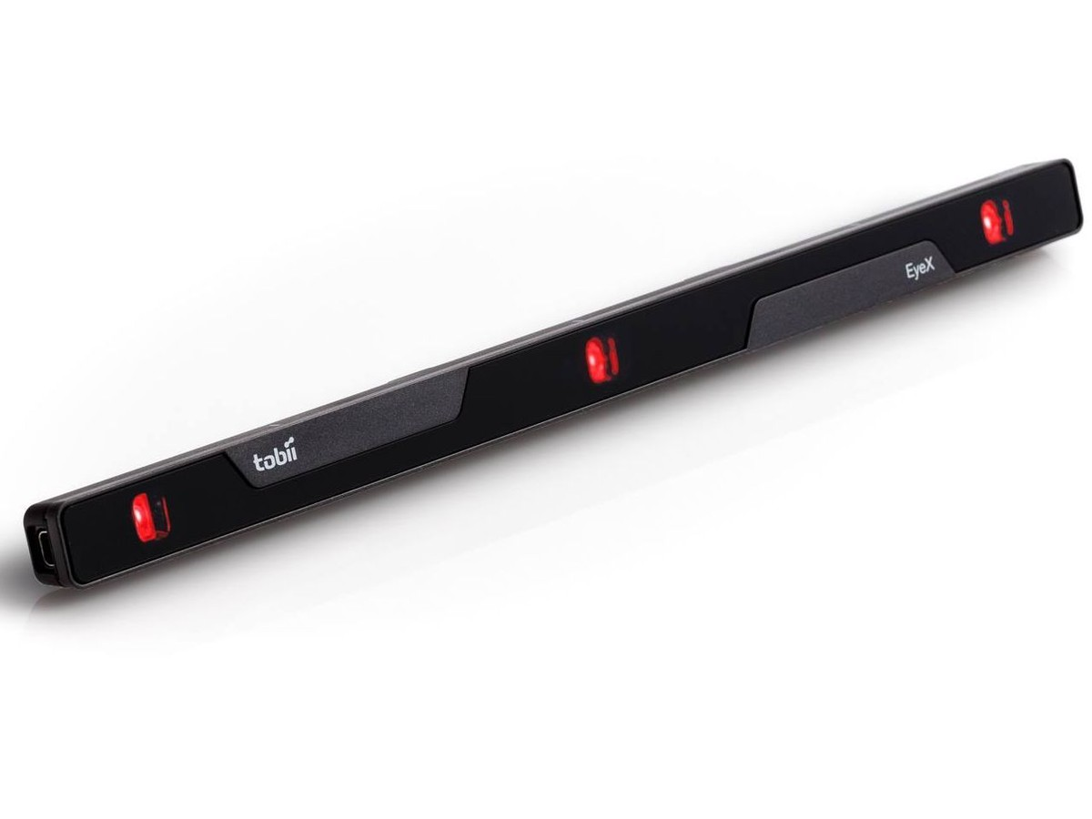

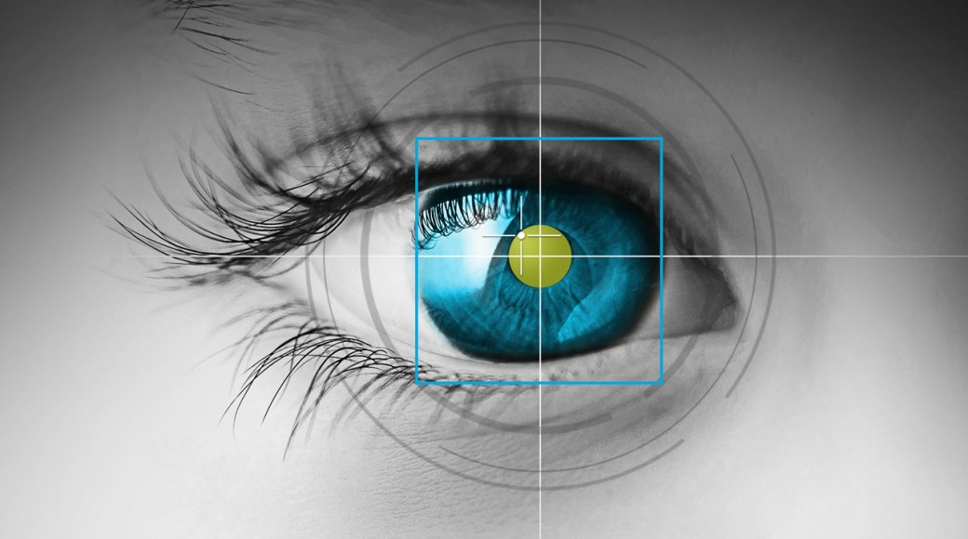
Who am I?
Instructor : Sampath Jayarathna
Joined Cal Poly Pomona Fall 2016 from Texas A&M.
Originally from Sri Lanka
Research : NeuroIR, Eye tracking, Brain EEG, User modeling
Web : http://www.cpp.edu/~ukjayarathna
Contact : 8-46, ukjayarathna@cpp.edu, (909) 869-3145
Office Hours : MW 1PM – 3PM, or email me for an appointment
[Open Door Policy]

Slide 4
Course Information
Schedule : MW, 8-348, 6.00 PM – 7.50 PM http://www.cpp.edu/~ukjayarathna/courses/w17/cs599
www.piazza.com/csupomona/winter2017/cs599/home
Blackboard
Prereqs
  Official: CS331 or approval of instructor
  Practical: Know object-oriented programming language
Format
  Before lecture: do reading
  In lecture: put reading in context
  After lecture: assignments, for hands-on practice

Slide 5
Required / Supplementary materials
Required Book
  Introduction to Information Retrieval C. Manning, P. Raghavan and H. Schutze Cambridge University Press, 2008. Free online version available at: http://nlp.stanford.edu/IR-book/
Supplementary
  Search Engines – Information Retrieval in Practice W. B. Croft, D. Metzler, and T. Strohman Cambridge University Press, 2015. Free online version available at: http://ciir.cs.umass.edu/downloads/SEIRiP.pdf
  Research Papers

Slide 6
Student Learning Outcomes
After successfully completing this course, students should be able to:
Define and explain the key concepts and models relevant to information storage and retrieval, including efficient text indexing, boolean, vector space and probabilistic retrieval models, relevance feedback, document clustering and text categorization.
Analyze, identify and design core text based retrieval system algorithms and advanced algorithms like document clustering and text categorization/classification.
Learn measures and techniques to evaluate IR systems and fundamental techniques to implement IR systems
Demonstrate through involvement in a team project the central elements of team building and team management and salient features in recent research results in web search and information retrieval.

Slide 7

Communication
Piazza:
  All questions will be fielded through Piazza.
  Many questions everyone can see the answer
  You can also post private messages that can only be seen by the instructor
Blackboard:
  Blackboard will be used primarily for assignments/homework, extra credit submission and grade dissemination.
Email:
  Again, email should only be used in rare instances, I will probably point you back to Piazza

Slide 8

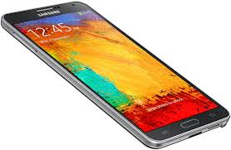
The Rules

Slide 9
Course Organization
Grading

Slide 10
Course Organization
Project: More in the next couple of slides…
Final Exam: The final exam is comprehensive, closed books and will be held on Monday, March 13, 6.00pm - 7.45pm.
Homework: We will have five homework assignments, each worth 4% of your overall grade. Homework 1 – 1 Page Resume, Due: 1/11, 6pm, Office 8-46
Research Paper Summary
  7 Papers, Summary due on the day of the discussion
Quizzes
  2 scheduled (1/25, 3/1), 2 pop quizzes
Extra Credit:
  Culture reports or User Study evaluation participation

Slide 11
Team Project
It's difficult to appreciate IR issues without working on a large project
Issues only become real on larger projects
10 weeks is too short
There will be a natural tendency to over emphasize development
Teams will be homogenous
But that won't stop us

Slide 12
Team Project - Evaluation
Form teams of 3 (+ 1?) students
  Independent and non-competing
  Think of other teams as working for other organizations
  Code and document sharing between teams is not permitted
Project grade will have a large impact on course grade (30%)
Project grade will (attempt to) recognize individual contributions
  Peer evaluation, Demo evaluation
All artifacts will be considered in the evaluation
Quality matters.

Slide 13
Team Project - Milestones
Project Proposal, 01/18
Progress reports, 02/01, 02/22
Final Report, 03/08
In-class presentation and Demo, 03/08

Slide 14
Team Project - Ideas
Personal Health Monitoring and Tracking
News and Summarization (timelines)
Social Media (Spammers, Social Honey-pot)
Universal Social Profile (social-media mining)
Recommender Systems (products, costs)
Improve class room experience (students, instructors)
Drones, Arduino, Raspberry PI, Robots…….

Slide 15
More on the class
Project (approximately 26 students, we’ll form groups this Monday)
  Strict milestones (only 10 weeks)
  Progress reports, list top 3 risks, plus other material
  Not primarily graded on whether your program "works“
Special topics (research papers)
Schedule is on the web page

Slide 16
Lecture Overview
Introduction to Information Retrieval
The Information Seeking Process
Information Retrieval History and Developments
Credit for some of the slides in this lecture goes to Ray Larson at UC Berkeley and Ray Mooney at UT Austin

Slide 17
Purposes of the Course
To impart a basic theoretical understanding of IR models
  Boolean
  Vector Space
  Probabilistic (including Language Models)
To examine major application areas of IR including:
  Web Search
  Text categorization and clustering
  Text summarization
  Digital Libraries
To understand how IR performance is measured:
  Recall/Precision
  Statistical significance
Gain hands-on experience with IR systems

Slide 18
Introduction
Goal of IR is to retrieve all and only the “relevant” documents in a collection for a particular user with a particular need for information
  Relevance is a central concept in IR theory
How does an IR system work when the “collection” is all documents available on the Web?
  Web search engines have been stress-testing the traditional IR models (and inventing new ways of ranking)

Slide 19
Origins
Communication theory revisited
Problems with transmission of meaning
Message
Message
Source
Encoding
Decoding
Destination
Channel
Noise
Message
Message
Source
Encoding
(writing/indexing)
Storage
Decoding
(Retrieval/Reading)
Destination

Slide 20
Standard Model of IR
Assumptions:
  The goal is maximizing precision and recall simultaneously
  The information need remains static
  The value is in the resulting document set
Users learn during the search process:
  Scanning titles of retrieved documents
  Reading retrieved documents
  Viewing lists of related topics/thesaurus terms
  Navigating hyperlinks
Problem: Some users don’t like long (apparently) disorganized lists of documents

Slide 21
Bates’ “Berry-Picking” Model
Standard IR model
  Assumes the information need remains the same throughout the search process
Berry-picking model
  Interesting information is scattered like berries among bushes
  The query is continually shifting
  New information may yield new ideas and new directions
  The information need
    Is not satisfied by a single, final retrieved set
    Is satisfied by a series of selections and bits of information found along the way

Slide 22
Berry-Picking Model
A sketch of a searcher… “moving through many actions towards a general goal of satisfactory completion of research related to an information need.” (after Bates 89)
Q2
Q4
Q3
Q1
Q5
Q0

Slide 23
Information Retrieval
The indexing and retrieval of textual documents.
Searching for pages on the World Wide Web is the “killer app.”
Concerned firstly with retrieving relevant documents to a query.
Concerned secondly with retrieving from large sets of documents efficiently.

Slide 24
IR System
Given:
A corpus of textual natural-language documents.
A user query in the form of a textual string.
Find: A ranked set of documents that are relevant to the query.
Document
corpus
IR
System
Query String
1. Doc1
2. Doc2
3. Doc3
.
.
Ranked
Documents

Slide 25
Relevance
Relevance is a subjective judgment and may include:
  Being on the proper subject.
  Being timely (recent information).
  Being authoritative (from a trusted source).
  Satisfying the goals of the user and his/her intended use of the information (information need).

Slide 26
Keyword Search
Simplest notion of relevance is that the query string appears verbatim in the document.
Slightly less strict notion is that the words in the query appear frequently in the document, in any order (bag of words).
May not retrieve relevant documents that include synonymous terms.
  “restaurant” vs. “café”
  “PRC” vs. “China”
May retrieve irrelevant documents that include ambiguous terms.
  “bat” (baseball vs. mammal)
  “Apple” (company vs. fruit)
  “bit” (unit of data vs. act of eating)

Slide 27
Beyond Keywords
We will cover the basics of keyword-based IR, but…
We will focus on extensions and recent developments that go beyond keywords.
We will cover the basics of building an efficient IR system, but…
We will focus on basic capabilities and algorithms rather than systems issues that allow scaling to industrial size databases.

Slide 28
Intelligent IR
Taking into account the meaning of the words used.
Taking into account the order of words in the query.
Adapting to the user based on direct or indirect feedback.
Taking into account the authority of the source.

Slide 29
IR System Components
Text Operations forms index words (tokens).
  Stopword removal
  Stemming
Indexing constructs an inverted index of word to document pointers.
Searching retrieves documents that contain a given query token from the inverted index.
Ranking scores all retrieved documents according to a relevance metric.

Slide 30
IR System Components (continued)
User Interface manages interaction with the user:
  Query input and document output.
  Relevance feedback.
  Visualization of results.
Query Operations transform the query to improve retrieval:
  Query expansion using a thesaurus.
  Query transformation using relevance feedback.

Slide 31
Web Search
Application of IR to HTML documents on the World Wide Web.
Differences:
  Must assemble document corpus by spidering the web.
  Can exploit the structural layout information in HTML (XML).
  Documents change uncontrollably.
  Can exploit the link structure of the web.

Slide 32
Web Search System
Web
Spider
Document
corpus
IR
System
Query String
1. Page1
2. Page2
3. Page3
.
.
Ranked
Documents

Slide 33
IR History Overview
Information Retrieval History
  Origins and Early “IR”
  Modern Roots in the scientific “Information Explosion” following WWII
  Non-Computer IR (mid 1950’s)
  Interest in computer-based IR from mid 1950’s
  Modern IR – Large-scale evaluations, Web-based search and Search Engines -- 1990’s

Slide 34

Origins
Biblical Indexes and Concordances
  1247 – Hugo de St. Caro – employed 500 Monks to create keyword concordance to the Bible
Journal Indexes (Royal Society, 1600’s)
“Information Explosion” following WWII
  Cranfield Studies of indexing languages and information retrieval

Slide 35
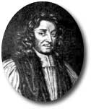
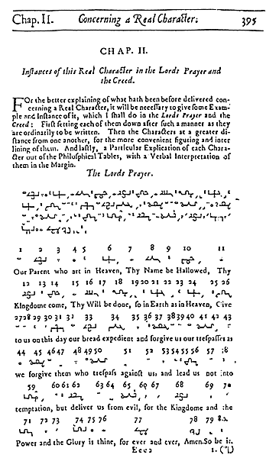
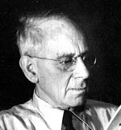
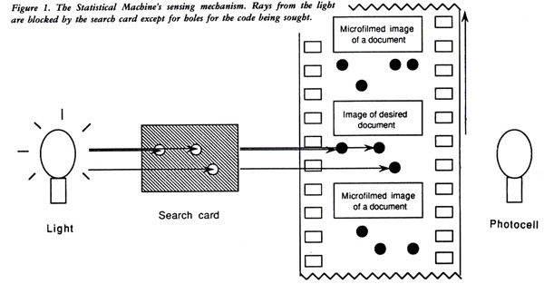
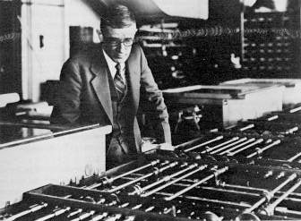
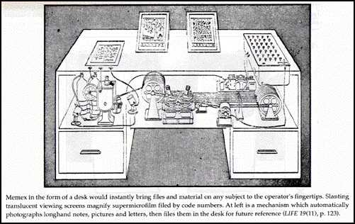
Visions of IR Systems
Rev. John Wilkins, 1600’s : The Philosophical Language and tables
Wilhelm Ostwald and Paul Otlet, 1910’s: The “monographic principle” and Universal Classification
Emanuel Goldberg, 1920’s - 1940’s
H.G. Wells, “World Brain: The idea of a permanent World Encyclopedia.” (Introduction to the Encyclopédie Française, 1937)
Vannevar Bush, “As we may think.” Atlantic Monthly, 1945.
Term “Information Retrieval” coined by Calvin Mooers. 1952

Slide 36
History of IR
1960-70’s:
  Initial exploration of text retrieval systems for “small” corpora of scientific abstracts, and law and business documents.
  Development of the basic Boolean and vector-space models of retrieval.
  Prof. Salton and his students at Cornell University are the leading researchers in the area.

Slide 37
IR History Continued
1980’s:
  Large document database systems, many run by companies:
    Lexis-Nexis
    Dialog
    MEDLINE
1990’s:
  Searching FTPable documents on the Internet
    Archie
    WAIS
  Searching the World Wide Web
    Lycos
    Yahoo
    Altavista

Slide 38
IR History Continued
1990’s continued:
  Organized Competitions
    NIST TREC
  Recommender Systems
    Ringo
    Amazon
    NetPerceptions
  Automated Text Categorization & Clustering

Slide 39
IR History Continued
2000’s
  Link analysis for Web Search
    Google
  Parallel Processing
    Map/Reduce
  Question Answering
    TREC Q/A track
  Multimedia IR
    Image
    Video
    Audio and music
  Cross-Language IR
  Document Summarization

Slide 40
Recent IR History
2010’s
  Intelligent Personal Assistants
    Siri
    Cortana
    Google
    Alexa
  Complex Question Answering
    IBM Watson
  Distributional Semantics
  Deep Learning

Slide 41
Recent IR History
2020’s and Beyond
  By 2025, the researchers believes that we have “rich multisensorial experiences that will be capable of producing hallucinations which blend or alter perceived reality.” The technology will allow humans to retrain, recalibrate and improve their perceptual systems. In contrast to current virtual reality systems that only stimulate visual and auditory senses, the experience will expand in the future to other sensory modalities including tactile with haptic devices.

Slide 42
Related Areas
Database Management
Library and Information Science
Artificial Intelligence
Natural Language Processing
Machine Learning

Slide 43
Database Management
Focused on structured data stored in relational tables rather than free-form text.
Focused on efficient processing of well-defined queries in a formal language (SQL).
Clearer semantics for both data and queries.
Recent move towards semi-structured data (XML) brings it closer to IR.

Slide 44
Library and Information Science
Focused on the human user aspects of information retrieval (human-computer interaction, user interface, visualization).
Concerned with effective categorization of human knowledge.
Concerned with citation analysis and bibliometrics (structure of information).
Recent work on digital libraries brings it closer to CS & IR.

Slide 45
Artificial Intelligence
Focused on the representation of knowledge, reasoning, and intelligent action.
Formalisms for representing knowledge and queries:
  First-order Predicate Logic
  Bayesian Networks
Recent work on web ontologies and intelligent information agents brings it closer to IR.

Slide 46
Machine Learning
Focused on the development of computational systems that improve their performance with experience.
Automated classification of examples based on learning concepts from labeled training examples (supervised learning).
Automated methods for clustering unlabeled examples into meaningful groups (unsupervised learning).

Slide 47
Research Sources in Information Retrieval
ACM Transactions on Information Systems
Am. Society for Information Science Journal
Document Analysis and IR Proceedings (Las Vegas)
Information Processing and Management (Pergammon)
Journal of Documentation
SIGIR Conference Proceedings
TREC Conference Proceedings
Much of this literature is now available online

Slide 48
To-do and Next time
Sign up for the Piazza
HW1 is out!
  Due 1/11 (Wednesday)
  Not for a grade (relax, people)
Next Monday
  Vector Space Model (Read Chapters 1 and 6)
  Team Project Groups (Use Piazza)

