Slide 1
Lecture 3&4 Supplement
Sampath Jayarathna
Cal Poly Pomona

Slide 2
Data normalization
Normalization is a formal process for deciding which attributes should be grouped together in a relation
Normalization is a process that “improves” a database design by generating relations that are of higher normal forms.
The objective of normalization: “to create relations where every dependency is on the key, the whole key, and nothing but the key”.

Slide 3
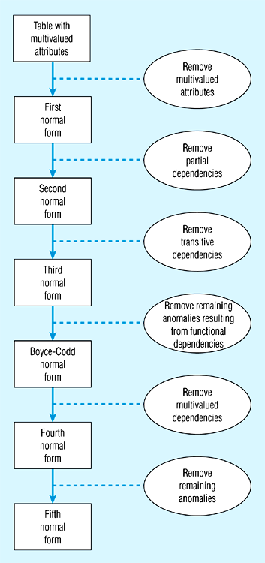
Data normalization
2NF is better than 1NF; 3NF is better than 2NF
For most business database design purposes, 3NF is as high as we need to go in normalization process
Highest level of normalization is not always most desirable

Slide 4
Functional dependencies and keys
Functional dependency: the value of one attribute (the determinant) determines the value of another attribute
A -> B, for every valid instance of A, that value of A uniquely determines the value of B
Candidate key: an attribute or combination of attributes that uniquely identifies an instance
Uniqueness: each non-key field is functionally dependent on every candidate key
Non-redundancy

Slide 5
Conversion to First Normal Form (continued)

Slide 6
First normal form
No multi-valued attributes.
Every attribute value is atomic.
The following in not in 1NF
EmpNum
EmpPhone
EmpDegrees
123
233-9876
333
233-1231
BA, BSc, PhD
679
233-1231
BSc, MSc

Slide 7
Second normal form
1NF and every non-key attribute is fully functionally dependent on the primary key.
Every non-key attribute must be defined by the entire key, not by only part of the key.
No partial functional dependencies.

Slide 8
Conversion to Second Normal Form

Slide 9
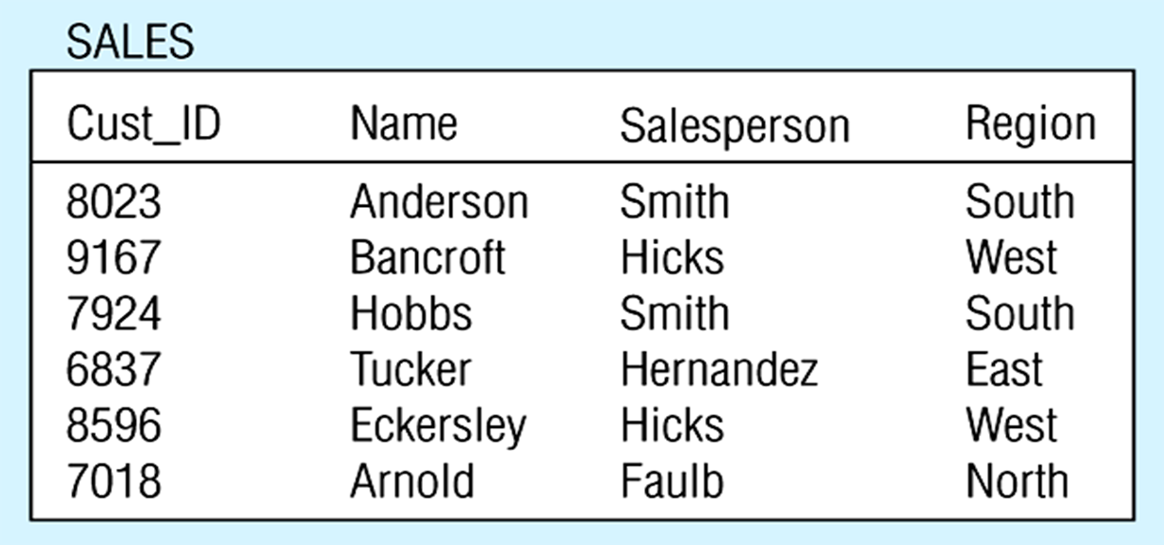
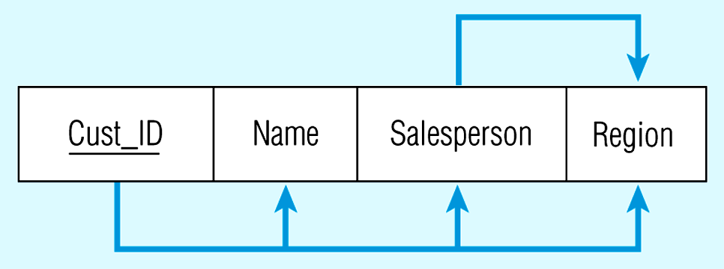
Third normal form
2NF and no transitive dependencies (functional dependency between non-key attributes.)

Slide 10
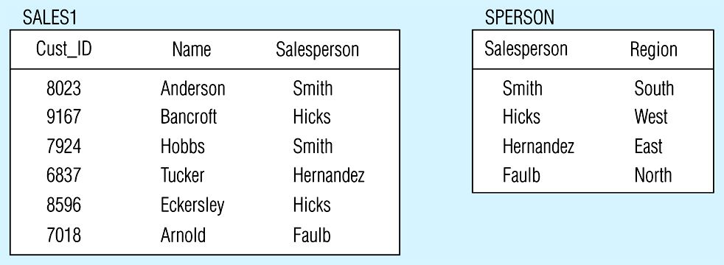
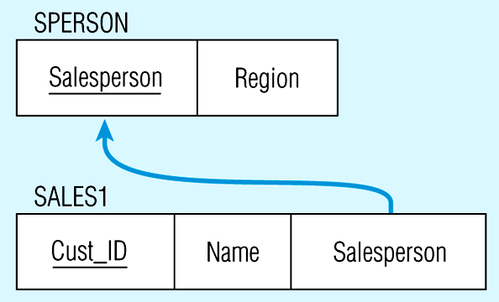
Removing a transitive dependency

Slide 11
Relations in 3NF

Slide 12
Conversion to Second Normal Form (continued)

Slide 13
The Boyce-Codd Normal Form (BCNF)
Every determinant in table is a candidate key
Has same characteristics as primary key, but for some reason, not chosen to be primary key
When table contains only one candidate key, the 3NF and the BCNF are equivalent
BCNF can be violated only when table contains more than one candidate key

Slide 14
The Boyce-Codd Normal Form (BCNF) (continued)
Most designers consider the BCNF as special case of 3NF
Table is in 3NF when it is in 2NF and there are no transitive dependencies
Table can be in 3NF and fails to meet BCNF
No partial dependencies, nor does it contain transitive dependencies
A nonkey attribute is the determinant of a key attribute

Slide 15
The Boyce-Codd Normal Form (BCNF) (continued)

Slide 16
The Boyce-Codd Normal Form (BCNF) (continued)

Slide 17
The Boyce-Codd Normal Form (BCNF) (continued)

