Slide 1
Basic SQL
Sampath Jayarathna
Cal Poly Pomona

Slide 2
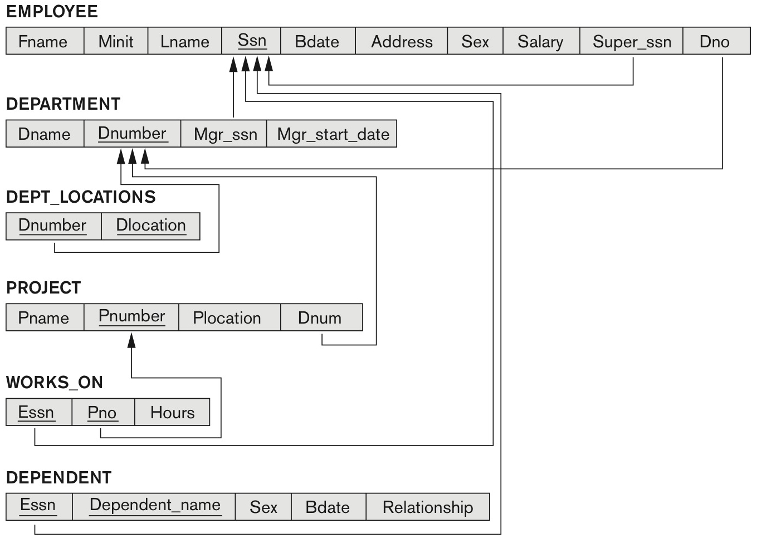
COMPANY relational database schema

Slide 3
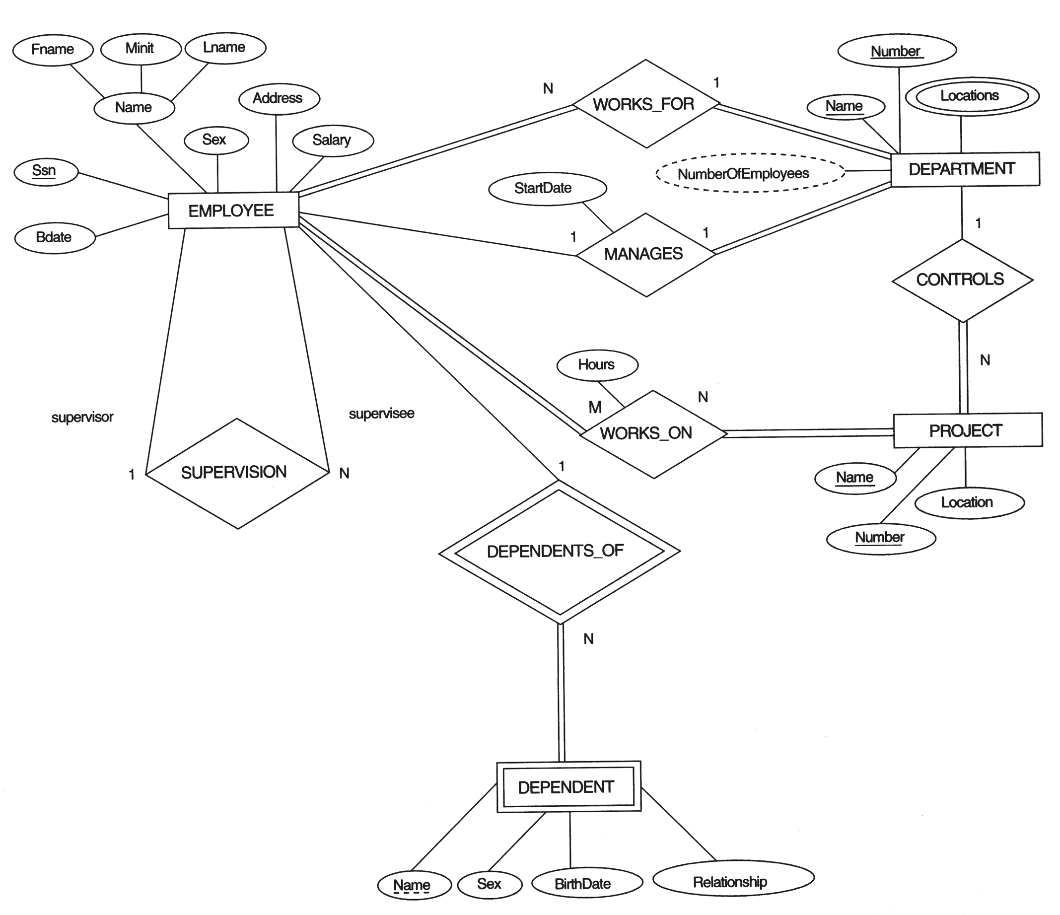
The ERD for the COMPANY database

Slide 4
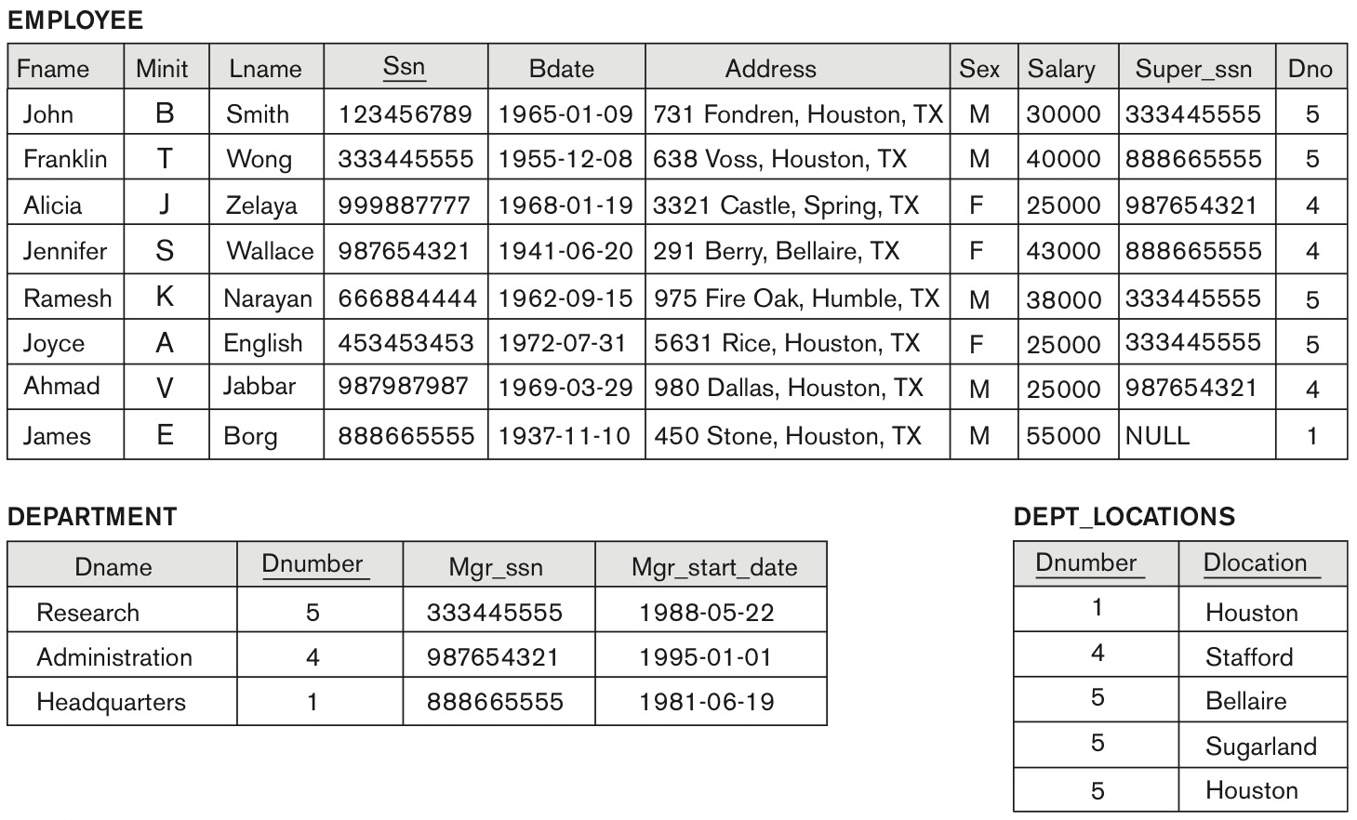
One possible database state for the COMPANY relational database schema

Slide 5
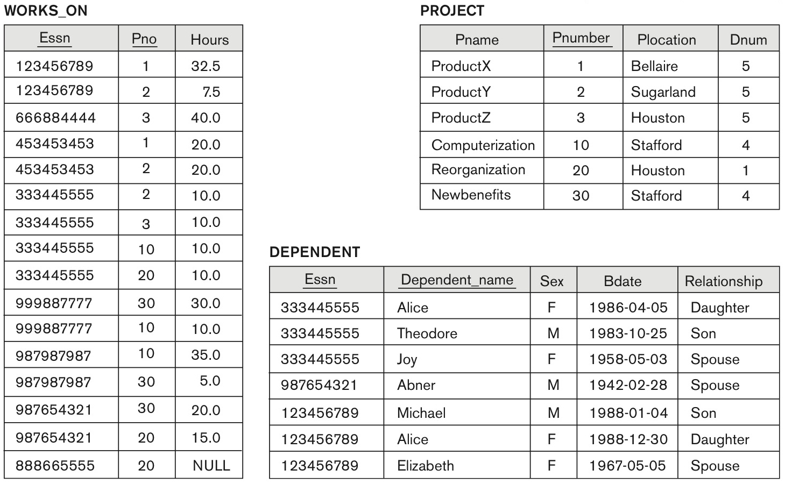
One possible database state for the COMPANY relational database schema – continued

Slide 6
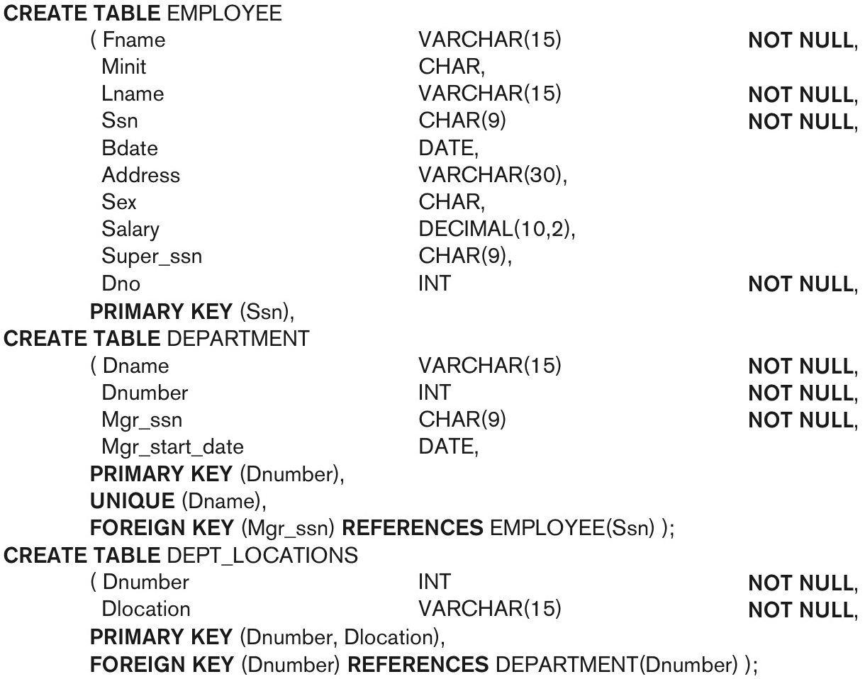
SQL CREATE TABLE data definition statements for defining the COMPANY schema
continued on next slide

Slide 7
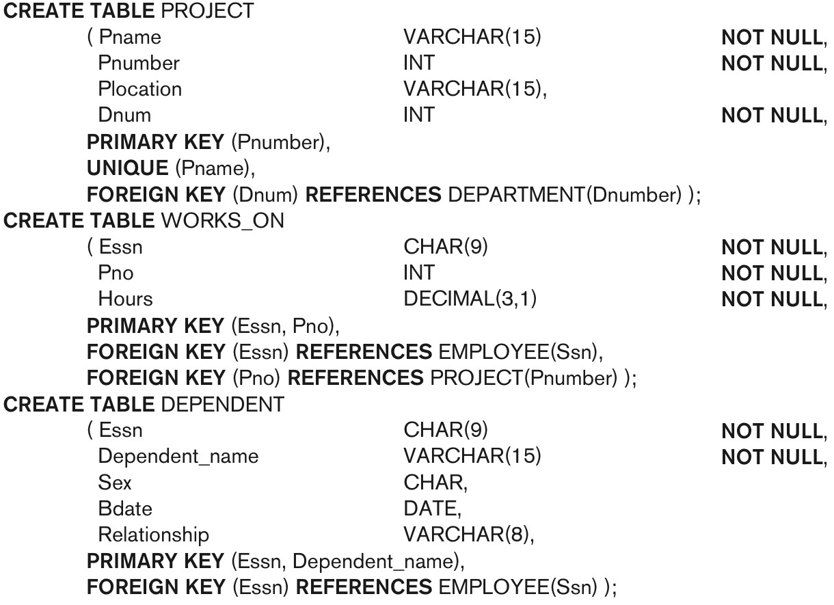
SQL CREATE TABLE data definition statements for defining the COMPANY schema -continued

Slide 8
Introduction to SQL
SQL functions fit into two broad categories:
Data definition language
SQL includes commands to:
Create database objects, such as tables, indexes, and views
Define access rights to those database objects
Data manipulation language
Includes commands to insert, update, delete, and retrieve data within database tables

Slide 9
Introduction to SQL (continued)
SQL is relatively easy to learn
Basic command set has vocabulary of less than 100 words
Nonprocedural language
American National Standards Institute (ANSI) prescribes a standard SQL
Several SQL dialects exist

Slide 10
Introduction to SQL (continued)

Slide 11
Introduction to SQL (continued)

Slide 12
Introduction to SQL (continued)

Slide 13
SQL(Builtin) Data Types
SQL
Data Types
Predefined
Types
Ref Types
Arrays
User-Defined
Types
ROW
Data Struct
Numeric
String
DateTime
Interval
Boolean
Date
Bit
Character
Blob
Exact
Approximate
Time
Fixed
Fixed
Varying
Timestamp
Varying
CLOB

Slide 14
Attribute Data Types and Domains in SQL
Additional data types
Timestamp data type
Includes the DATE and TIME fields
Plus a minimum of six positions for decimal fractions of seconds
Optional WITH TIME ZONE qualifier
INTERVAL data type
Specifies a relative value that can be used to increment or decrement an absolute value of a date, time, or timestamp
DATE, TIME, Timestamp, INTERVAL data types can be cast or converted to string formats for comparison.

Slide 15
Attribute Data Types and Domains in SQL
Domain
Name used with the attribute specification
Makes it easier to change the data type for a domain that is used by numerous attributes
Improves schema readability
Example:
CREATE DOMAIN SSN_TYPE AS CHAR(9);

Slide 16
Specifying Constraints in SQL
Basic constraints:
Relational Model has 3 basic constraint types that are supported in SQL:
Key constraint: A primary key value cannot be duplicated
Entity Integrity Constraint: A primary key value cannot be null
Referential integrity constraints : The “foreign key “ must have a value that is already present as a primary key, or may be null.

Slide 17
Common SQL Constrains
The following constraints are commonly used in SQL:
NOT NULL - Ensures that a column cannot have a NULL value
UNIQUE - Ensures that all values in a column are different
PRIMARY KEY - A combination of a NOT NULL and UNIQUE. Uniquely identifies each row in a table
FOREIGN KEY - Uniquely identifies a row/record in another table
CHECK - Ensures that all values in a column satisfies a specific condition
DEFAULT - Sets a default value for a column when no value is specified
INDEX - Used to create and retrieve data from the database very quickly

Slide 18
Specifying Key and Referential Integrity Constraints
PRIMARY KEY clause
Specifies one or more attributes that make up the primary key of a relation
Dnumber INT PRIMARY KEY;
UNIQUE clause
Specifies alternate (secondary) keys (called CANDIDATE keys in the relational model).
Dname VARCHAR(15) UNIQUE;
FOREIGN KEY clause
Default operation: reject update on violation
Attach referential triggered action clause
Options include SET NULL, CASCADE, and SET DEFAULT
Action taken by the DBMS for SET NULL or SET DEFAULT is the same for both ON DELETE and ON UPDATE
CASCADE option suitable for “relationship” relations

Slide 19
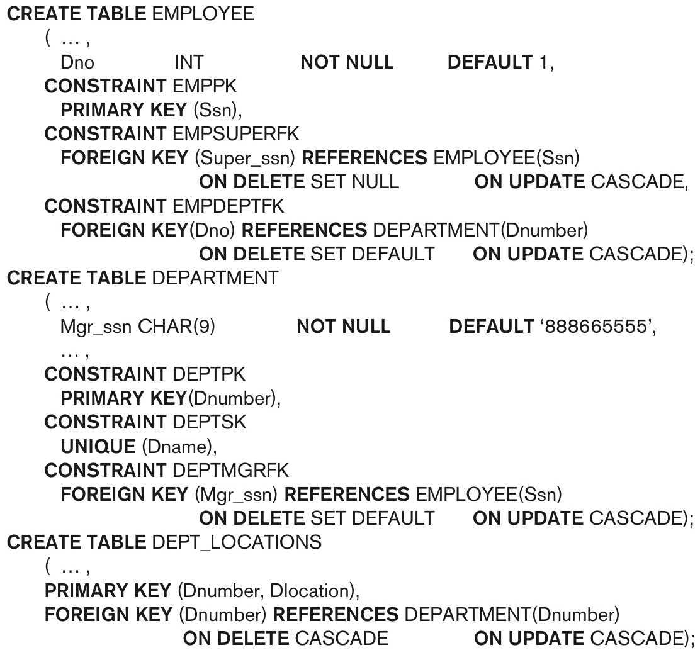
Giving Names to Constraints
Using the Keyword CONSTRAINT
Name a constraint
Useful for later altering
SQL will generate error message with the constraint name. With clear and descriptive names, its easier to understand the error.

Slide 20
Specifying Constraints on Tuples Using CHECK
Additional Constraints on individual tuples within a relation are also possible using CHECK
CHECK clauses at the end of a CREATE TABLE statement
Apply to each tuple individually
CHECK (Dept_create_date <= Mgr_start_date);

Slide 21
Class Activity 5
Consider the following relations for a database that keeps track of student enrollment in courses and the books adopted for each course:
STUDENT(SSN, Name, Major, Bdate)
COURSE(Course#, Cname, Dept)
ENROLL(SSN, Course#, Quarter, Grade)
BOOK_ADOPTION(Course#, Quarter, Book_ISBN)
TEXT(Book_ISBN, Book_Title, Publisher, Author)
Create a Database BOOKSTORE and relevant tables in MySQL.
Create relevant Constraints for PRIMARY key, FOREIGN key including referential integrity constraints

Slide 22
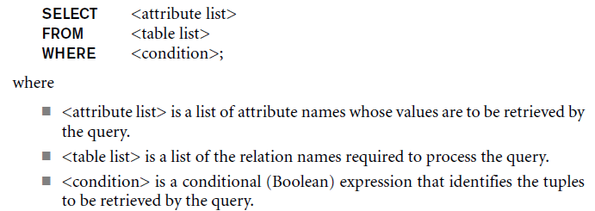
Basic Retrieval Queries in SQL
SELECT statement
One basic statement for retrieving information from a database
SQL allows a table to have two or more tuples that are identical in all their attribute values

Slide 23
The Structure of Basic SQL Queries
Logical comparison operators
=, <, <=, >, >=, and <>
Projection attributes
Attributes whose values are to be retrieved
Selection condition
Boolean condition that must be true for any retrieved tuple. Selection conditions include join conditions when multiple relations are involved.

Slide 24
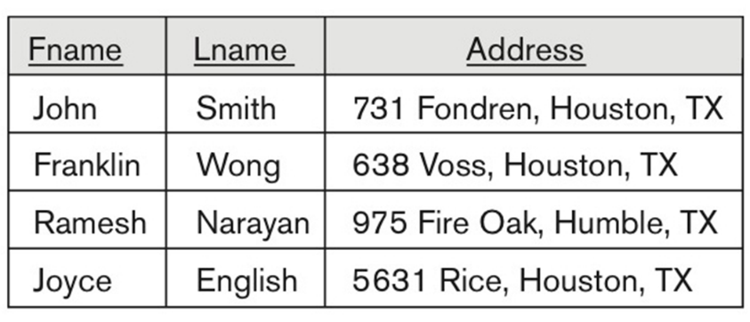
Basic Retrieval Queries

Slide 25
Basic Retrieval Queries (Contd.)

Slide 26
Ambiguous Attribute Names
Same name can be used for two (or more) attributes in different relations
As long as the attributes are in different relations
Must qualify the attribute name with the relation name to prevent ambiguity

Slide 27
Aliasing, and Renaming
Aliases or tuple variables
Declare alternative relation names E and S to refer to the EMPLOYEE relation twice in a query:
Query 8. For each employee, retrieve the employee’s first and last name and the first and last name of his or her immediate supervisor.
SELECT E.Fname, E.Lname, S.Fname, S.Lname
FROM EMPLOYEE AS E, EMPLOYEE AS S
WHERE E.Super_ssn=S.Ssn;
Recommended practice to abbreviate names and to prefix same or similar attribute from multiple
The attribute names can also be renamed
EMPLOYEE AS E(Fn, Mi, Ln, Ssn, Bd, Addr, Sex, Sal, Sssn, Dno)
Note that the relation EMPLOYEE now has a variable name E which corresponds to a tuple variable
The “AS” may be dropped in most SQL implementations

Slide 28
Unspecified WHERE Clause
Missing WHERE clause
Indicates no condition on tuple selection
Effect is a CROSS PRODUCT
Result is all possible tuple combinations result

Slide 29
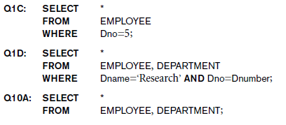
Use of the Asterisk
Specify an asterisk (*)
Retrieve all the attribute values of the selected tuples

Slide 30
Arithmetic Operations
Standard arithmetic operators:
Addition (+), subtraction (–), multiplication (*), and division (/) may be included as a part of SELECT
Show the resulting salaries if every employee working on the ‘ProductX’ project is given a 10 percent raise.
SELECT E.Fname, E.Lname, 1.1 * E.Salary AS Increased_sal
FROM EMPLOYEE AS E, WORKS_ON AS W, PROJECT AS P
WHERE E.Ssn=W.Essn AND W.Pno=P.Pnumber AND P.Pname=‘ProductX’;

Slide 31
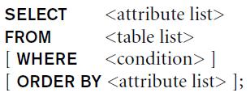
Ordering of Query Results
Use ORDER BY clause
Keyword DESC to see result in a descending order of values
Keyword ASC to specify ascending order explicitly
Typically placed at the end of the query
ORDER BY D.Dname DESC, E.Lname ASC, E.Fname ASC

Slide 32
Grouping of Query Results
Use Group BY clause
GROUP BY will aggregate records by the specified columns which allows you to perform aggregation functions on non-grouped columns (such as SUM, COUNT, AVG, etc).
SELECT Count(Ssn),Lname
FROM EMPLOYEE
GROUP BY Lname

Slide 33
Tables as Sets in SQL
SQL does not automatically eliminate duplicate tuples in query results
For aggregate operations duplicates must be accounted for
Use the keyword DISTINCT in the SELECT clause
Only distinct tuples should remain in the result

Slide 34
INSERT, DELETE, and UPDATE Statements
Three commands used to modify the database:
INSERT, DELETE, and UPDATE
INSERT typically inserts a tuple (row) in a relation (table)
UPDATE may update a number of tuples (rows) in a relation (table) that satisfy the condition
DELETE may also update a number of tuples (rows) in a relation (table) that satisfy the condition

Slide 35
INSERT
In its simplest form, it is used to add one or more tuples to a relation
Attribute values should be listed in the same order as the attributes were specified in the CREATE TABLE command
Constraints on data types are observed automatically
Any integrity constraints as a part of the DDL specification are enforced

Slide 36
The INSERT Command
Specify the relation name and a list of values for the tuple. All values including nulls are supplied.
The variation below inserts multiple tuples where a new table is loaded values from the result of a query.

Slide 37
DELETE
Removes tuples from a relation
Includes a WHERE-clause to select the tuples to be deleted
Referential integrity should be enforced
Tuples are deleted from only one table at a time (unless CASCADE is specified on a referential integrity constraint)
A missing WHERE-clause specifies that all tuples in the relation are to be deleted; the table then becomes an empty table
The number of tuples deleted depends on the number of tuples in the relation that satisfy the WHERE-clause

Slide 38
The DELETE Command
Removes tuples from a relation
Includes a WHERE clause to select the tuples to be deleted. The number of tuples deleted will vary.

Slide 39
UPDATE
Used to modify attribute values of one or more selected tuples
A WHERE-clause selects the tuples to be modified
An additional SET-clause specifies the attributes to be modified and their new values
Each command modifies tuples in the same relation
Referential integrity specified as part of DDL specification is enforced

Slide 40
UPDATE
Example: Change the location and controlling department number of project number 10 to 'Bellaire' and 5, respectively
U5: UPDATE PROJECT SET PLOCATION = 'Bellaire', DNUM = 5 WHERE PNUMBER=10

Slide 41
Summary
SQL
A Comprehensive language for relational database management
Data definition, queries, updates, constraint specification, and view definition
Covered :
Data definition commands for creating tables
Commands for constraint specification
Simple retrieval queries
Database update commands

