Slide 1
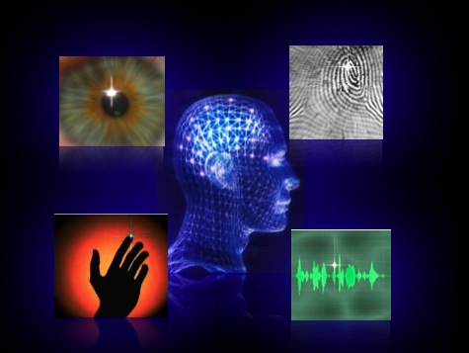
Oculomotor Plant Biometrics:
Person-Specific Features in Eye Movements
Ukwatta Sam Jayarathna±, Cecilia Aragon*, Oleg Komogortsev±
*Lawrence Berkeley National Laboratory, ±Texas State University – San Marcos

Slide 2
Outline
Biometrics : Past , Present, and Future
Human Eye & Biometrics, is it possible?
Oculomotor Plant & Eye movements
2DOPMM, stands for???
Eye tracking Technology
Statistical Significance
Dead Ends………..
Bahill, Oculomotor coefficients, and Error Minimization
Eye Movement Features & Classification
Berkeley Lab internship : What I learned
Q & A
Thanks

Slide 3
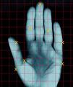
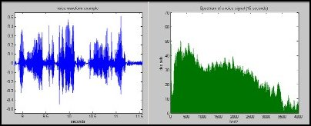
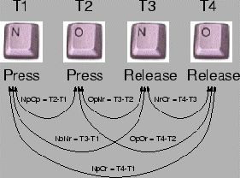
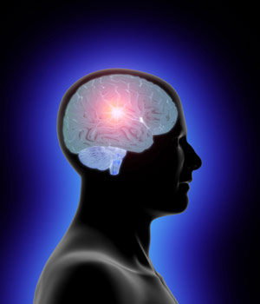
Biometrics : Past , Present, and Future
Biometrics refers to methods for uniquely recognizing humans based upon one or more intrinsic physical or behavioral traits
Two main classes,
Physiological, related to the shape of the body.
Behavioral, related to the behavior of a person.

Slide 4
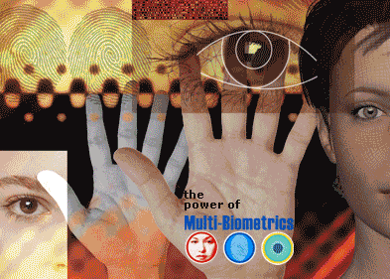
Biometrics : Past , Present, and Future
Physiological
Hand & Palm Prints and geometry
Fingerprints
Vascular (Vein) patterns
Face/Iris
Voice/Speech
Odor/Scent
DNA
Behavioral
Brain Waves
Voice/Speech
Typing rhythm, handwriting, & Signature
Gait analysis (human locomotion)
Eye Movements ???

Slide 5
Human Eye & Biometrics, is it possible?
Movie – Minority Report
Clip 1
Clip 2

Slide 6
Role of eye movements in Biometrics
Most popular biometrics like fingerprint verification or iris recognition are based on physiological properties of human body.
It makes it possible to identify an unconscious or even a dead person.
Physiological properties vulnerable to forging.
Eye Movements combine both physiological (muscle) and behavioral (brain) aspects.
Eye movement based identification uses information mostly produced by the brain, and so far impossible to imitate.

Slide 7
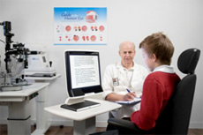
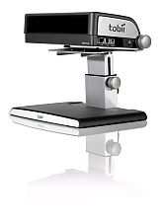
Eye tracking technology
Tobii T120 Tobii x120
Eye Movements :
1. Saccades
2. Fixations
3. Smooth Pursuits
4. Optokinetic reflex, Vestibule-ocular reflex, and Vergence
Eye Movement detection Algorithms: I-VT, I-HMM, I-KF, I-MST

Slide 8
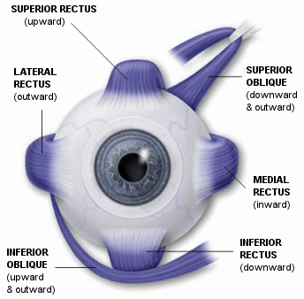
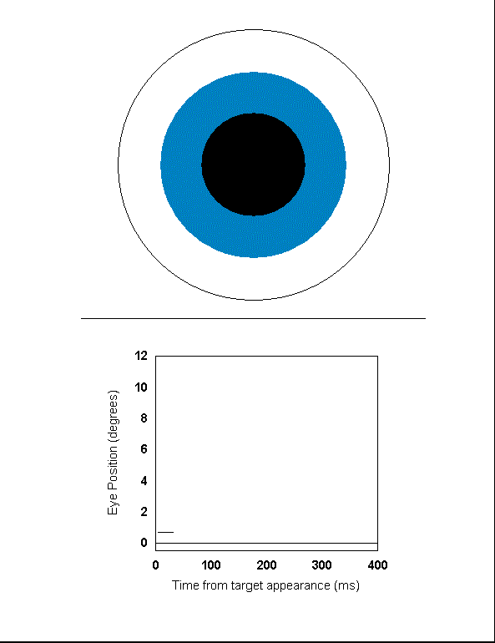
Oculomotor Plant & Eye movements
Human Visual System

Slide 9
2DOPMM, stands for???
Two-Dimensional Oculomotor Plant Mechanical Model (2DOPMM)
Initial
Moving Right Upward
Muscle projections
Reference :
Bahill (1980)
Komogortsev (2004)
Jayarathna, Komogortsev (2008)

Slide 10
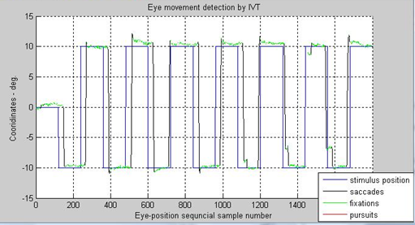
Statistical Significance
2DOPMM verification against subject data.
How significant the difference between recorded subject saccades and predicted 2DOPMM saccades? Null Hypothesis: There is no significant difference between recorded and predicted saccades
Statistical Analysis : Chi-square test, RMSE, Regression Analysis
Subjects | RMSE | R²
1D HR | 0.8783 | 0.9361
1D VR | 0.9289 | 0.9219
2D | 0.9163 | 0.9061

Slide 11
Dead ends (frustrations & joys of research)
2DOPMM reverse engineering
Obtain initial coefficients from the model prediction.
Series Elasticity displacement value of oculomotor muscles
What went wrong?
No statistical significance (of the values) between different subjects
Saccadic amplitude
Verify different subject saccadic amplitudes are different and same subject no significant difference.
What went wrong?
No statistical significance (of the values) between different subjects
Research can be very rewarding and very frustrating, like a roller-coaster with tremendous highs and tremendous lows.

Slide 12
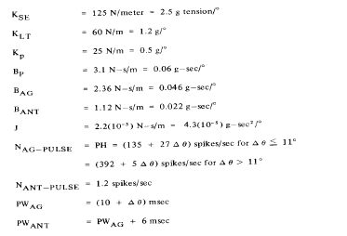
Bahill, Oculomotor Coefficients, & Error Minimization
Bahill (Development, Validation, and Sensitivity Analysis of Human Eye Movement Models, 1980)
Coefficients in the Bahills model are derived from the data from one patient during strabismus correction surgery (surgery on the extra-ocular muscles to correct the misalignment of eyes).

Slide 13
Bahill, Oculomotor Coefficients, & Error Minimization
Error Function : RMSE
Minimization Algorithm : Levenberg-Marquardt algorithm
Method: Minimize the RMSE and obtain optimized oculomotor coefficients.
K_se
K_lt
B_p
B_ag
K_p
J

Slide 14
Research Findings
Oculomotor Bahill coefficient values for same subject with no significant difference (accept the null hypothesis).
Coefficient of Variation (CoV) of the Oculomotor Bahill coefficients values for different subjects with significant difference (reject null hypothesis).
Important alternative finding (apart from the Biometrics):
There is a significant difference between the Bahill “Golden Standard” and 2DOPMM coefficients.

Slide 15
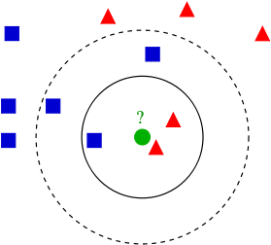
Eye Movement features & Classification
Output features: Oculomotor coefficient vector (Average, Std, and CoV value for each coefficient)
What next???? Classification
Training Samples Vs Testing Samples
Possible Algorithms: K-NN, C4.5, Naïve Bayes
Work in progress
Ex: K-NN with K=3

Slide 16
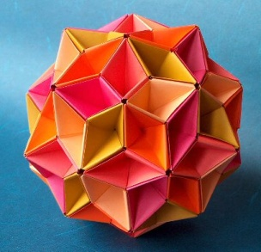
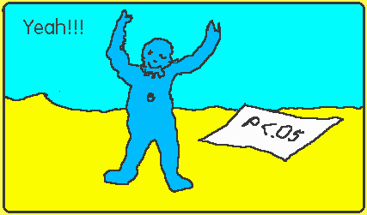
What I learned from : Berkeley Lab Internship
Model Evaluation (statistical significance)
Research Collaboration
Never Give-up
Think out side the box!
Life outside the Research (Unit Origami, experiments with cooking )

Slide 17
Q & A

Slide 18
Thanks
LBNL
Cecilia Aragon
Deb Agarwal
Craig Evan (Math, UC Berkeley)
Gail Maeda
Maria Maroudas
Terry Ligocki
Marcia Ocon Leimer
Texas State
Oleg Komogortsev
Denise Gobert
Do Hyong Koh
Sandeep Gowda
Taylor Groves
Stephen Gross
Nirmala Karunarathna
LBNL – Student Interns
Jacob, Jie, Andy, Manav, Sowmya, Kevin Bauer, Aaron, Kaustubh, Jan
This research is partially supported by Sigma Xi : The Scientific Research Society Grant-In-Aid of Research program grants G200810150639, G2009102034, and Texas State University – San Marcos.

