Slide 1

Unified Relevance Feedback for Multi-Application User Interest Modeling
Sampath Jayarathna
PhD Candidate
Computer Science & Engineering

Slide 2
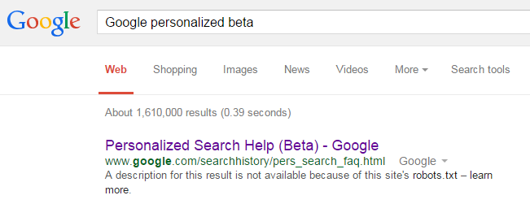
Introduction
Methodology
Design
Results
Conclusion
Motivation
Search Personalization
  Web search history (query data) : “privacy”

Slide 3
Motivation
How to build a user interest model without web search history?
  Relevance feedback

Slide 4

Goals
A unified user interest model combining implicit and semi-explicit feedback
A user model based on multiple everyday applications
A user model to predict explicit ratings from the estimated unified feedback

Slide 5
Hypothesis
Unified feedback across multiple applications will result in more accurate and rapid assessment of document than available through either implicit or semi-explicit feedback alone.

Slide 6
Background
 | Centralized | Distributed
Feature-based | PersonisAD, UMS | Mypes, Life-log sharing
Content-based | IPM | G-profile, CUMULATE
Our approach
  Content encountered (not pre-agreed)
  No pre-defined interest/taxonomy required
  No pair-wise alignment rules for applications

Slide 7

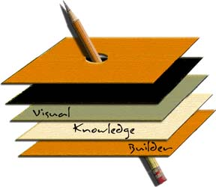




Introduction
Methodology
Design
Results
Conclusion
User Behavior
Consumption
Applications
Production
Applications

Slide 8
User Models
Baseline model (text edited from production applications)
Semi-explicit model (baseline + text annotated from consumption applications)
Unified model (baseline + semi-explicit + implicit feedback)

Slide 9
System Architecture

Slide 10
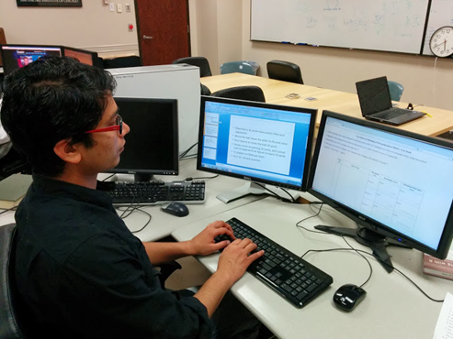
Introduction
Methodology
Design
Results
Conclusion
User Study
Task No | Task Name | Mean and Variance
1 | How does Google Glass work? | 3.55 ± 0.96
2 | What is mars one project? | 3.23 ± 1.11
3 | How to improve your credit score? | 3.53 ± 0.98
4 | What are the rules of American football? | 3.52 ± 1.01
4 simulated search tasks (30 minutes per task)
Multiple everyday applications (Word, Powerpoint, Firefox web browser)
31 undergraduate and graduate students

Slide 11
Evaluation
Explicit feedback
  Paragraph relevance score (1~5)
  Page relevance score (1~5)
Root Mean Squared Error (RMSE)
  Smaller RMSE Better performance
  Page relevance score (user assigned)
  System predicted score

Slide 12
Introduction
Methodology
Design
Results
Conclusion
Results
 | Page-Level RMSE
 | Task-1 | Task-2 | Task-3 | Task-4
Baseline | 1.180 | 1.315 | 1.239 | 1.515
Semi-Explicit | 1.126 | 1.326 | 1.258 | 1.463
Unified | 1.097 | 1.198 | 1.162 | 1.388
Baseline, Semi-explicit, p=0.414
Baseline, Unified, p=0.0037
Semi-explicit, Unified, p=0.0287

Slide 13
Results

Slide 14
Introduction
Methodology
Design
Results
Conclusion
Conclusion
Multi-application modeling technique unifying implicit and semi-explicit relevance feedback
Significant improvement over baseline and semi-explicit models. (Validates our hypothesis)
Future work: how to combine semi-explicit feedback with implicit feedback in segment-level (paragraph, sections…..)

Slide 15
Practical Implications
First software framework designed to share unified feedback among applications
Support wide range of applications
Easily extendable to other sensory inputs
e.g. Eye tracking, face/gesture detection

Slide 16

Acknowledgement
Prof. Frank Shipman, CSE, Texas A&M
Dr. Soonil Bae, Samsung Research
Prasanth Ganta, Amazon
Atish Patra, Qualcomm
Sampath Jayarathna, Atish Patra, and Frank Shipman. "Unified Relevance Feedback for Multi-Application User Interest Modeling", Proceedings of ACM & IEEE Joint Conference on Digital Libraries (JCDL)
Sampath Jayarathna, Atish Patra, and Frank Shipman. "Mining User Interest from Search Tasks and Annotations", ACM Conference on Information and Knowledge Management (CIKM)

