Slide 1
Linear Regression

Slide 2
Regression
Predict a value of a real-valued variable (y) based on the values of other variables known as features (X = {x₁,⋯, x_{p}}), assuming a certain model of dependency.
In statistics, find a model to predict the response or dependent variable (y) as a function (f) of the values of independent variables(X), mathematically, y = f(X).
Goal: previous unseen examples should be predicted as accurately as possible.
Usually, the given data set is divided into training and test sets, with training set used to build the model and test set used to validate it.

Slide 3
Model Representation
x^{i} -> input y^{i} -> output
Pair (x^{i}, y^{i}) is the training example
Training set: (x^{i}, y^{i}); i = 1, 2, 3…..m
Goal is, given a training set, to learn a function
h: X -> Y Here h hypothesis and is a good predictor for corresponding value of y.

Slide 4
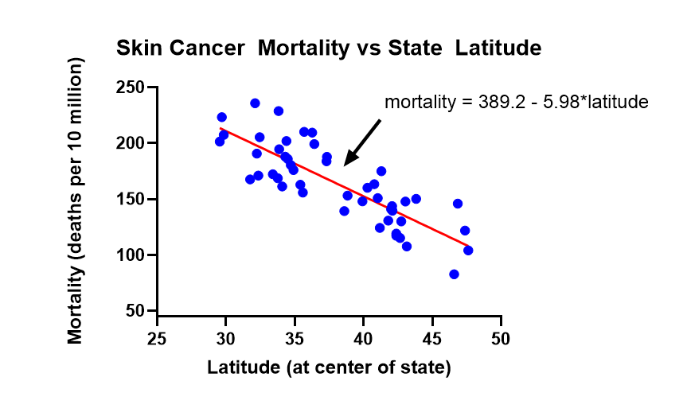
Regression example
Source

Slide 5
Linear Regression
The regression function h is assumed to be linear
h$θ$(x^{(i)}) = 𝜃₀ + 𝜃₁ * x^{(i)}

Slide 6
Cost function
It measures the accuracy of our hypothesis function
J(𝜃_{0,}𝜃₁) = $\frac{1}{2m} \sum_{i=1}^{m}{ (\text{h}θ\text{(}\text{x}\text{(}\text{i}\text{)}\text{)}−yi)}$²
It is also called Square error function or Mean Squared error. The goal is to keep it as minimum as possible.
$\frac{1}{2m} \sum_{i=1}^{m}{ (\text{h}θ\text{(}\text{x}\text{(}\text{i}\text{)}\text{)}−yi)}$²
minimize
𝜃_{0,}𝜃₁

Slide 7
Gradient descent
Iterative optimization algorithm to find the minimum of a function. Here that function is our Loss Function. Algorithm:
$\frac{δ}{δθJ}$ J(𝜃_{0,}𝜃₁) = $\frac{δ}{δθJ}$ $\frac{1}{2m} \sum_{i=1}^{m}{ (\text{h}θ\text{(}\text{x}\text{(}\text{i}\text{)}\text{)}−yi)}$²
Repeat until convergence: {
𝜃₀ := 𝜃₀ - $α ∗\frac{1}{m} \sum_{i=1}^{m}{ (\text{h}θ\text{(}\text{x}\text{(}\text{i}\text{)}\text{)}−yi)}$²
𝜃₁ := 𝜃₁ - $α ∗\frac{1}{m} \sum_{i=1}^{m}{ \text{x}\text{(}\text{i}\text{)}∗(\text{h}θ\text{(}\text{x}\text{(}\text{i}\text{)}\text{)}−yi)}$²
}
Here $α$ is learning rate.

Slide 8
Gradient descent example
Here 𝜃₁ = m and 𝜃₀ = c
source

