Slide 1
Text Classification

Slide 2
Why text classification?
Monitoring Events
E.g. “Explosion in the middle east”
You want to find new news items on this topic
You will be sent new news arcticles
I.e., it’s not ranking but classification (relevant vs. not relevant)

Slide 3
Spam filtering Another text classification task
From: "" <sagikun@gmail.com>
Subject: Lose weight in 10 days
1 miracle pill a day will change your life.
Change your life NOW !
=================================================
Click Below to order:
http://www.youareafool.com/sales/pill.htm
=================================================

Slide 4
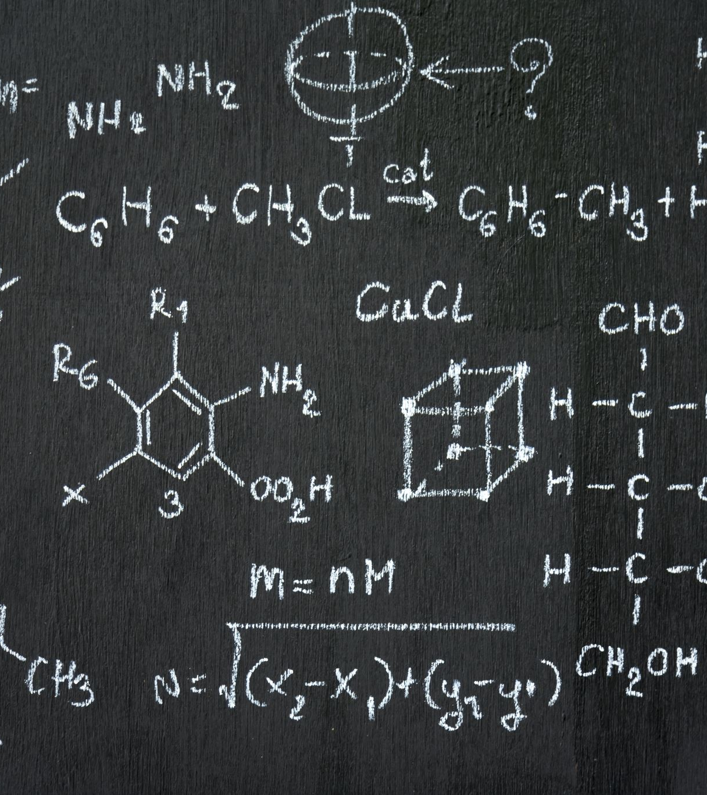
Categorization/Classification
Given:
A representation of a document d
Issue: how to represent text documents.
Usually some type of high-dimensional space – bag of words
A fixed set of classes:
C = {c₁, c₂,…, c_{J}}
Determine:
The category of d: γ(d) ∈ C, where γ(d) is a classification function
We want to build classification functions (“classifiers”).

Slide 5
Classification Techniques
Manual classification
Used by the original Yahoo! Directory
Looksmart, about.com, ODP, PubMed
Accurate when job is done by human experts
Consistent when the problem size is small
Difficult and expensive to scale
Implies we need automatic classification methods

Slide 6
Classification Techniques
Hand-coded rule-based classifiers
One technique used by new agencies, intelligence agencies, etc.
Widely deployed in government and enterprise
Vendors provide “IDE” for writing such rules

Slide 7
Classification Techniques
Hand-coded rule-based classifiers
Commercial systems have complex query languages
Accuracy can be high if a rule has been carefully refined over time by a subject expert
Building and maintaining these rules is expensive

Slide 8
Supervised learning
Given:
A document d
A fixed set of classes:
C = {c₁, c₂,…, c_{J}}
A training set D of documents each with a label in C
Determine:
A learning method or algorithm which will enable us to learn a classifier γ
For a test document d, we assign it the class
γ(d) ∈ C

Slide 9
Classification Techniques
Supervised learning
Naive Bayes (simple, common) – see video
k-Nearest Neighbors (simple, powerful)
Support-vector machines (new, generally more powerful)
No free lunch: requires hand-classified training data
But data can be built up (and refined) by amateurs
Many commercial systems use a mixture of methods

Slide 10
The bag of words representation
I love this movie! It's sweet, but with satirical humor. The dialogue is great and the adventure scenes are fun… It manages to be whimsical and romantic while laughing at the conventions of the fairy tale genre. I would recommend it to just about anyone. I've seen it several times, and I'm always happy to see it again whenever I have a friend who hasn't seen it yet.
γ(
)=c

Slide 11
The bag of words representation
great | 2
love | 2
recommend | 1
laugh | 1
happy | 1
... | ...
γ(
)=c

Slide 12
Features
Supervised learning classifiers can use any sort of feature
URL, email address, punctuation, capitalization, dictionaries, network features
In the bag of words view of documents
We use only word features
we use all of the words in the text (not a subset)

Slide 13
Feature Selection: Why?
Text collections have a large number of features
10,000 – 1,000,000 unique words … and more
Selection may make a particular classifier feasible
Some classifiers cannot deal with 1,000,000 features
Reduces training time
Training time for some methods is quadratic or worse in the number of features
Makes runtime models smaller and faster
Can improve generalization (performance)
Eliminates noise features
Avoids overfitting

Slide 14
Feature Selection: Frequency
The simplest feature selection method:
Just use the most common terms
No particular foundation
But it make sense why this works
They are the words that can be well-estimated and are most often available as evidence
In practice, this is often 90% as good as a better method

Slide 15
Evaluating Categorization
Evaluation must be done on test data that is independent of the training data
Sometimes use cross-validation (averaging results over multiple training and test splits of the overall data)
Easy to get good performance on a test set that was available to the learner during training (e.g., just memorize the test set)

Slide 16
Evaluating Categorization
Measures: precision, recall, F1, classification accuracy
Classification accuracy: r/n where n is the total number of test docs and r is the number of test docs correctly classified

Slide 17
WebKB Experiment (1998)
Classify webpages from CS departments into:
student, faculty, course, project
Train on ~5,000 hand-labeled web pages
Cornell, Washington, U.Texas, Wisconsin
Crawl and classify a new site (CMU) using Naïve Bayes

Slide 18
Spam Assassin – Early Work
Naïve Bayes for spam filtering
Paul Graham’s A Plan for Spam
Widely used in spam filters
But many features beyond words:
black hole lists, etc.
particular hand-crafted text patterns

Slide 19
Naive Bayes is Not So Naive
Very fast learning and testing (basically just count words)
Low storage requirements
Very good in domains with many equally important features
More robust to irrelevant features than many learning methods
Irrelevant features cancel each other without affecting results

Slide 20
Classification Using Vector Spaces
In vector space classification, training set corresponds to a labeled set of points (equivalently, vectors)
Premise 1: Documents in the same class form a contiguous region of space
Premise 2: Documents from different classes don’t overlap (much)
Learning a classifier: build surfaces to delineate classes in the space

Slide 21
Documents in a Vector Space
Government
Science
Arts

Slide 22
Test Document of what class?
Sec.14.1
Government
Science
Arts

Slide 23
Test Document = Government
Government
Science
Arts
Find good separators

Slide 24
CLASSIFIERS
SVM
Random Forest
CNN
LSTM

Slide 25
Yet another Project IDEA
Success/Failure of Online Light Novels

