Slide 1
Next Generation Assistive Technologies using Artificial Intelligence
Vikas Ashok
Assistant Professor
Old Dominion University
Presented By:-
Contributors: Utku Uckun, Hae-Na Lee (Stony Brook University)

Slide 2
About Me: Quick Introduction
Assistant Professor (2019 - Present)
Department of Computer Science, Old Dominion University
PhD – Stony Brook University (2018)
MS – Old Dominion University (2011)
Research Interests:
Accessible Computing,
Natural Language Processing,
Machine Learning,
Health Informatics
Next Generation Assistive Technologies using Artificial Intelligence
1
Notes:
-Here is an overview of my presentation.
-First I’ll talk about the first contribution of this proposal which is about PDF form accessibility with HTML overlays
-Second contribution is user-interface accessibility with AccessBolt interface
-

Slide 3
Overview
Motivation
PDF Form Accessibility with HTML Overlay
Breaking the Accessibility Barrier in Non-Visual Interaction with PDF Forms.
User-Interface Accessibility with AccessBolt Overlay
Taming User-Interface Heterogeneity with Uniform Overlays for Blind Users.
Future Research Ideas
Next Generation Assistive Technologies using Artificial Intelligence
2
Notes:
-Here is an overview of my presentation.
-First I’ll talk about the first contribution of this proposal which is about PDF form accessibility with HTML overlays
-Second contribution is user-interface accessibility with AccessBolt interface
-

Slide 4
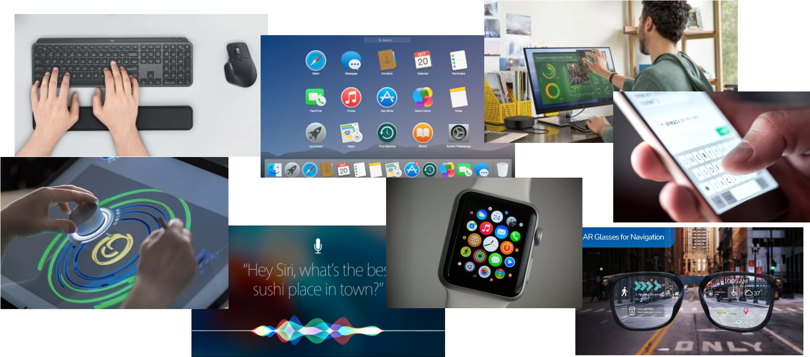
Human Computer Interaction
Next Generation Assistive Technologies using Artificial Intelligence
3
Notes:
My research broadly falls under Human-Computer Interaction. For those who are unfamiliar with HCI, it is “a discipline that is concerned with the design, evaluation, and implementation of interactive computing systems for human use and with the study of major phenomena surrounding them”.
It includes studying how humans interact with computers, and designing interfaces and interactive technologies that enable humans to interact with computers in novel ways while satisfying their needs.

Slide 5
Accessible Computing
Next Generation Assistive Technologies using Artificial Intelligence
4
Notes:
So, there is a separate sub-field in HCI dedicated to understanding the interaction needs of people with disabilities. Accessible computing focuses on the accessibility of a computer system to all people, regardless of disability type or severity of impairment. This is my research area, and I specifically focus on people with visual disabilities.

Slide 6
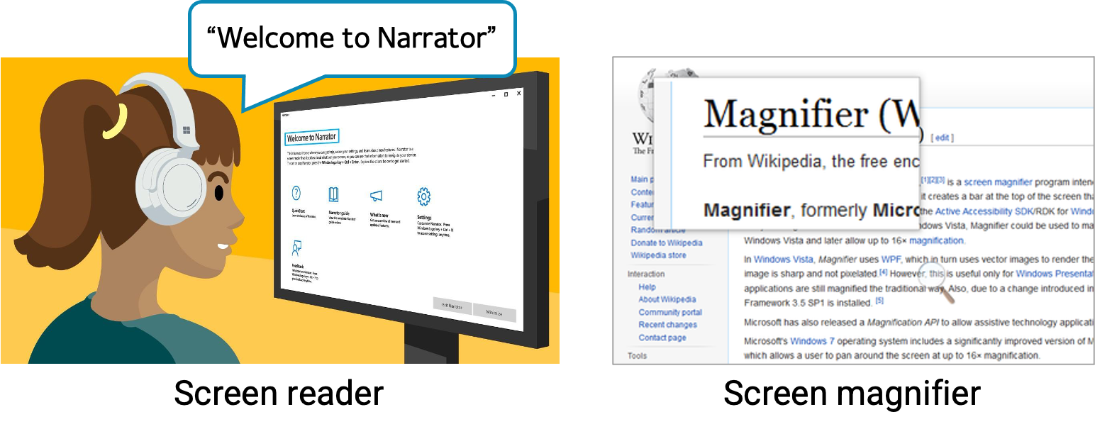
Assistive Technology for Visually-Impaired Users
Next Generation Assistive Technologies using Artificial Intelligence
5
Notes:
Depending on the extent of impairment, people with visual impairments will either use a screen reader or a screen magnifier to interact with computer applications.
Specifically, blind people use a screen reader that serially narrates application content, and people with low vision utilize a screen magnifier that enlarges screen content, as shown in the figures.

Slide 7
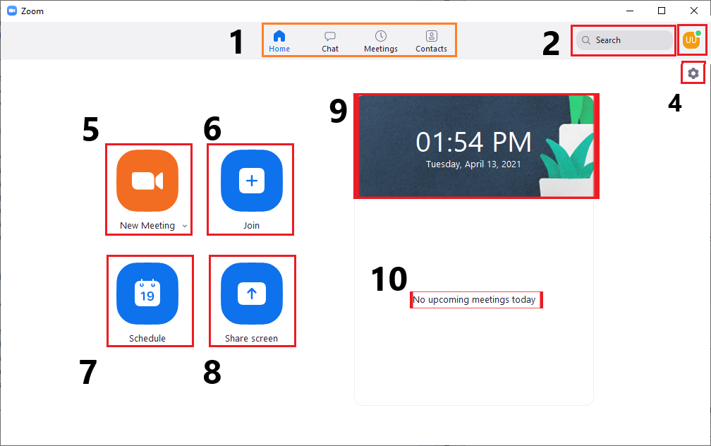
Motivation | Background
There are 253 million people with Visual Impairments worldwide
People with visual impairments rely on assistive technologies to interact with computers
Screen readers narrate the content on the screen
Provide keyboard shortcuts for serial navigation
Next Element:
Previous Element:
Next Generation Assistive Technologies using Artificial Intelligence
6
Notes:
-63 million of them are considered blind
-both in personal and professional settings
-screen reader are such software

Slide 8
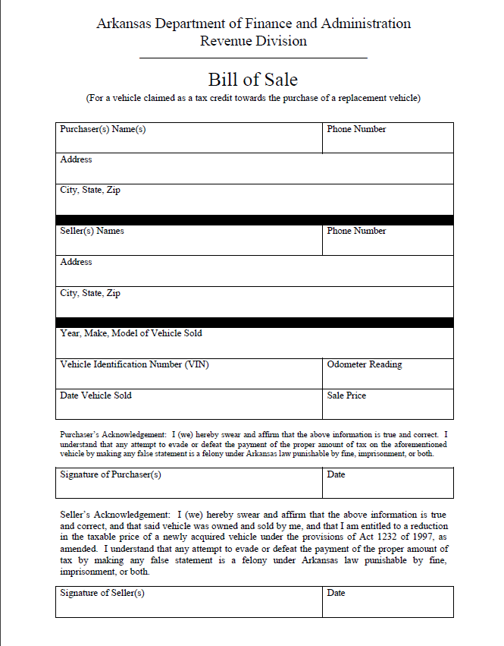
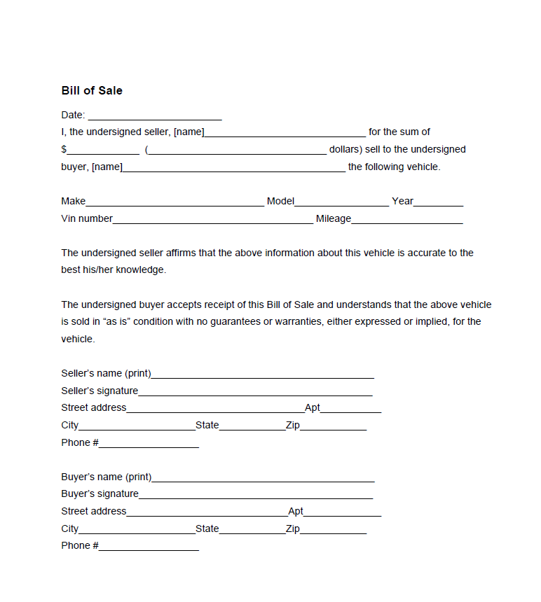
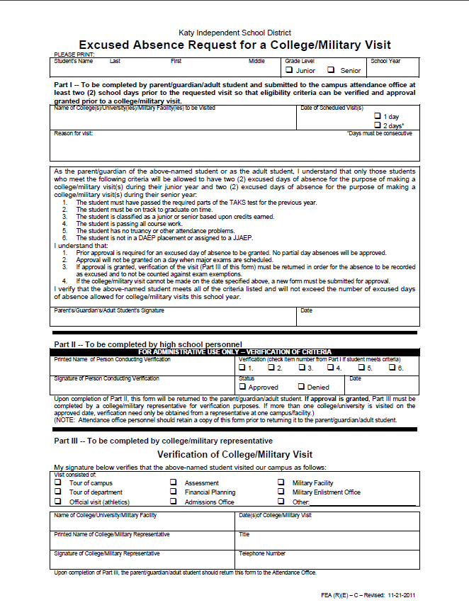
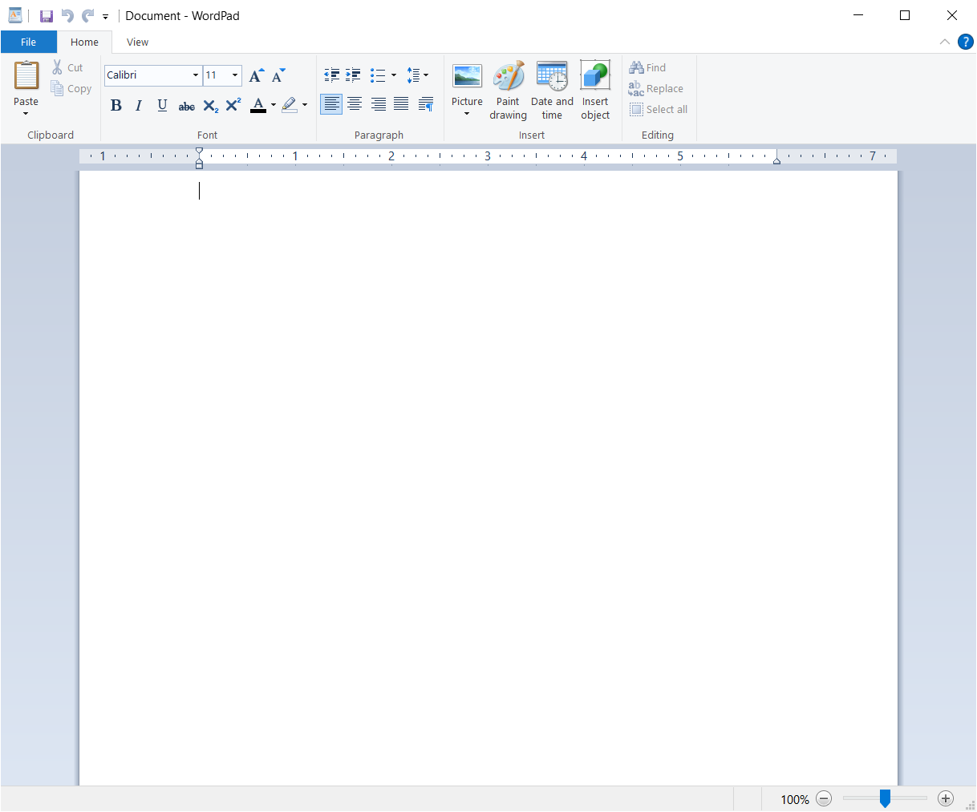
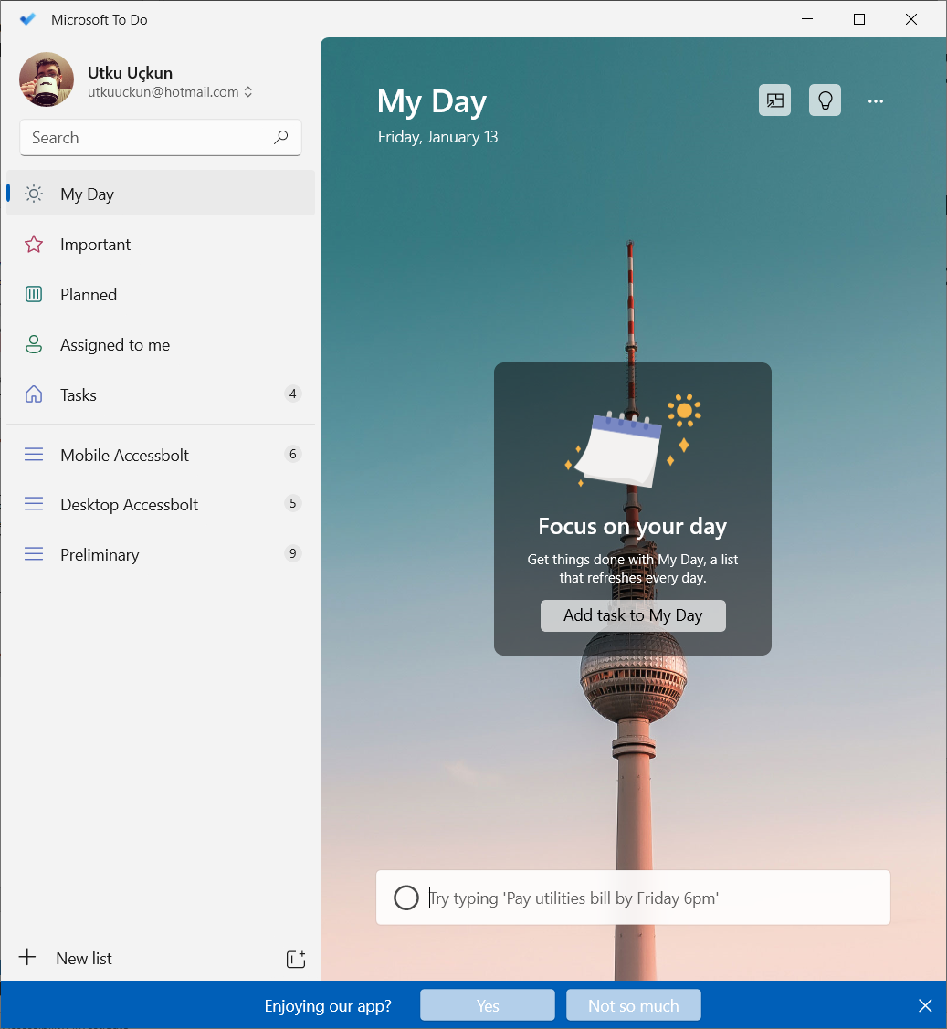
Motivation | Usability Issues
Non-visual interaction is overlooked while designing documents and applications
Leads to interaction heterogeneity across application and documents
PDF document forms
Software application user interface
Heterogeneity puts mental burden
on the blind users
Learning
Memorizing
Next Generation Assistive Technologies using Artificial Intelligence
7
Notes:
-Most digital content creators and software developers do not consider non-visual navigation while designing documents and applications
-Two such fields where the heterogeneity is felt are PDF document forms and software application user interfaces
-Need for learning how to access a button on the user interface or what information a specific form field requires
-Once learned need to memorize that interaction for later use

Slide 9
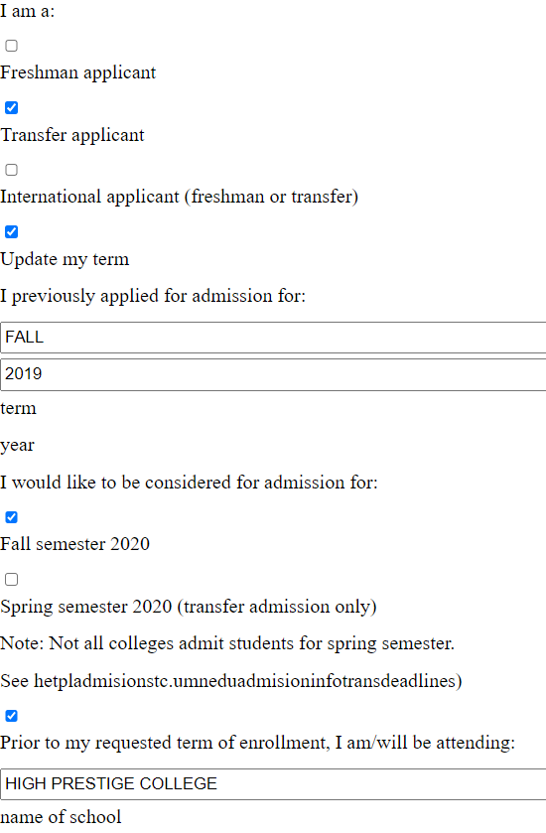
Motivation | Solution
Idea: Masking the heterogeneity with uniform overlays
Providing convenient and efficient access
PDF
HTML
Application
AccessBolt
Next Generation Assistive Technologies using Artificial Intelligence
8
Notes:
-Main idea behind our solution to these problems is using uniformly accessible overlays to mask the underlying heterogeneity

Slide 10
Breaking the Usability Barrier in Non-Visual Interaction with PDF Forms

Slide 11
PDF Forms | Ubiquity
PDF forms are everywhere!
Used for collecting information
Job Application
School Application
Medical Appointments
Legal Documents
Online Commerce
User Experience Survey with 14 blind users
Interacting with forms at least once a month
10 participants claimed they need help while filling PDF forms
Next Generation Assistive Technologies using Artificial Intelligence
9
Notes:
-we carried out a user experience survey with 14 blind users

Slide 12
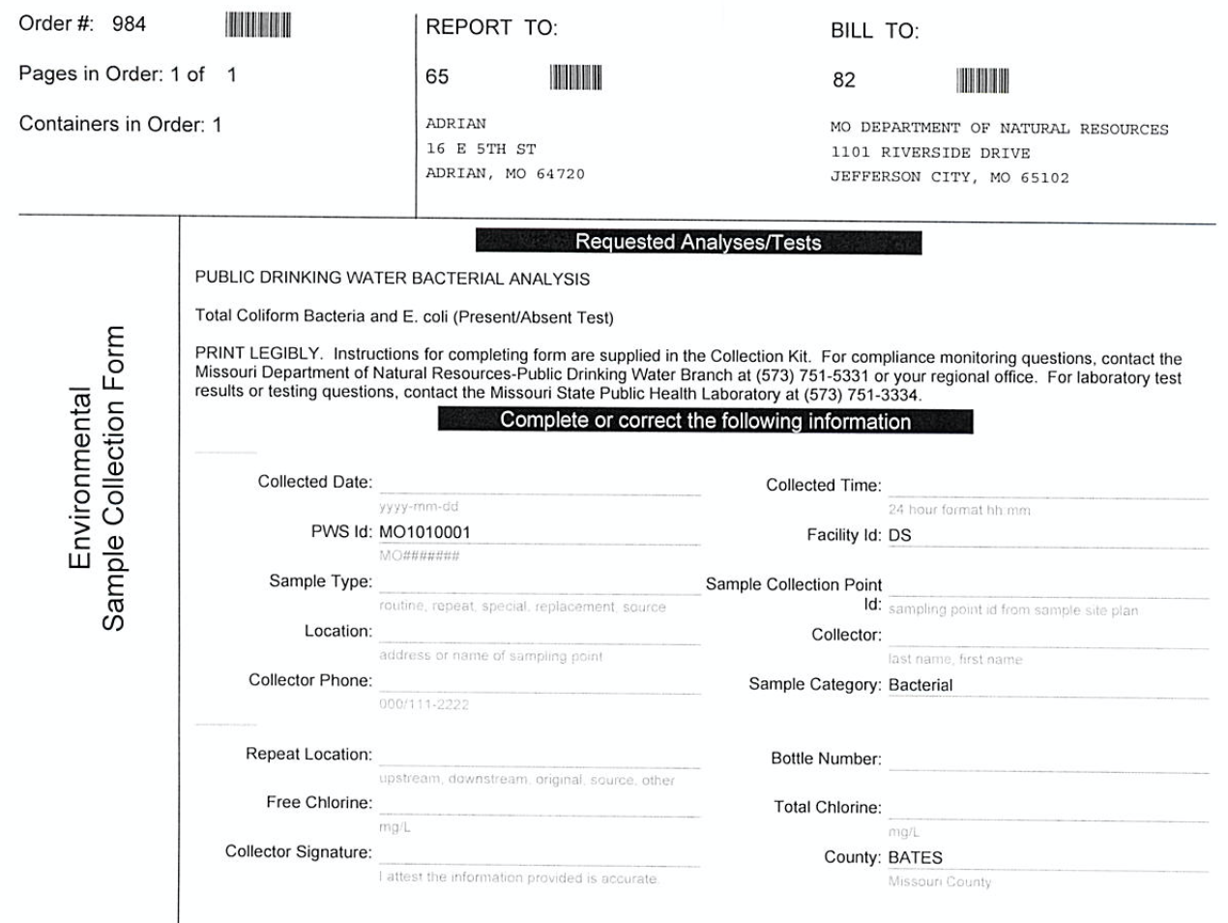
PDF Forms | State of Accessibility
Collected 856 PDF forms from WWW using Google search
Findings:
%1 - Image PDFs
%51.4 -Text-only PDF forms / non-interactive
%55.4 of the interactive PDFs – Fields without labels
Label: Information that a form field requires Name, City, Zip etc.
Scanned Form
Form with some intractability
Next Generation Assistive Technologies using Artificial Intelligence
10
Notes:
- In order to better understand the state of accessibility of PDF forms on the web we collected 856 pdf forms from various websites

Slide 13
PDF Forms | Usability Issues
Problems with screen-reader reading order
Problems with form field size
Next Generation Assistive Technologies using Artificial Intelligence
11
Notes:
- Furthermore, we discovered that some documents had usability issues with non-visual interaction

Slide 14
TransPAc: Transformation for PDF Form Accessibility
Overview of the Transformation Process
Goal: Create an HTML form that is
Equivalent to the PDF form
Has correct labels for the form fields
Follows the correct reading order of the document
User interacts with the HTML Overlay
The answers are transferred to the PDF form
Make sure the text is readable
Next Generation Assistive Technologies using Artificial Intelligence
12

Slide 15
TransPAc: Transformation for PDF Form Accessibility
PDF Structure
PDFs as collection of text and form elements
Some of these elements are meant to be read together
Lines, paragraphs, groups of form fields, etc.
Group the elements into segments
Logical lines and logical segments
Next Generation Assistive Technologies using Artificial Intelligence
13
Notes:
-PDFs can be represented as a collection of text and form elements

Slide 16
TransPAc: Transformation for PDF Form Accessibility
TransPAc Pipeline
Inaccessible PDF Form
Accessible PDF Form
Next Generation Assistive Technologies using Artificial Intelligence
14

Slide 17
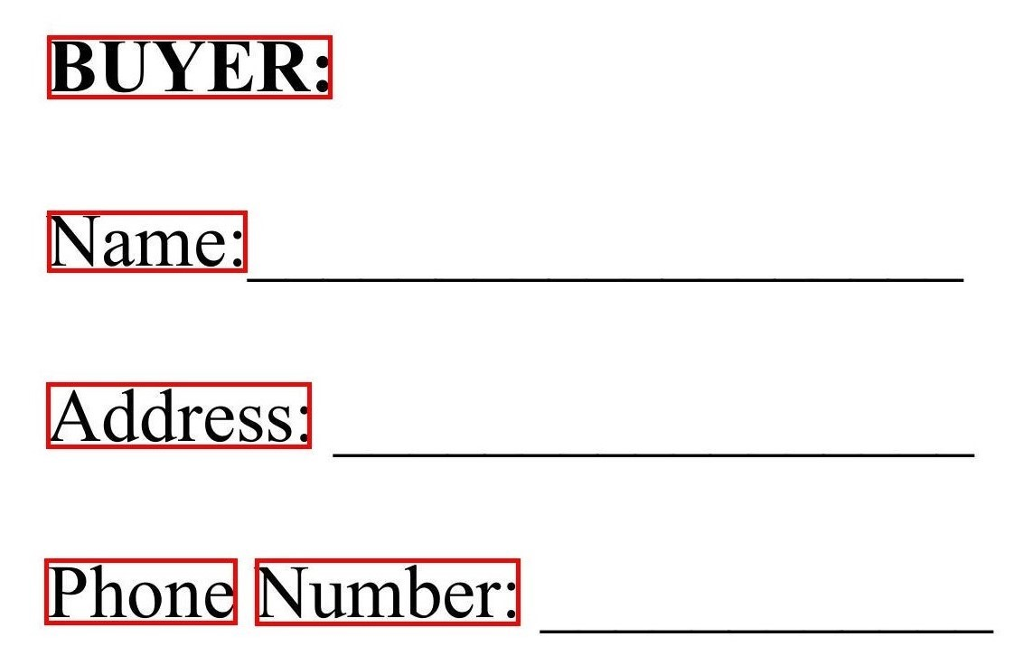
Element Extraction
Text Elements
Text Elements
Text elements are detected by AWS Textract (OCR)
Coordinates of the bounding box and the text
Next Generation Assistive Technologies using Artificial Intelligence
15

Slide 18
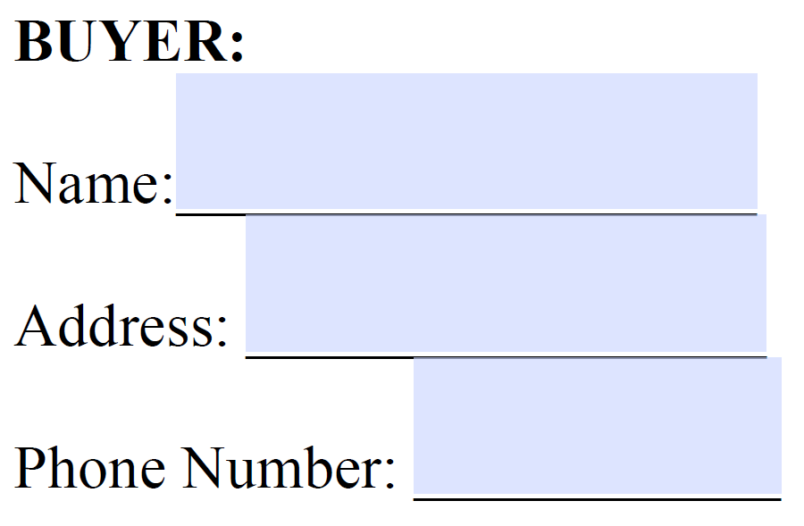
Element Extraction
Form Elements
Form fields in original PDF (if available)
Form element detection by
Adobe Pro
AWS Textract
Coordinates of the bounding box and the label of the form field
Form Fields
Next Generation Assistive Technologies using Artificial Intelligence
16
Notes:
-AWS better at finding the location of the box
-Adobe is better at finding the label for the field

Slide 19
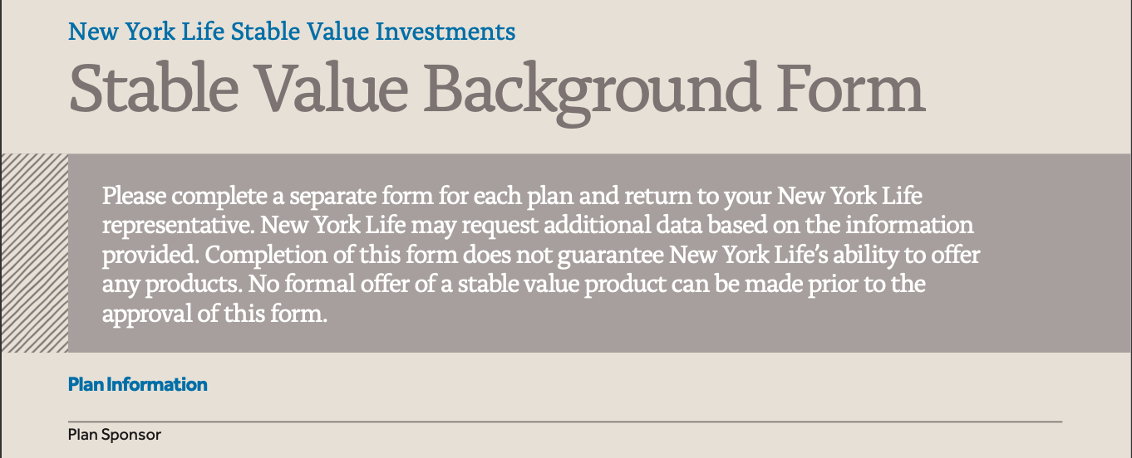
Logical Segmentation
Goal: Divide the document into logical segments in order to detect the correct reading order
Visual cues to consider:
Element Proximity
Explicit Boxes
Implicit Boxes
Next Generation Assistive Technologies using Artificial Intelligence
17

Slide 20
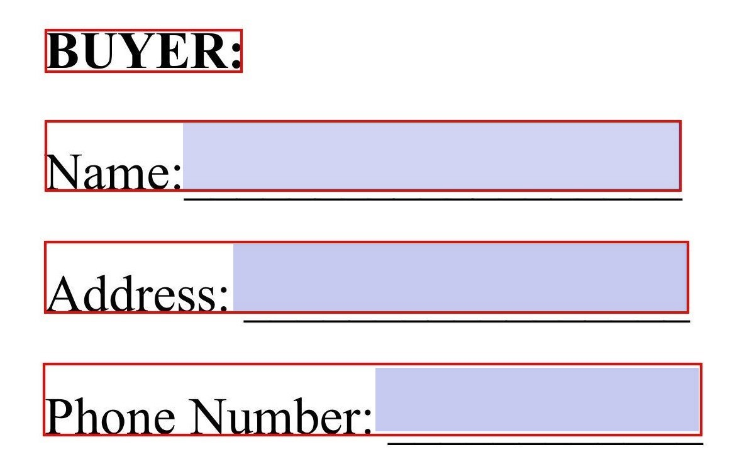
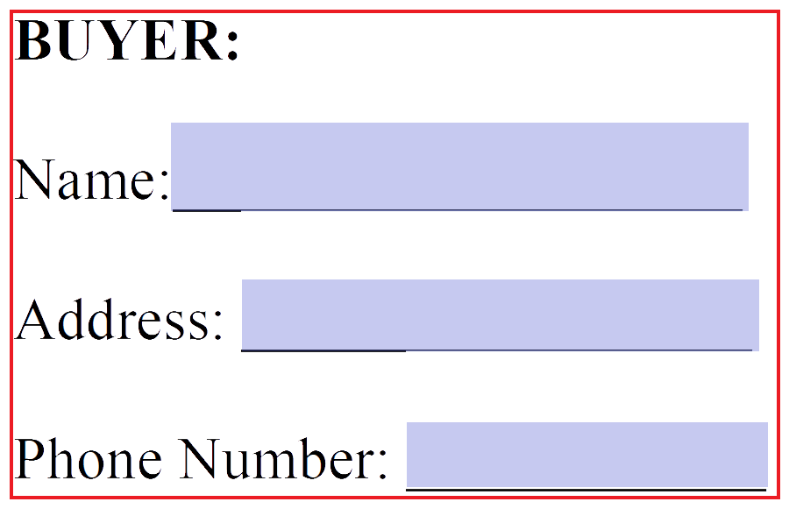
Logical Segmentation
Ontology
Gradually combining text and field elements into groups using geometrical information
Using vertical and horizontal alignment and distance
Considering explicit and implicit boxes to decide which elements to group
Text Bounding Boxes
Form Field Bounding Boxes
Logical Lines
Logical Segments
Next Generation Assistive Technologies using Artificial Intelligence
18

Slide 21
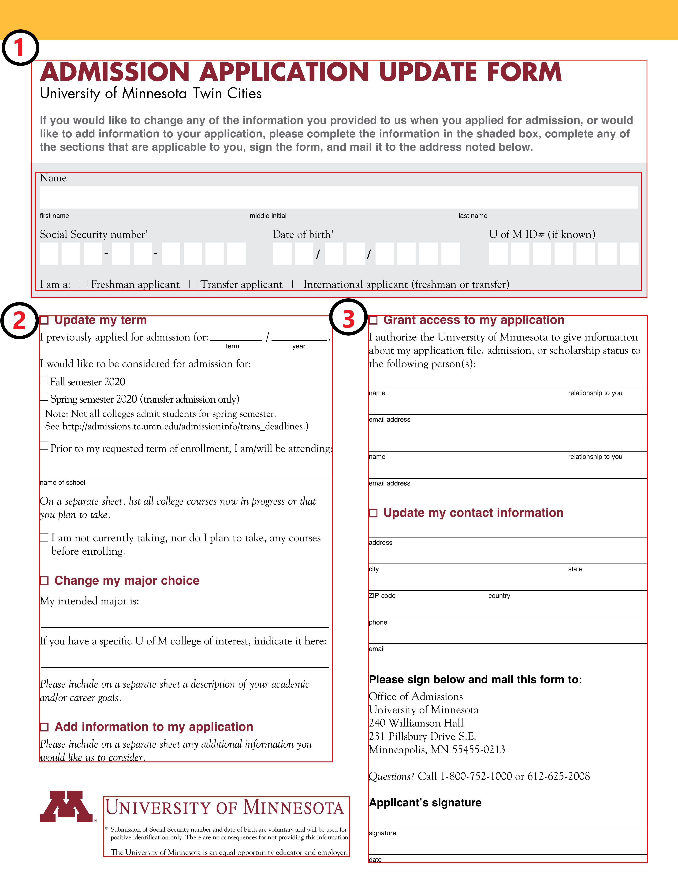
Logical Segments
Merging
Next Generation Assistive Technologies using Artificial Intelligence
19
Notes:
- Over segmented

Slide 22
Transformation into HTML Form
HTML form created with the elements arranged in the determined reading order
Serial layout is more suitable for non-visual interaction
User’s answers are injected into the original PDF form later
Next Generation Assistive Technologies using Artificial Intelligence
20
Notes:
-HTML equivalent of the original form using the elements extracted and the correct reading order

Slide 23
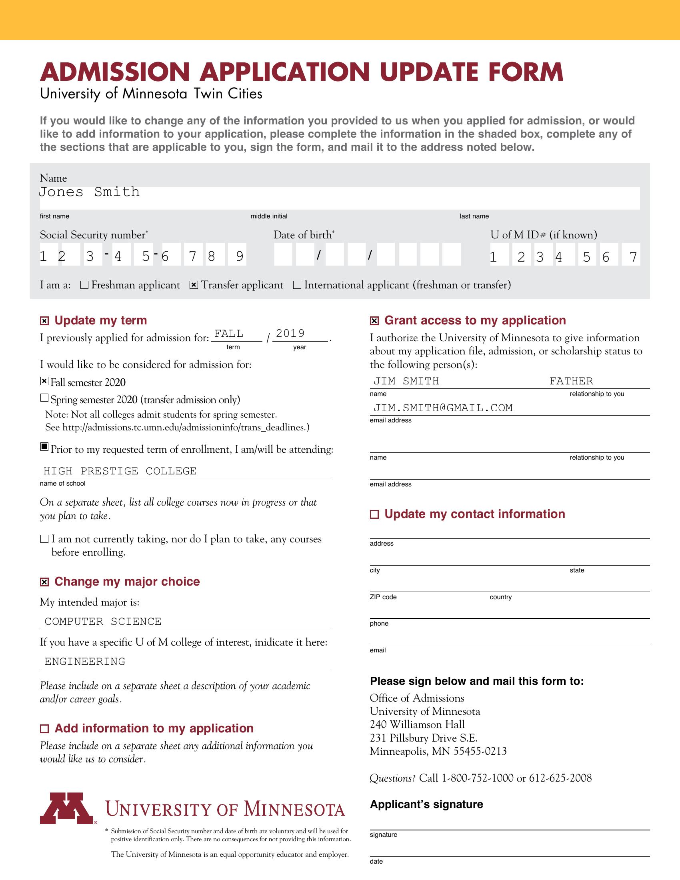
Populating PDF Form Fields
Sometimes the answers would not fit into the form fields
Alter the original PDF form
Divide the answer to multiple lines
Expand the form field without interfering much with the document layout
Next Generation Assistive Technologies using Artificial Intelligence
21

Slide 24
Evaluation
User Study
We carried out a user-study with 14 visually impaired users
Task: Filling forms using screen-reader
Baseline: Adobe Pro labelling + Adobe Acrobat Reader
Proposed: TransPAc pipeline + HTML interface
6 PDF forms with 24.5 form fields on average
Metrics:
Form fields left empty because of confusion
SEQ Score(Single Ease Questions: 1 - Hard, 7 - Easy)
Next Generation Assistive Technologies using Artificial Intelligence
22

Slide 25
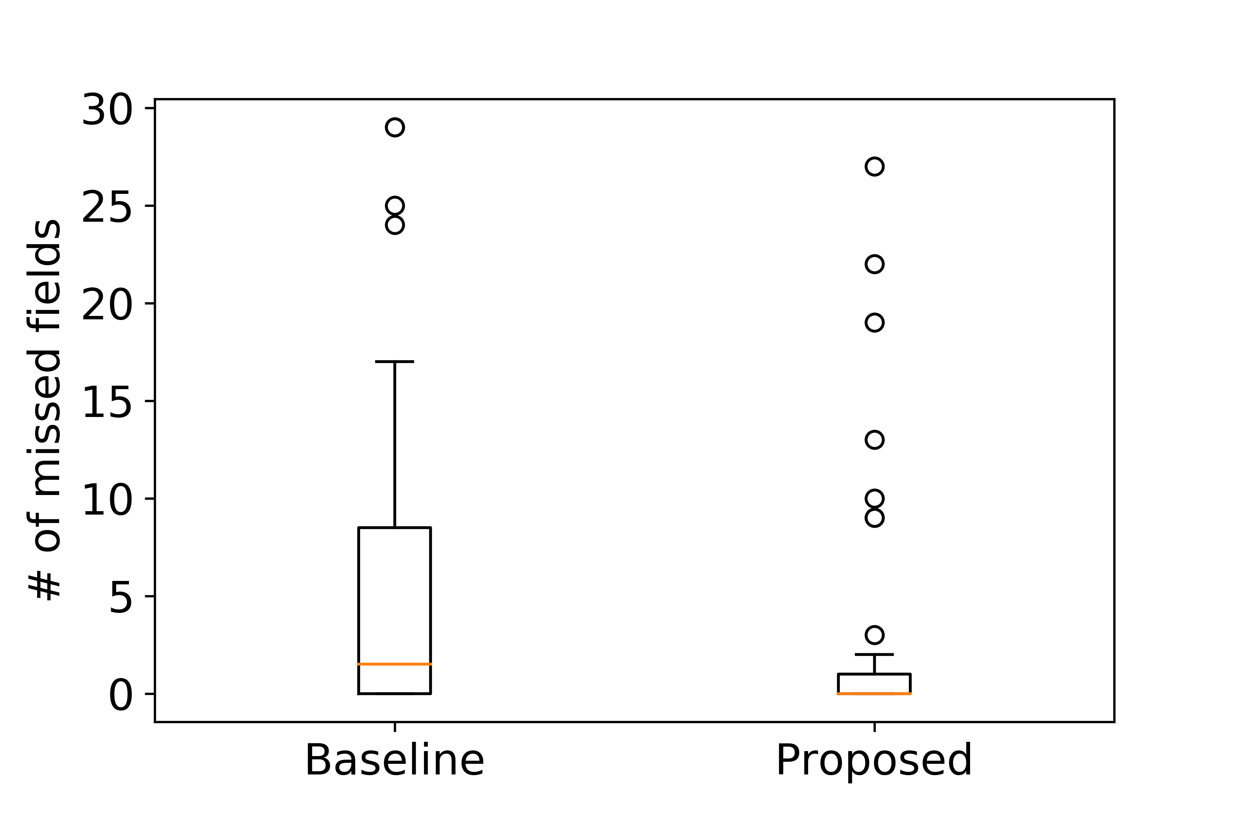
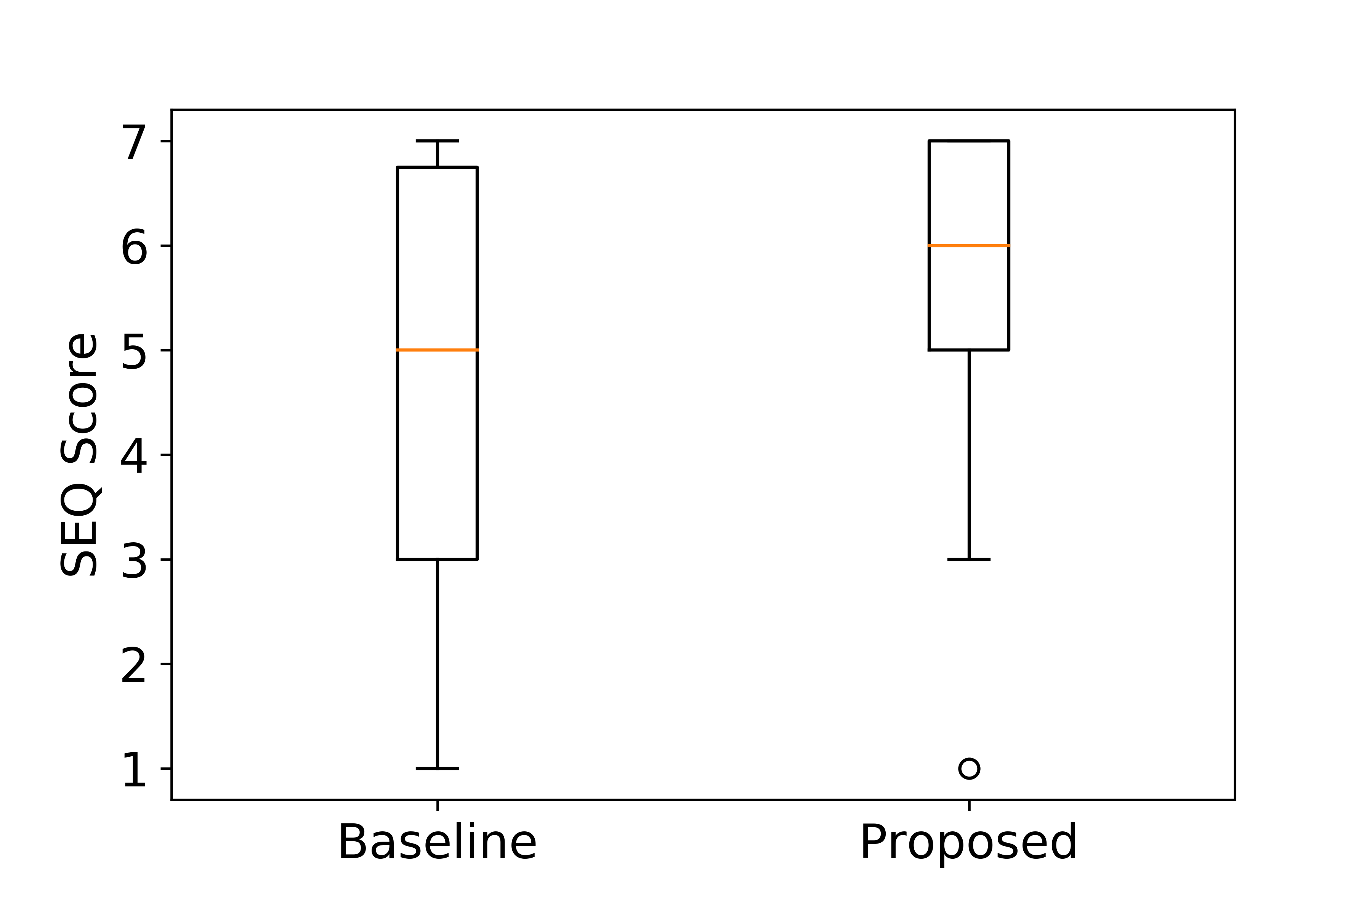
Evaluation
User Study
Average number of missed form fields
Baseline - 5.79 (%23.6)
Proposed - 2.81 (%11.5)
Average SEQ score
Baseline - 4.52
Proposed - 5.54
Next Generation Assistive Technologies using Artificial Intelligence
23

Slide 26
Taming User-Interface Heterogeneity with Uniform Overlays for Blind Users

Slide 27
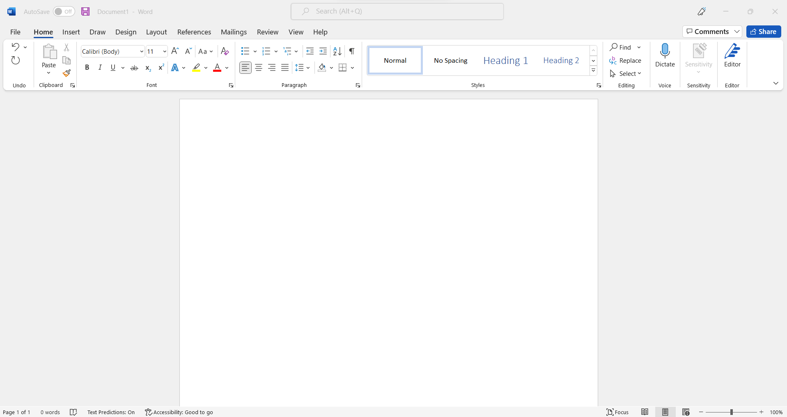
Motivation
Computer applications are integral part of most professional and educational settings
Graphical User Interfaces (GUIs) are primarily intended for sighted interaction (e.g., using point-and-click devices)
SR users expend significantly more effort and time for accessing application controls
x23
Next Generation Assistive Technologies using Artificial Intelligence
24
Notes:
-Computer applications are integral part of most professional settings and the ability to use productivity software such as Office applications greatly increase work eligibility
-Unfortunately most desktop applications use GUIs which are primarily intended for sighted interaction and cause usability issues for SR users
-For example, when using a Word processor the user would mainly interact with the text editing area. If a sighted user wanted to access the bullets command they would just point and click with their mouse. On the other hand, a SR user would have to press alt key to move the SRs focus to the top ribbon then press Tab key 23 times to reach the same command.
-As a result SR users needs to spend more time and effort than their sighted peers to do similar tasks. Therefore, we built a system to increase application usability for blind people as explained later in the presentation

Slide 28
Preliminary Study | Interview Format
An IRB-approved interview study with 12 screen reader users
Questions related to desktop application usability
How frequently do you come across unusable desktop applications?
What are the causes for usability issues in desktop applications?
What do you do to overcome these challenges?
Next Generation Assistive Technologies using Artificial Intelligence
25
Notes:
-In order to better understand the usability issues SR users face we conducted an interview study over the phone where we asked 12 participants questions about desktop application usability, shortcut usage habits.

Slide 29
Preliminary Study | Findings
Poor Interface Navigability
Heterogeneous Keyboard Shortcuts
Need for relearning
Dealing with Navigational Challenges
Repeating actions
Seeking external help from sighted users
Next Generation Assistive Technologies using Artificial Intelligence
26
Notes:
-These were the main findings of our study
6 - how different applications use different keyboard shortcuts for their commands and different control paradigms for traversing their interfaces. We’ll examine this further in the next slide.
3 – Mentioned learning new shortcuts as an issues
4 - they repeat their actions hoping that it will work eventually
8 - participants mentioned seeking help from a sighted person.

Slide 30
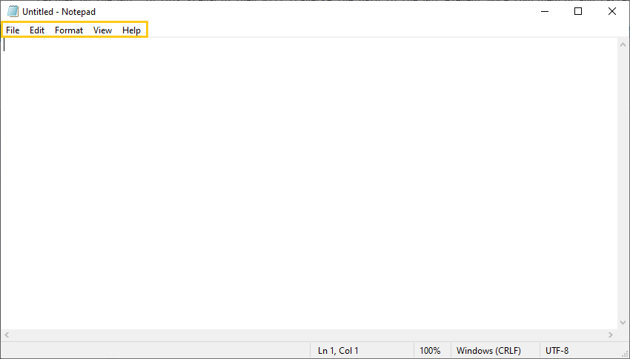
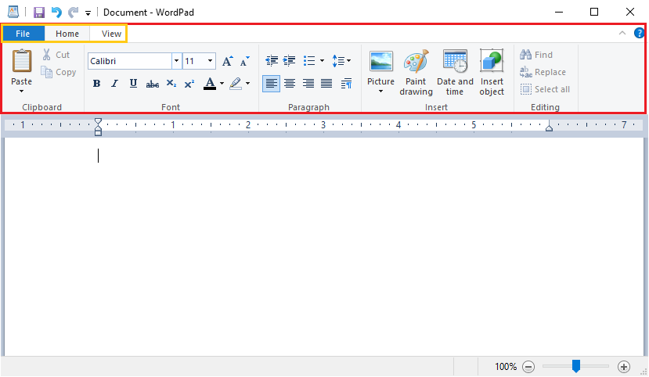
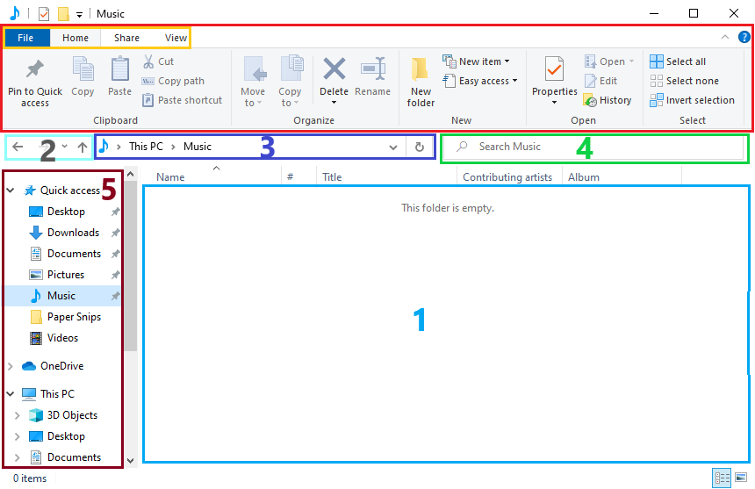
Preliminary Study | Inspection
A
B
C
D
Next Generation Assistive Technologies using Artificial Intelligence
27
Notes:
-After the interview study we inspected some desktop applications for navigation usability issues that the participants brought up
-Figure A shows the Notepad application. The commands in the yellow rectangle are accessed via ALT key and are navigable via arrow keys. The yellow rectangles in Figure B and C also use this navigation paradigm
-Figure B shows the Wordpad application. Commands in the red rectangle are accessible via ALT key and are navigable via TAB key. Red rectangle in Figure C also uses this navigation paradigm.
-Figure C shows the File Explorer. Commands in the left ribbon labelled as 5 are accessed via pressing TAB key 4 times and are navigable via arrow keys.
-Figure D shows the zoom application. The user navigates the commands of the application in the numbered order via pressing TAB key. However, the commands in the top ribbon labelled as 1 are navigable via arrow keys.

Slide 31
AccessBolt | Design
In order to solve the aforementioned issues, we developed AccessBolt
Core principles:
Uniformity
Efficiency
Usability
Next Generation Assistive Technologies using Artificial Intelligence
28
Notes:
In order to solve the aforementioned issues, we developed Accessbolt around 3 core principles: uniformity, efficiency and usability

Slide 32
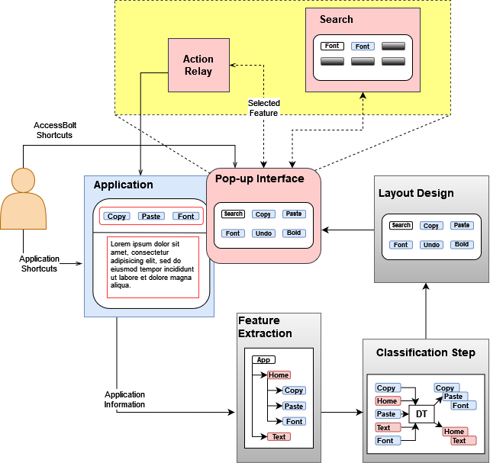
AccessBolt | Technical Details
Architectural Workflow
Next Generation Assistive Technologies using Artificial Intelligence
29
Notes:
-Here we can see the architectural workflow of the accesbolt system. When the user triggers the accessbolt shortcut it will automatically detect the application in use and extract its controls. A binary classifier then separates command controls from non-command controls. Command controls are added to the pop-up interface and are presented to the user. User interacts with the popup interface using accessbolt’s simple shortcuts and its efficient search functionality. Once the user makes a selection, popup interface is closed automatically and accessbolt triggers the selected action in the application.
- Next we will discuss these submodules in detail

Slide 33
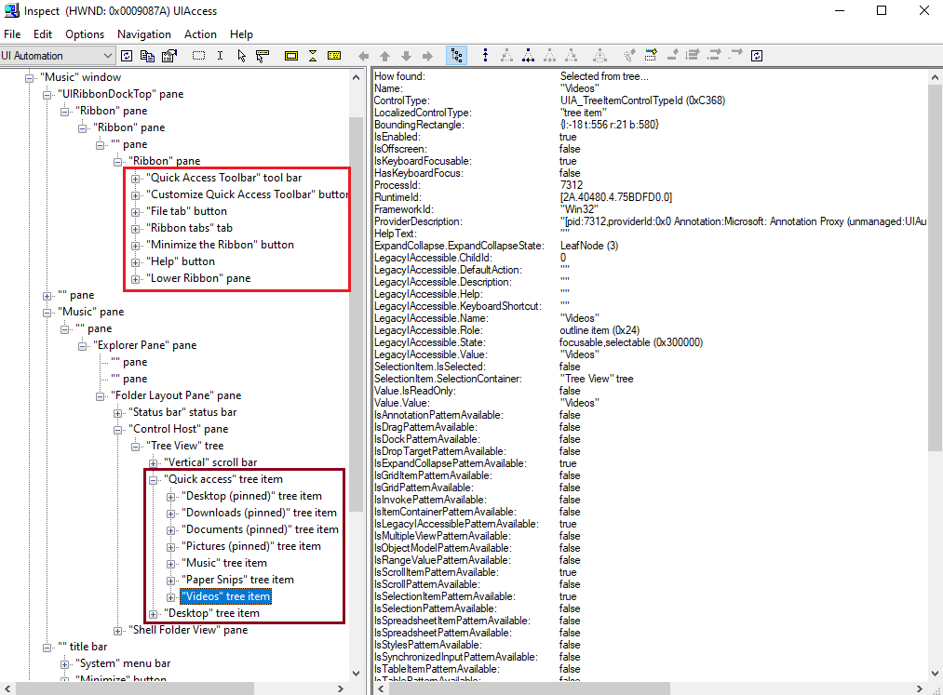
AccessBolt | Technical Details
Feature Extraction
Windows accessibility framework provides access to application’s UI tree
Control information such as:
Name
Description
Control Type
Default Action
API for programmatically triggering controls
Next Generation Assistive Technologies using Artificial Intelligence
30
Notes:
-Windows accessibility framework provides access to application’s UI tree which contains its structural information along with detailed information such as name, description, control type, and default action for each of the application’s controls
-Figure on the right displays the UI tree of the File Explorer application

Slide 34
AccessBolt | Technical Details
Classifying Application Controls
Types of controls in an application:
Structural Controls: Container controls that hold other controls (e.g., Panes, Ribbons etc.)
Functional Controls: Interactive controls (e.g., click, toggle, expand)
Content Controls: Main focus of the application (e.g., Cells in Excel, Files in File Explorer)
Command Controls: Controls that provide application functionality (e.g., Bold in Word, Mute in Music Player etc.)
Next Generation Assistive Technologies using Artificial Intelligence
31
Notes:
-Application controls fall into 3 categories
-Structural controls such as Panes and Ribbons are container controls which create the layout of the application. These controls are not interactive
-We call the interactive controls functional controls and they are separated into two subcategories.
-Files in the file explorer or cells in excel are examples of content controls. These are the focus of the application
-Controls that provide application functionality such as bold button in word or mute in music player are command controls.

Slide 35
AccessBolt | Technical Details
Classification Models
Ontology Model
$Control Type ∈\{button, checkbox,…\}$, $Default Action ∈\{clickable, toggleable,…\}$
SVM
Radial Basis Function Kernel
Neural Network
Two hidden layers with 36 nodes each, Rectified Linear Unit Function
Decision Tree
Gini impurity
Next Generation Assistive Technologies using Artificial Intelligence
32
Notes:
-Purpose of the Classification model is to separate command controls from non-command controls.
-For this task we trained and tested 3 ML models and an ontology model.
-Ontology model followed handcrafted rules such as whether the control’s type and its default action are in a predetermined list and whether it is a leaf node in the UI tree. These rules were selected based on our observations.
-3 machine learning models had the shown properties.

Slide 36
AccessBolt | Technical Details
Dataset for Classification
We built our Dataset from 15 desktop applications
Calendar
Excel
File Explorer
Google Chrome
MS To do
Mozilla Firefox
Notepad
Notepad++
Outlook
PowerPoint
Skype
Weather
Word
WordPad
Zoom
1014 Command Controls (25%)
3095 Non-Command Controls (75%)
Next Generation Assistive Technologies using Artificial Intelligence
33
Notes:
-Dataset that was used in the training of the models was manually collected from 15 applications that are listed here.
-In total there was 1014 command controls and 3095 non-command controls in the dataset

Slide 37
AccessBolt | Technical Details
Evaluation of Classification Models
Inclusion of location features improved Command vs. Content control separation (except SVM)
Next Generation Assistive Technologies using Artificial Intelligence
34
Notes:
-Table on the right shows the precision, recall and the F1 scores of the tested models.
-Ontology model by its design did not use location feature. ML models were tested with and without the location features
-Inclusion of location features in the training process improved Command vs. Content control separation.
-We decided to use the decision tree model in our system as it had the highest F1 score

Slide 38
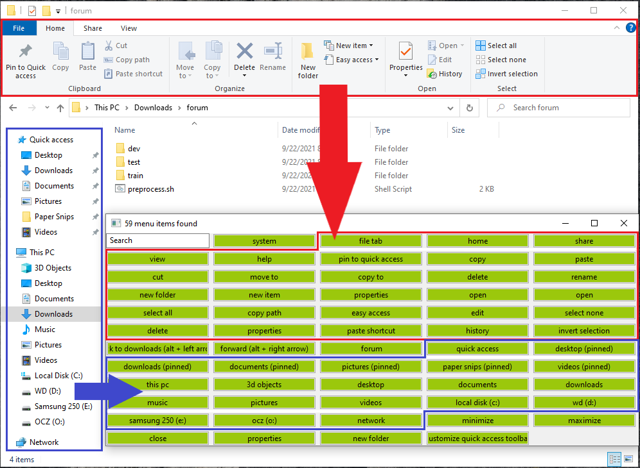
AccessBolt | Technical Details
Interface
Flat interface design rather than hierarchical
Easy controls for navigation and selection
Flexible search with sentence embeddings (BERT)
Next Generation Assistive Technologies using Artificial Intelligence
35
Notes:
-We designed accessbolt to have a flat interface rather than a hierarchical one because we observed that users were more likely to remember the name of the command, such as delete, rather than the name of a container such as organize.
-Accessbolt interface is serially navigable with tab and arrow keys.
-It also provides a search functionality for looking up command names quickly.

Slide 39
Evaluation | Study Design
Subtasks
We conducted an IRB-approved user study with 6 screen reader users
Task: Complete a series of subtask within 10 minutes
Baseline Condition: Using only the screen reader
Proposed Condition: Using screen reader with AccessBolt interface
Next Generation Assistive Technologies using Artificial Intelligence
36
Notes:
-In order to evaluate the effectiveness of accessbolt we conducted a user study with 6 SR users
-Each participants completed 2 tasks for each condition, totaling to 4 task per participant. Tasks were divided into subtask shown in the table and the participants had to finish them in given time limit.
-In baseline condition participants only used SR
-In Proposed condition they used SR with accessbolt

Slide 40
Evaluation | Study Results
Metrics | Baseline | Proposed
Successfully Completed Tasks | 5 / 12 | 12 / 12
Average Keypresses | 178.35 | 72.18
Single Ease Question | 2.08 | 5.66
NASA-TLX | 11.08 | 3.33
Single Ease Question after each task: 1 (hard) – 7 (easy)
NASA-TLX Questionnaire after each condition: 1(easy) – 20 (demanding)
Next Generation Assistive Technologies using Artificial Intelligence
37
Notes:
-Participants were also administered the NASA-TLX questionnaire after each study condition in order to estimate their perceived workload
A deeper examination of our data revealed that out of the six categories the average scores for the performance, effort and frustration categories were very high for the baseline condition.
-Overall, proposed condition had much lower TLX scores across all the categories.

Slide 41
Ongoing Work

Slide 42
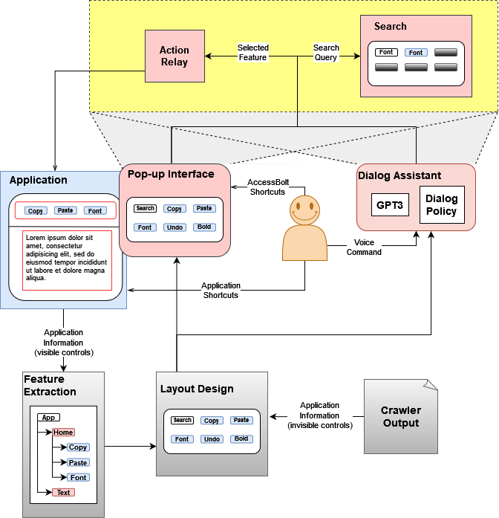
Current Research
Next Generation Assistive Technologies using Artificial Intelligence
38
Notes:
-After the pilot study we saw few ways that we can enhance the AccessBolt system. Here you can see the enhance diagram for the Accessbolt system. The main changes are the inclusion of the crawler application’s output and the dialog assistant interface. We will talk about these extensions next.

Slide 43
Current Research | Extending to Invisible Controls
UI Tree only contains controls which are visible on the application’s interface
Invisible control examples:
Options under a combobox/dropbox
Controls in a different tab
Crawler takes actions to reveal invisible controls
Creates a complete map of the user interface
Next Generation Assistive Technologies using Artificial Intelligence
39
Notes:
-As we mentioned before we use the windows framework to access the UI tree of an application. However, the elements which aren’t visible on the screen do not appear in the UI tree as well.

Slide 44
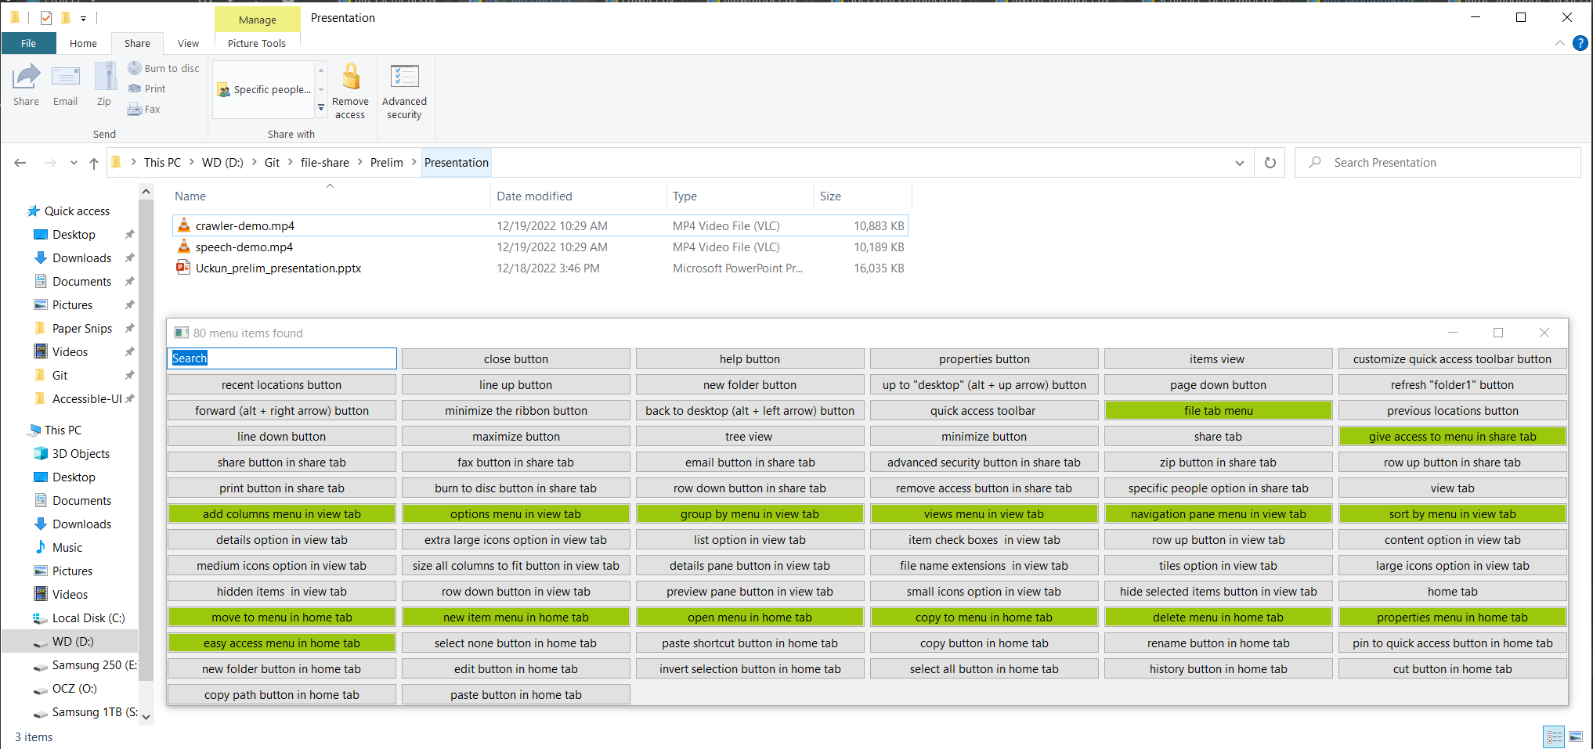
Current Research | Extending to Invisible Controls
Interface
AccessBolt interface with invisible controls included
Next Generation Assistive Technologies using Artificial Intelligence
40
Notes:
- As you can see the AccessBolt interface now includes controls from other tabs as well

Slide 45
Current Research | Extending to Invisible Controls
Interface Demo
Next Generation Assistive Technologies using Artificial Intelligence
41
Notes:
[Add a 30 sec demo video]

Slide 46
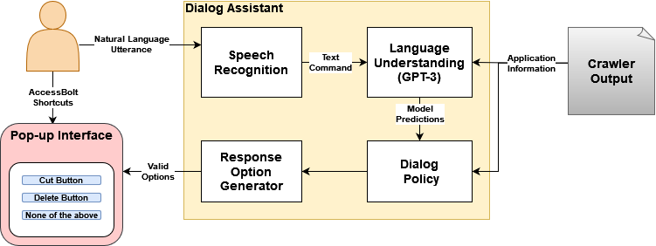
Current Research | Dialog Assistant
Architectural Workflow
Goal:
More intuitive and flexible interaction
Less physical effort
Next Generation Assistive Technologies using Artificial Intelligence
42
Notes:
-The other enhancement we wanted to bring to the AccessBolt system was the inclusion of a dialog assistant
-The goal of this extension is to provide a more intuitive and flexible interface to the user
-It also requires less physical effort in terms of less key presses

Slide 47
Current Research | Dialog Assistant
Speech Recognition
Google’s Python API for speech-to-text conversion
Next Generation Assistive Technologies using Artificial Intelligence
43

Slide 48
Current Research | Dialog Assistant
Language Understanding Module
Map the user’s command to a control of the application
OpenAI’s GPT-3 model
Next Generation Assistive Technologies using Artificial Intelligence
44

Slide 49
Current Research | Dialog Assistant
GPT-3 Model
GPT-3 has an innate understanding of natural languages
Highly generalizable for different NLP tasks
Uses few-shot (example) learning: does not require a lot of training data
Model takes prompt (text) as input (with few-shot examples)
Model adjusts internal probability distributions according to prompt
It outputs a sequence (text) that continues/completes the input text
Next Generation Assistive Technologies using Artificial Intelligence
45

Slide 50
AccessBolt | Dialog Assistant
GPT-3 Model Prompt
Example Prompt for Wordpad
(customize quick access toolbar, None),(help, None),(save, None),(minimize the ribbon, None),(undo, None),(-, None),(redo, None),(close, None),(page right, None),(maximize, None),(+, None),(minimize, None),(system,close), (system,minimize), (system,restore),(system,size),(system,move),(system,maximize),(page left, None),(quick access toolbar, None),(file tab, None),(word wrap,no wrap),(word wrap,wrap to ruler),(word wrap,wrap to window),(measurement units,inches),(measurement units,centimeters),(measurement units,picas),(measurement units,points),(zoom in, None),(status bar, None),(zoom out, None),(ruler, None),(100%, None),(text highlight color, None),(text color,pastel orange),(text color,professional blue),(text color,white),(text color,earthy red),(text color,dark gray),(text color,earthy yellow),(text color,vibrant purple),(text color,professional purple),(text color,pastel red),(text color,medium gray),(text color,vibrant blue),(text color,pastel blue),(text color,pastel yellow),(text color,light gray),(text color,charcoal),(text color,earthy orange),(font family,comic sans ms), ...
Text: Save the document
Answer: (save, None)
—
Text: Change the measurement to inches
Answer: (measurement units, inches)
—
Text: Change the measurement to meters
Answer: None
—
Text: Refresh the page
Answer: None
—
Text: Change font to comic sans
Answer: (font family,comic sans ms)
Next Generation Assistive Technologies using Artificial Intelligence
46

Slide 51
AccessBolt | Dialog Assistant
GPT-3 Model Prompt
Choosing the few-shot examples:
Manually picking examples that demonstrate the task
Dynamically generating examples from randomly selected controls
Using a second GPT-3 model that generates natural utterance for a given application control
Next Generation Assistive Technologies using Artificial Intelligence
47

Slide 52
AccessBolt | Dialog Assistant
Dialog Policy
GPT-3 can produce multiple answers
Some answers do not map to any controls
Dialog Policy decides which options to eliminate
Response Option Generator populates the pop-up interface
Next Generation Assistive Technologies using Artificial Intelligence
48

Slide 53
AccessBolt | Dialog Assistant
Speech Interface Demo
Next Generation Assistive Technologies using Artificial Intelligence
49

Slide 54
Concluding Remarks
Significant advancements in AI
Natural Language Processing
Computer Vision
Machine Learning
Many opportunities in Accessible Computing
Equal access for everyone
Current assistive technologies insufficient
Next Generation Assistive Technologies using Artificial Intelligence
50

Slide 55
Thank You!
Contact:
Email
Web
Twitter
Phone
Address
vganjigu@odu.edu
www.cs.odu.edu/~vashok/
@vikas_daveb
757-683-7797
Rm 3107, E&CS Bldg, ODU
Next Generation Assistive Technologies using Artificial Intelligence
51

