Slide 1
Lecture 13
Pruning
Vikas Ashok
Department of Computer Science
ODU
Reading for This Class:
Chapter 7, Russell and Norvig

Slide 2
Review
Last Class
Games
Adversarial Search
This Class
Pruning a Game Tree
Next Class
Knowledge-based Agent

Slide 3
Imperfect Decisions
complete search is impractical for most games
Even though we can prune the tree
alternative:
search only part of the tree
Cutoff required
requires a cutoff-test to determine where to stop
use a heuristics-based evaluation function to estimate the expected utility of the game from a given position

Slide 4
Evaluation Function
determines the performance of a game-playing program
must be consistent with the utility function
values for terminal nodes must be the same
tradeoff between accuracy and time cost
without time limits, minimax could be used
should reflect the actual chances of winning
frequently weighted linear functions are used
E = w₁ f₁ + w₂ f₂ + … + w_{n} f_{n}
combination of features, weighted by their relevance

Slide 5
Example: Tic-Tac-Toe
simple evaluation function
E(s) = (rx + cx + dx) - (ro + co + do)
where r,c,d are the numbers of row, column and diagonal lines still available; x and o are the pieces of the two players
1-ply lookahead
start at the top of the tree
evaluate all 9 choices for player 1
pick the maximum E-value
2-ply lookahead
also looks at the opponents possible move
assuming that the opponents picks the minimum E-value

Slide 6
Tic-Tac-Toe 1-Ply
E(s0) = Max{E(s11), E(s1n)} = Max{2,3,4} = 4
E(s11)
8
- 5
= 3
E(s12)
8
- 6
= 2
E(s13)
8
- 5
= 3
E(s14)
8
- 6
= 2
E(s15)
8
- 4
= 4
E(s16)
8
- 6
= 2
E(s17)
8
- 5
= 3
E(s18)
8
- 6
= 2
E(s19)
8
- 5
= 3
X
X
X
X
X
X
X
X
X

Slide 7
Tic-Tac-Toe 2-Ply
E(s0) = Max{E(s11), E(s1n)} = Max{2,3,4} = 4
E(s1:1)
8
- 5
= 3
E(s1:2)
8
- 6
= 2
E(s1:3)
8
- 5
= 3
E(s1:4)
8
- 6
= 2
E(s1:5)
8
- 4
= 4
E(s1:6)
8
- 6
= 2
E(s1:7)
8
- 5
= 3
E(s1:8)
8
- 6
= 2
E(s1:9)
8
- 5
= 3
X
X
X
X
X
X
X
X
X
E(s2:41)
5
- 4
= 1
E(s2:42)
6
- 4
= 2
E(s2:43)
5
- 4
= 1
E(s2:44)
6
- 4
= 2
E(s2:45)
6
- 4
= 2
E(s2:46)
5
- 4
= 1
E(s2:47)
6
- 4
= 2
E(s2:48)
5
- 4
= 1
O
O
O
X
X
X
O
X
X
O
X
X
X
O
O
O
E(s2:9)
5
- 6
= -1
E(s2:10)
5
-6
= -1
E(s2:11)
5
- 6
= -1
E(s2:12)
5
- 6
= -1
E(s2:13)
5
- 6
= -1
E(s2:14)
5
- 6
= -1
E(s2:15)
5
-6
= -1
E(s2:16)
5
- 6
= -1
O
X
X
O
X
X
X
X
X
X
O
O
O
O
O
O
E(s21)
6
- 5
= 1
E(s22)
5
- 5
= 0
E(s23)
6
- 5
= 1
E(s24)
4
- 5
= -1
E(s25)
6
- 5
= 1
E(s26)
5
- 5
= 0
E(s27)
6
- 5
= 1
E(s28)
5
- 5
= 0
X
O
X
O
X
X
X
X
X
X
O
O
O
O
O
O

Slide 8
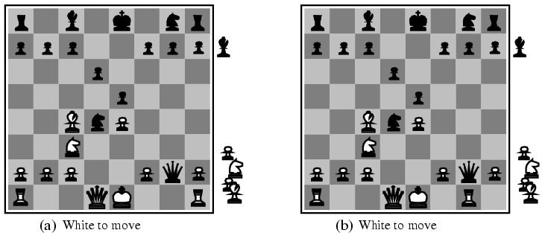
Difficulty in Evaluation Function
Very difficult to develop an appropriate evaluation function
Example
Two slightly different chess positions
A. black has an advantage of a knight and two pawns and will win the game
B. back will lose after white captures the queen

Slide 9
Horizon Problem
moves may have disastrous consequences in the future, but the consequences are not visible
the corresponding change in the evaluation function will only become evident at deeper levels
they are “beyond the horizon”
determining the horizon is an open problem without a general solution
only some pragmatic approaches restricted to specific games or situation

Slide 10
Pruning
discards parts of the search tree
guaranteed not to contain good moves
high likelihood that the solution is not in the branch or subtree
results in substantial time and space savings
the leftover part of the task may still be exponential, however

Slide 11
Mathematics under Pruning
MINIMAX-VALUE(root) =max(min(3,12,8), min(2,x,y),min(14,5,2))
=max(3, min(2,x,y), 2)
In such a case, regardless what value x and y will be, it wouldn’t affect the minimax value.

Slide 12
Alpha-Beta Pruning
moves that with certainty won’t result in a better evaluation value than a move further up in the tree are not considered
they would lead to a less desirable outcome
applies to moves by both players
α indicates the best choice for Max so far never decreases
β indicates the best choice for Min so far never increases
extension of the minimax approach
results in the same move as minimax, but with less overhead
prunes uninteresting parts of the search tree

Slide 13
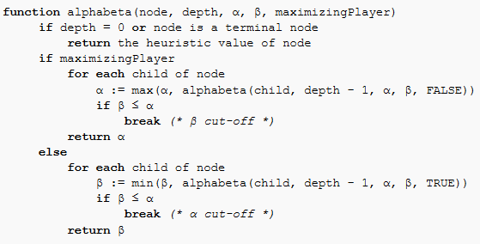
Alpha-Beta Algorithm

Slide 14
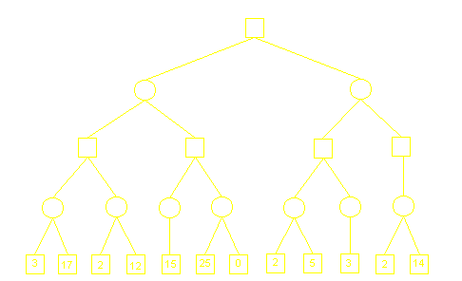
Alpha-Beta Pruning Example

Slide 15
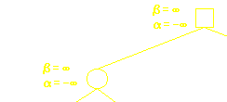
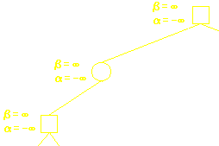
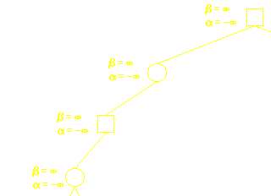
Alpha-Beta Pruning Example

Slide 16
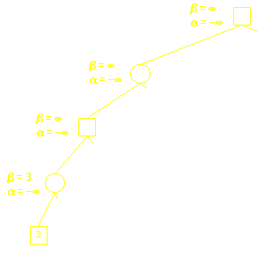
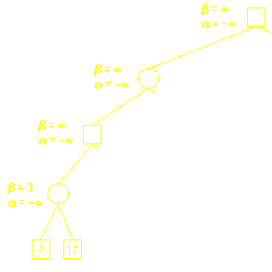
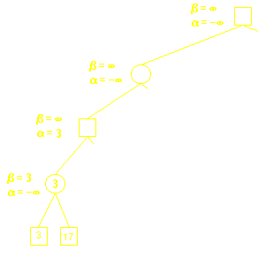
Alpha-Beta Pruning Example

Slide 17
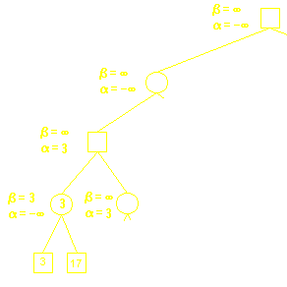
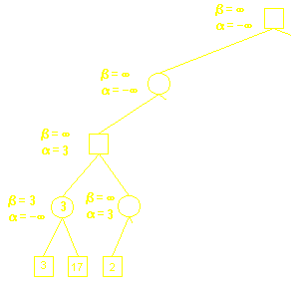
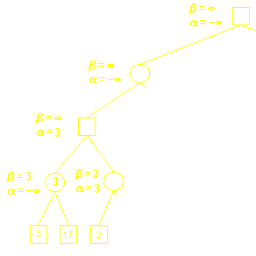
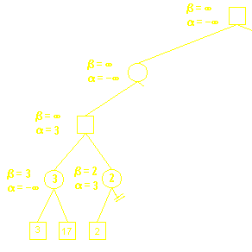
Alpha-Beta Pruning Example

Slide 18
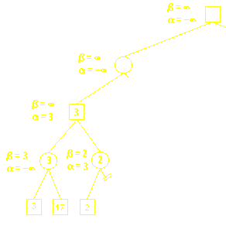
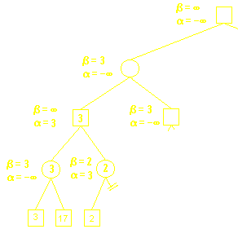
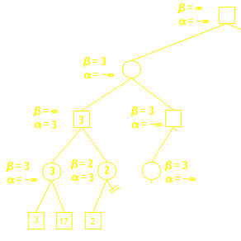
Alpha-Beta Pruning Example

Slide 19
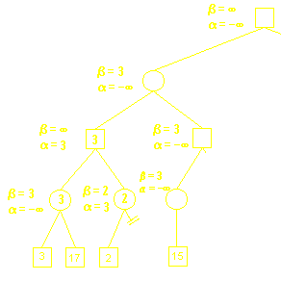
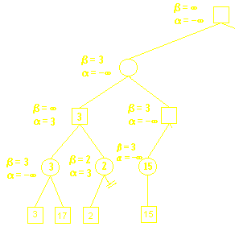
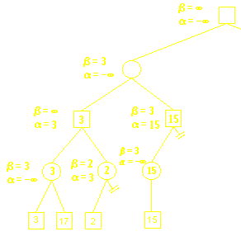
Alpha-Beta Pruning Example

Slide 20
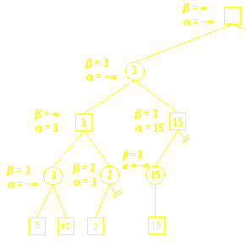
Alpha-Beta Pruning Example

Slide 21
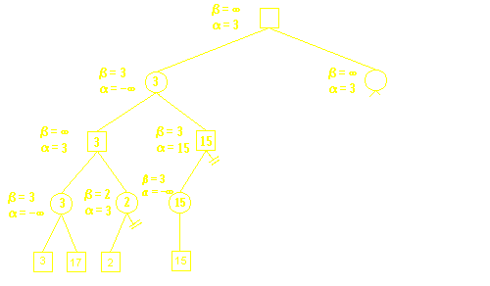
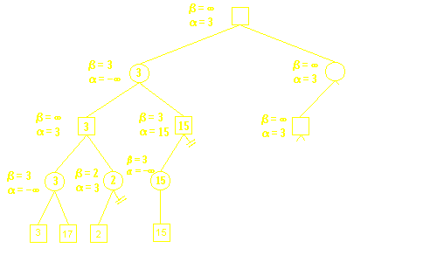
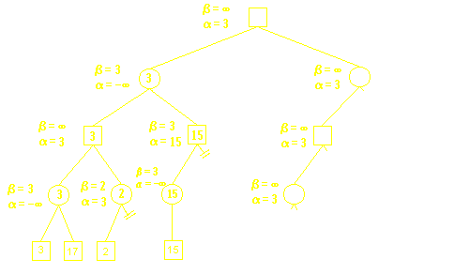
Alpha-Beta Pruning Example

Slide 22
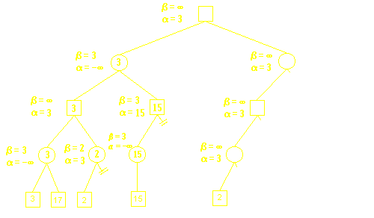
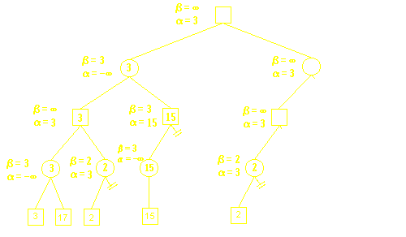
Alpha-Beta Pruning Example

Slide 23
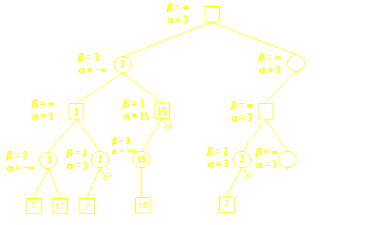
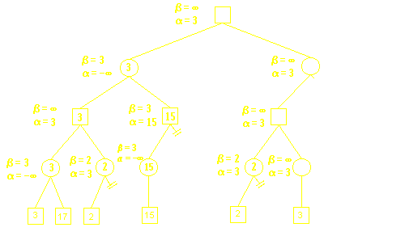
Alpha-Beta Pruning Example

Slide 24
Alpha-Beta Pruning Example

Slide 25
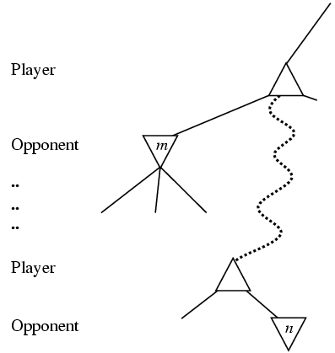
The general case of Alpha-Beta Pruning
If m is better than n for Player, we will never get to n to play
This is Alpha-cutting

Slide 26
Summary
Game Tree
Alpha-Beta Pruning

Slide 27
What I want you to do
Review Chapter 7
Work on your assignment

