Slide 1
Applications of NLP
Vikas Ashok
Lecture 2

Slide 2
Language Models
Assigning a probability to a sentence or sequence of words:
P(S) = P(t₁,t₂,t₃,t₄, … t_{n})
Assigning a probability for the next word after a sequence:
P(t₅|t₁,t₂,t₃,t₄)
A model that can compute either of the above probabilities is called a language model

Slide 3
Applications of Language Model
Better Word Suggestions
P(high winds tonite) > P(large winds tonite)
Spelling Correction
The office is about fifteen minuets from my house
P(about fifteen minutes from) > P(about fifteen minuets from)
Speech Recognition
P(I saw a van) >> P(eyes awe of an)
Machine Translation
Smart Compose
Examples for Dan Jurafsky’s slides

Slide 4
How to compute P(S)
How to compute this joint probability:
P(its, water, is, so, transparent, that)
Intuition: let’s rely on the Chain Rule of Probability
P(“its water is so transparent”) = P(its) × P(water|its) × P(is|its water) × P(so|its water is) × P(transparent|its water is so)

Slide 5
How to estimate the individual probabilities
Standard method of count and divide?
Impractical
Not enough training data to capture every possible sequence

Slide 6
Markov Assumption
Simplifying assumption:
Or maybe

Slide 7
Language Models
Unigram, Bigram, Trigram
N-gram (Google)
Neural Language Modeling (RNN, LSTM, BERT)

Slide 8
Training Corpora
Corpora are online collections of text and speech
Brown Corpus
Wall Street Journal
AP newswire
Hansards
Timit
DARPA/NIST text/speech corpora (Call Home, Call Friend, ATIS, Switchboard, Broadcast News, Broadcast Conversation, TDT, Communicator)
TRAINS, Boston Radio News Corpus

Slide 9
Part-Of-Speech (POS) Tagging

Slide 10
Word Classes
Words that somehow ‘behave’ alike:
Appear in similar contexts
Perform similar functions in sentences
Undergo similar transformations
~9 traditional word classes of parts of speech
Noun, verb, adjective, preposition, adverb, article, interjection, pronoun, conjunction
From Julia Hirschberg’s slides
10
Notes:
10

Slide 11
Some Examples
N noun chair, bandwidth, pacing
V verb study, debate, munch
ADJ adjective purple, tall, ridiculous
ADV adverb unfortunately, slowly
P preposition of, by, to
PRO pronoun I, me, mine
DET determiner the, a, that, those
From Julia Hirschberg’s slides
11
Notes:
11

Slide 12
POS Tagging
The process of assigning a part-of-speech or lexical class marker to each word in a corpus:
WORDS
TAGS
the
koala
put
the
keys
on
the
table
N
V
P
DET
From Julia Hirschberg’s slides
12
Notes:
12

Slide 13
Applications for POS Tagging
Parsing: e.g. Time flies like an arrow
Is flies an N or V?
Word prediction in speech recognition
Possessive pronouns (my, your, her) are likely to be followed by nouns
Personal pronouns (I, you, he) are likely to be followed by verbs
Machine Translation
Many More…
From Julia Hirschberg’s slides
13
Notes:
13

Slide 14
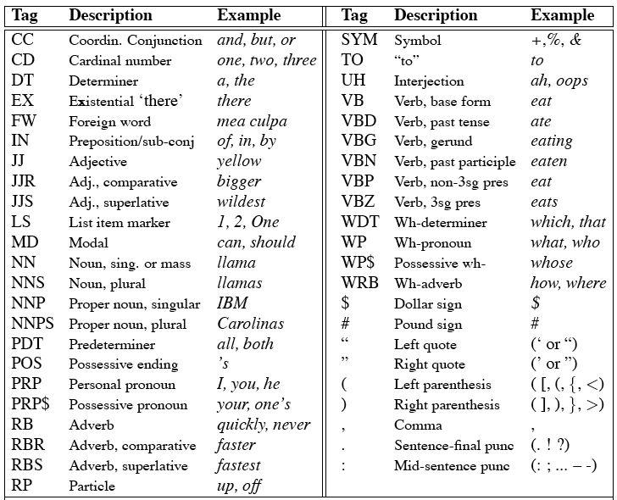
Penn Treebank Tagset
14
Notes:
14

Slide 15
Using the Penn Treebank Tags
The/DT grand/JJ jury/NN commmented/VBD on/IN a/DT number/NN of/IN other/JJ topics/NNS ./.
Prepositions and subordinating conjunctions marked IN (“although/IN I/PRP..”)
Except the preposition/complementizer “to” is just marked “TO”
From Julia Hirschberg’s slides
15
Notes:
15

Slide 16
Tag Ambiguity
Words often have more than one POS: back
The back door = JJ
On my back = NN
Win the voters back = RB
Promised to back the bill = VB
The POS tagging problem is to determine the POS tag for a particular instance of a word
From Julia Hirschberg’s slides
16
Notes:
16

Slide 17
Tagging Whole Sentences with POS is Hard
Ambiguous POS contexts
E.g., Time flies like an arrow.
Possible POS assignments
Time/[V,N] flies/[V,N] like/[V,Prep] an/Det arrow/N
Time/N flies/V like/Prep an/Det arrow/N
Time/V flies/N like/Prep an/Det arrow/N
Time/N flies/N like/V an/Det arrow/N
…..
17
Example from Julia Hirschberg’s slides
Notes:
17

Slide 18
Useful Links
https://www.mygreatlearning.com/blog/pos-tagging/
https://towardsdatascience.com/pos-tagging-using-rnn-7f08a522f849
https://medium.com/analytics-vidhya/part-of-speech-tagging-what-when-why-and-how-9d250e634df6
https://www.javatpoint.com/tensorflow-types-of-rnn
https://colah.github.io/posts/2015-08-Understanding-LSTMs/

Slide 19
Parsing

Slide 20
Syntactic Analysis
Rules of syntax (grammar) specify the possible organization of words in sentences and allows us to determine sentence’s structure(s)
“John saw Mary with a telescope”
John saw (Mary with a telescope)
John (saw Mary with a telescope)
Parsing: given a sentence and a grammar
Checks that the sentence is correct according to the grammar and if so, returns a parse tree representing the structure of the sentence

Slide 21
Syntactic Analysis - Grammar
sentence -> noun_phrase, verb_phrase
noun_phrase -> proper_noun
noun_phrase -> determiner, noun
verb_phrase -> verb, noun_phrase
proper_noun -> [mary]
noun -> [apple]
verb -> [ate]
determiner -> [the]

Slide 22
Parse Tree Example
S
NP
VP
NP
Nom
Pro
Verb
Det
Noun
Noun
I
prefer
a
morning
flight
From Dan Jurafsky’s slides

Slide 23
Dependency Parsing Example
S
NP
VP
Parse tree:
Nesting of multi-word constituents
VBD
VP
NP
PP
IN
NP
VBN
PP
NNS
IN
NP
NNS
CC
NN
NNP
NNP
Bills on ports and immigration were submitted by Senator Brownback
submitted
nsubjpass
auxpass
agent
Typed dep parse:
Grammatical relations between individual words
Bills
were
Brownback
prep_on
nn
ports
Senator
conj_and
immigration
From Dan Jurafsky’s slides

Slide 24
Syntax
Applications
Grammar checkers
Question answering
Information extraction
Machine translation

Slide 25
Syntactic Analysis – Challenges
Handling ambiguity
1
Syntactic ambiguity: “fruit flies like a banana”
Having to parse syntactically incorrect sentences
2

Slide 26
Next Class
Word Embedding
Machine Translation
Text Simplification

