Slide 1
Lecture 7
Vikas Ashok

Slide 2
1-of-N Encoding
Word Embedding
apple = [ 1 0 0 0 0]
dog
bag = [ 0 1 0 0 0]
rabbit
run
cat = [ 0 0 1 0 0]
jump
cat
dog = [ 0 0 0 1 0]
tree
flower
elephant = [ 0 0 0 0 1]
Word Class
class 1
Class 2
Class 3
dog
ran
flower
cat
jumped
bird
walk
tree
apple

Slide 3
A word can have multiple senses.
https://arxiv.org/abs/1902.06006
Have you paid that money to the bank yet ?
It is safest to deposit your money in the bank .
The victim was found lying dead on the river bank .
They stood on the river bank to fish.
The hospital has its own blood bank.
The third sense or not?
Notes:
Examples
The :

Slide 4
Contextualized Word Embedding
Contextualized
Word Embedding
Contextualized Word Embedding
…
the
river
bank
…
…
money
in
the
bank
…
Contextualized Word Embedding
…
own
blood
bank
…
Notes:
Examples

Slide 5
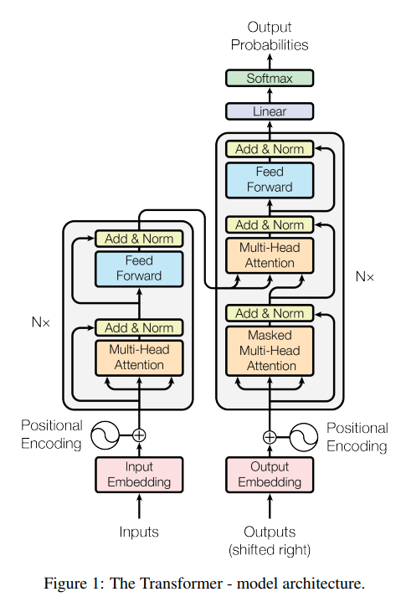
Transformer
Scaled Dot-Product Attention
Multi-Head Attention
Position-wise Feed-Forward Networks
Embeddings and Softmax
Positional Encoding
From Wang Yue’s slides

Slide 6
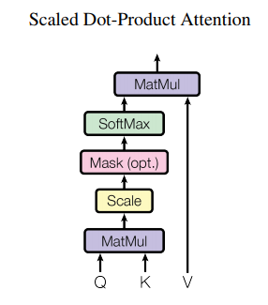
Transformer
Scaled Dot-Product Attention
Multi-Head Attention
Position-wise Feed-Forward Networks
Embeddings and Softmax
Positional Encoding
Q: queries, K: keys, V: values
From Wang Yue’s slides

Slide 7
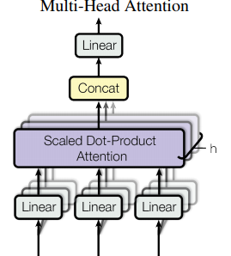
Transformer
Scaled Dot-Product Attention
Multi-Head Attention
Position-wise Feed-Forward Networks
Embeddings and Softmax
Positional Encoding
The total computational cost is similar to that of single-head attention with full dimensionality.
From Wang Yue’s slides

Slide 8
Transformer
Scaled Dot-Product Attention
Multi-Head Attention
Position-wise Feed-Forward Networks
Embeddings and Softmax
Positional Encoding
From Wang Yue’s slides

Slide 9
Transformer
Scaled Dot-Product Attention
Multi-Head Attention
Position-wise Feed-Forward Networks
Embeddings and Softmax
Positional Encoding
Share embedding weights and the pre-softmax
linear transformation (refer to arXiv:1608.05859)
From Wang Yue’s slides

Slide 10
Transformer
Scaled Dot-Product Attention
Multi-Head Attention
Position-wise Feed-Forward Networks
Embeddings and Softmax
Positional Encoding
Reason: no RNN to model the sequence position
Two types:
learned positional embeddings (arXiv:1705.03122v2)
Sinusoid:
From Wang Yue’s slides

