Slide 1
Sentiment Analysis
What is Sentiment Analysis?

Slide 2
Positive or negative movie review?
Unbelievably disappointing
Full of zany characters and richly applied satire, and some great plot twists
This is the greatest screwball comedy ever filmed
It was pathetic. The worst part about it was the boxing scenes.

Slide 3
What is SA & OM?
Identify the orientation of opinion in a piece of text
Can be generalized to a wider set of emotions
The movie
was fabulous!
The movie
stars Mr. X
The movie
was horrible!

Slide 4
Sentiment analysis has many other names
Opinion extraction
Opinion mining
Sentiment mining
Subjectivity analysis

Slide 5
Motivation
Knowing sentiment is a very natural ability of a human being.
Can a machine be trained to do it?
SA aims at getting sentiment-related knowledge especially from the huge amount of information on the internet
Can be generally used to understand opinion in a set of documents

Slide 6
Why sentiment analysis?
Movie: is this review positive or negative?
Products: what do people think about the new iPhone?
Public sentiment: how is consumer confidence? Is despair increasing?
Politics: what do people think about this candidate or issue?
Prediction: predict election outcomes or market trends from sentiment

Slide 7
Sentiment Analysis
Sentiment analysis is the detection of attitudes
“enduring, affectively colored beliefs, dispositions towards objects or persons”
Holder (source) of attitude
Target (aspect) of attitude
Type of attitude
From a set of types
Like, love, hate, value, desire, etc.
Or (more commonly) simple weighted polarity:
positive, negative, neutral, together with strength
Text containing the attitude
Sentence or entire document

Slide 8
Sentiment Analysis
Simplest task:
Is the attitude of this text positive or negative?
More complex:
Rank the attitude of this text from 1 to 5
Advanced:
Detect the target, source, or complex attitude types

Slide 9
Challenges
Contrasts with standard text-based categorization
Mere presence of words is
Indicative of the category
in case of text categorization.
Not the case with
sentiment analysis

Slide 10
Challenges
Domain dependent
Sentiment of a word
is w.r.t. the
domain.
Example: ‘unpredictable’
For steering of a car – BAD!
For movie review – GOOD!

Slide 11
Challenges
Sarcasm
Sarcasm uses words of
a polarity to represent
another polarity.
Example: The perfume is so
amazing that I suggest you wear it
with your windows shut

Slide 12
Challenges
Thwarted expressions
the sentences/words that
contradict the overall sentiment
of the set are in majority
Example: The actors are good,
the music is brilliant and appealing.
Yet, the movie fails to strike a chord.

Slide 13
Tripod of Sentiment Analysis
Cognitive Science
Sentiment Analysis
Natural Language Processing
Machine Learning

Slide 14
SentiWordNet
Lexical resource for sentiment analysis
Built on the top of WordNet synsets
Attaches sentiment-related information with synsets

Slide 15
Quantifying sentiment
Positive
Negative
Subjective Polarity
Term sense position
Objective Polarity
Each term has a Positive, Negative and Objective score. The scores sum to one.

Slide 16
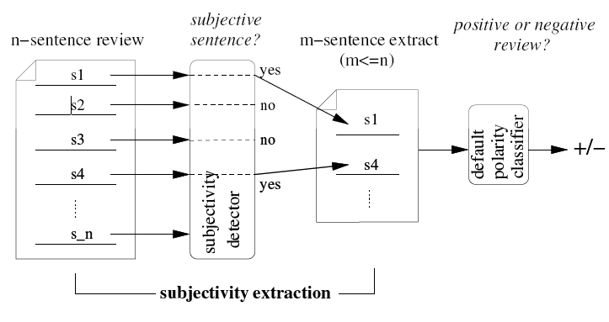
Subjectivity detection
Aim: To extract subjective portions of text
Algorithm used: Minimum cut algorithm

Slide 17
Tagging adjectives
Many adjectives have high sentiment value
A ‘beautiful’ bag
A ‘wooden’ bench
An ‘embarrassing’ performance
An idea would be to augment this polarity information to adjectives in the WordNet

Slide 18
Tagging adjectives
Two anchor words (extremes of the polarity spectrum) were chosen
PMI of adjectives with respect to these adjectives is calculated
Polarity Score (W)= PMI (W , “excellent”) – PMI (W , “poor”)
word
PMI
PMI
excellent
poor

Slide 19
Machine Learning Algorithms
Tokenization
Feature Extraction
Classification using different classifiers
Naïve Bayes
MaxEnt
SVM

Slide 20
Sentiment Tokenization Issues
Deal with HTML and XML markup
Twitter mark-up (names, hash tags)
Capitalization (preserve for
words in all caps)
Phone numbers, dates
Emoticons

Slide 21
Extracting Features for Sentiment Classification
How to handle negation?
I didn’t like this movie
vs.
I really like this movie
Which words to use?
Only adjectives
All words
All words turns out to work better, at least on this data

Slide 22
Sentiment Analysis with Deep Learning
https://towardsdatascience.com/sentiment-analysis-for-text-with-deep-learning-2f0a0c6472b5

